Slide 1
Building Brand Loyalty
Intro to Business & Marketing

Slide 2
Objectives
Identify company's brand promise
Explain the nature of product/service branding
Examine the steps necessary to build a brand
Create a brand for your gourmet popcorn business

Slide 3
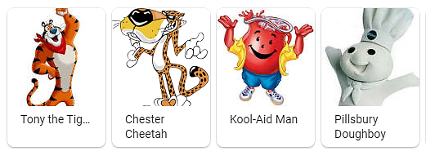
Branding
Definition - the promotion of a particular product or
company by means of advertising and distinctive design.
Brand Characters:

Slide 4
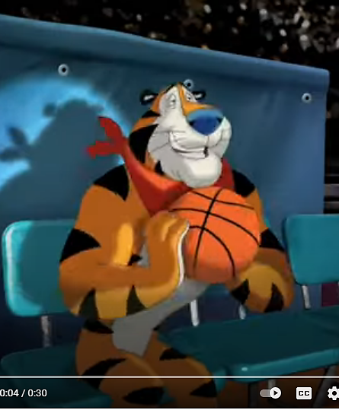
Famous Brand Characters
https://www.youtube.com/watch?v=9qp4JsOu4ns
https://www.youtube.com/watch?v=ysmbOLzIvq0&feature=emb_logo

Slide 5
Reading: Brand Marketing Through the Coronavirus Crisis
Executive Summary: The coronavirus crisis has led to new consumer behaviors and sentiments. The author recommends five ways for brands to serve and
grow their customers, mitigate risk, and take care of their people during this
difficult time:
Present with empathy and transparency;
Use media in more agile ways;
Associate your brand with good;
Track trends and build scenarios;
Adapt to new ways of working to keep delivering.

Slide 6
Who is Johnny Cupcakes?
Johnny Earle started selling t-shirts out of the trunk of his beat up ‘89 Toyota Camry, and then out of his crusty suitcase while on tour with his band “On Broken Wings.” People all around the country began to purchase them. Before he knew it, his Johnny Cupcakes t-shirts caught the attention of so many people and making them quickly became his passion. Johnny took a risk by quitting his day job and his band, as he knew launching this brand would require 100% of his energy. Instead of playing loads of video games or partying like most of his peers, he chose to spend his time and money building the foundation of his new independent clothing line—Johnny Cupcakes.
www.johnnycupcakes.com

Slide 7
Johnny Cupcakes
With each new launch, the hysteria around
the ‘Johnny Cupcakes’ brand continues to
conquer the globe. The reactions range
from 10-block-long queues of fans anxiously waiting for the shop to open, to super-fan
Cupcake tattoos—yes, permanent ones.
In this awe-inducing presentation, Johnny
will educate you on how you too can create a wave of word-of-mouth marketing,
loyalty, and obsession around your
products, service or organization—and
within your team—through the power of
experiential branding.
https://www.decapower.org/sessions/building-brand-loyalty

Slide 8
Activity – Video Q&A
Answer the following questions:
What are the three brands that you are loyal to? What is it about those brands that keeps you dedicated and coming back for more?
What are three brands that your parents are loyal to? What is it about those brands that keeps them dedicated and coming back for more?
What are at least two examples of cross promotions between Johnny Cupcakes and other brands that are showcased in the video?
What are some benefits of cross promotion between brands?
Visit johnnycupcakes.com and list four ways that the website helps to build the Johnny Cupcakes brand.
What are four examples of experiential branding events from the Johnny Cupcakes presentation?

Slide 9
Building Your Brand
Building your own brand essentially boils down to seven steps:
Research your target audience and your competitors.
Pick your focus and personality.
Choose your business name.
Write your slogan.
Choose the look of your brand (colors and font).
Design your logo.
Apply your branding across your business.

Slide 10
Activity: Branding Brainstorming Worksheet
Brainstorming is emotional, not rational. While you should have
information from your market research in mind while brainstorming, it’s important to be creative. Free associate and don’t by shy about putting down any ideas that pop into your mind. Remember, when brainstorming, there are no wrong answers.

Slide 11
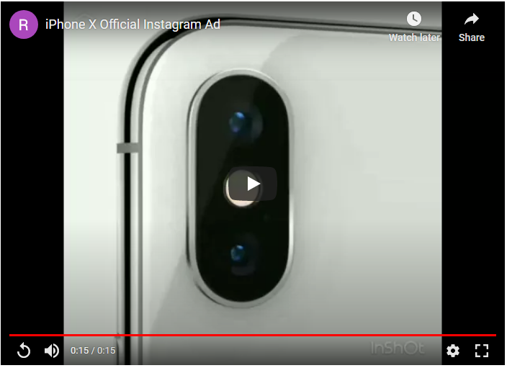
Project: Create an Instagram Ad for Your Gourmet Popcorn Business
Create a 15-second Instagram ad using your brand character for your gourmet popcorn business.
Remember to consider your target audience for your business. Be ready to share your ad in class.
Example: iPhone X
httphttps://youtu.be/fFFsyq5kFbws://youtu.be/fFFsyq5kFbw
https://youtu.be/fFFsyq5kFbw

