Slide 1
Certified logistics associate prep

Slide 2
Slide 1
Material Handling Equipment
Chapter 3
Notes:
These can be changed to reflect your school’s specific rules.

Slide 3
Manually operated equipment

Slide 4
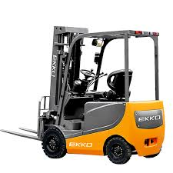
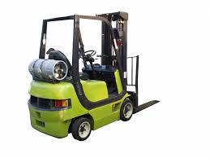
Industrial fork trucks/lift trucks
Electric Trucks:
Most widely used – easy to maintain, quieter, and more environmentally friendly
Propane Trucks:
More common than gas – travel faster and handle heavier loads than electric

Slide 5
Electric pallet trucks
Double Pallet Trucks:
Often used for picking full cases in large warehouses with long picking aisles
Picking is only done on floor level

Slide 6
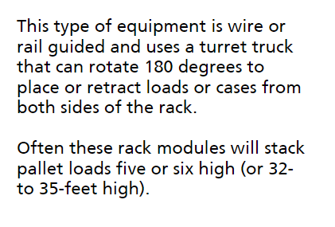
Narrow aisle trucks
Very Narrow Aisle Equipment

Slide 7
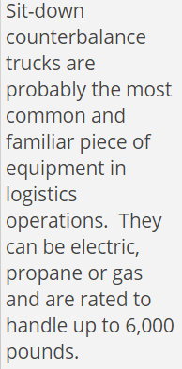
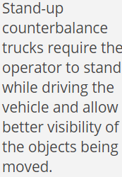
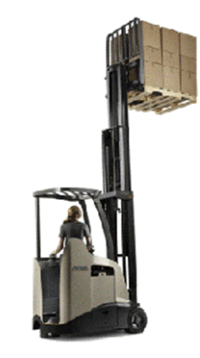
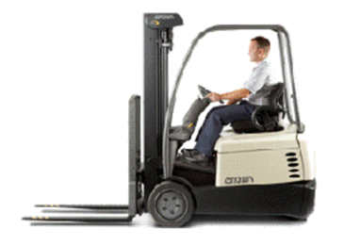
Counterbalance trucks

Slide 8
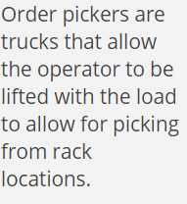
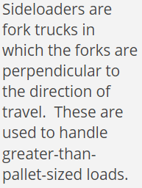
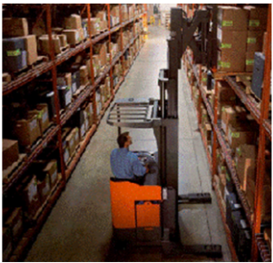
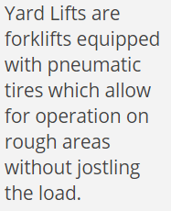
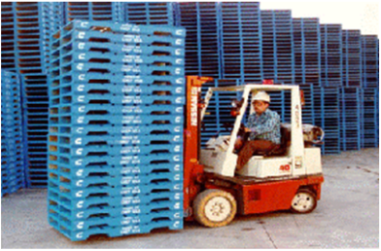
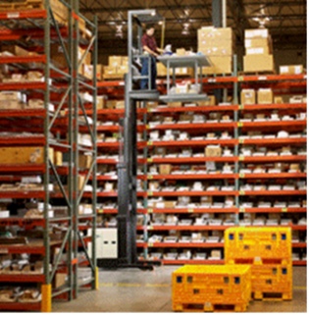
Types of lift trucks

Slide 9
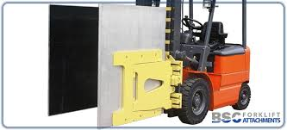
Specialized forklift equipment

Slide 10
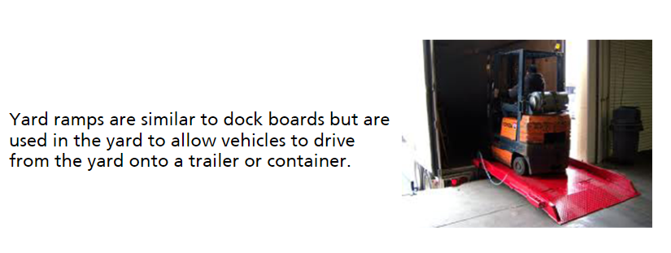
Loading dock equipment

Slide 11
Basic conveyors

Slide 12
Automated conveyer systems

Slide 13
Knowledge check

Slide 14
Answer key

Slide 15
Knowledge check

Slide 16
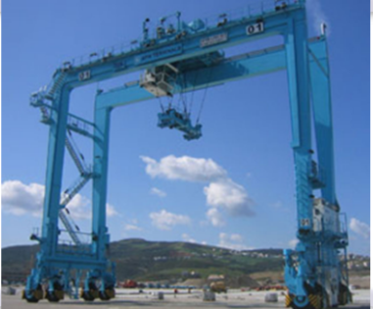
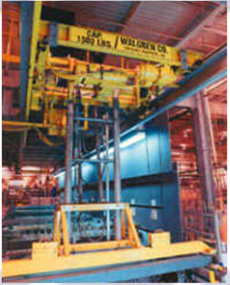
Overhead equipment
OVERHEAD TRAVELING CONVEYORS
GANTRIES
OVERHEAD CRANE AND HOIST SYSTEMS
Not on a track – has wheels on the floor

Slide 17
Overhead traveling cranes
Basic Components:
Runways – track on which crane travels
End Trucks – structure attached to warehouse
Bridge Beam – end trucks are placed at each end
Hoist – lifting mechanism place on the bridge beam – usually electrically powered chain

Slide 18
AUTOMATED SYSTEMS

Slide 19
Slide 1
Safety Principles
Chapter 4
Notes:
These can be changed to reflect your school’s specific rules.

Slide 20
Federal Safety organizations

Slide 21
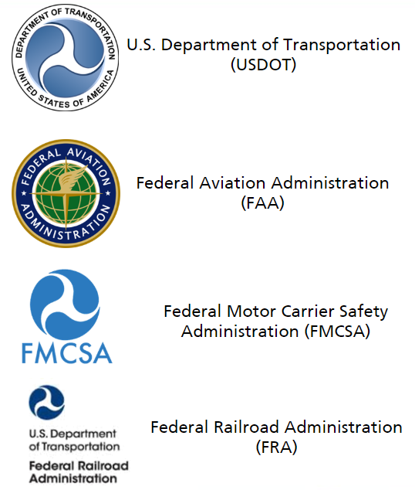
Federal Safety organizations
US DOT
Regulates transportation safety
Rules encompass aspects of transportation from routes to specific driver safety
FAA
Develops and enforces air transportation rules
FMCSA
Focuses on safety regulations for large trucks and buses
FRA
Safety inspectors investigate operating practices, tracks, structures, and other train control issues

Slide 22
Federal Safety organizations
EPA
Develops and enforces rules protecting land, air, and water from industrial pollution
NIOSH
Studies causes of workplace injuries and develops solutions to help control hazards
State Regulations
Most states also set and enforce their own standards for workplace safety, commercial transportation and environmental preservation

Slide 23
Who is responsible for workplace safety?

Slide 24
Employer responsibility

Slide 25
Employee responsibility

Slide 26
Workplace safety inspections

Slide 27
Effective reporting

Slide 28
Workplace environment

Slide 29
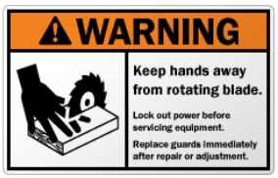
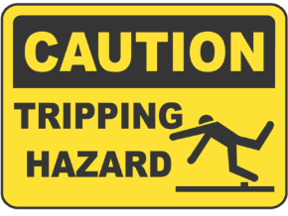
Safety markings

Slide 30
Knowledge check

Slide 31
Knowledge check answer key

Slide 32
Fire prevention
Fire Extinguisher PASS Sequence:
Pull the pin to unlock fire extinguisher
Aim low toward the base of the fire
Squeeze the lever to discharge agent
Sweep the hose back and forth across fire

Slide 33
Types of fire extinguishers
Class A:
Wood, paper, cloth and plastic
Most common
Class B:
Grease, oil, and certain chemicals
Class C:
Electrical fires

Slide 34
Types of fire extinguishers
Class D:
Combustible switches, wiring, metals and iron
Class K:
Cooking fires such as combustible vegetable oil or animal fat
Class ABC:
Used to fight a Class, B or C fire

Slide 35
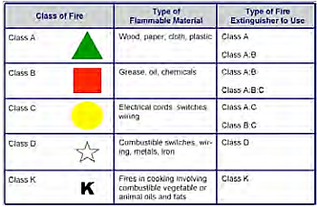
Types of fire extinguishers

Slide 36
Electrical safety

Slide 37
Knowledge check

