Slide 1
Certified logistics associate prep

Slide 2
Slide 1
Safe Material Handling and
Equipment Operation
Chapter 5
Notes:
These can be changed to reflect your school’s specific rules.

Slide 3
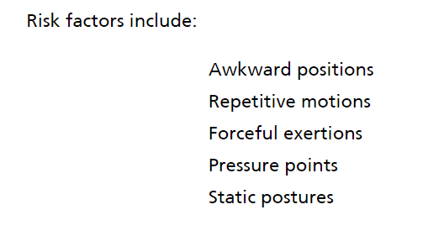
Safety issues related to manual material handling

Slide 4
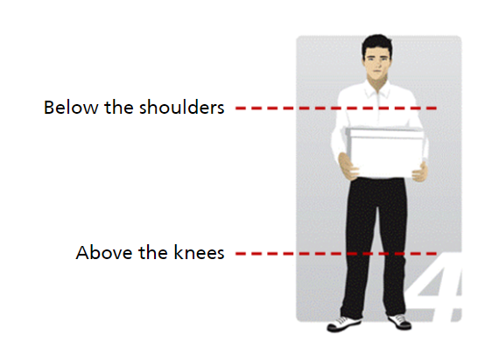
Safe lifting and handling
POWER ZONE

Slide 5
Safe lifting and handling

Slide 6
Safe lifting and handling

Slide 7
KNOWLEDGE CHECK

Slide 8
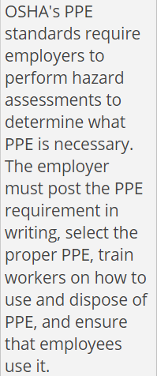
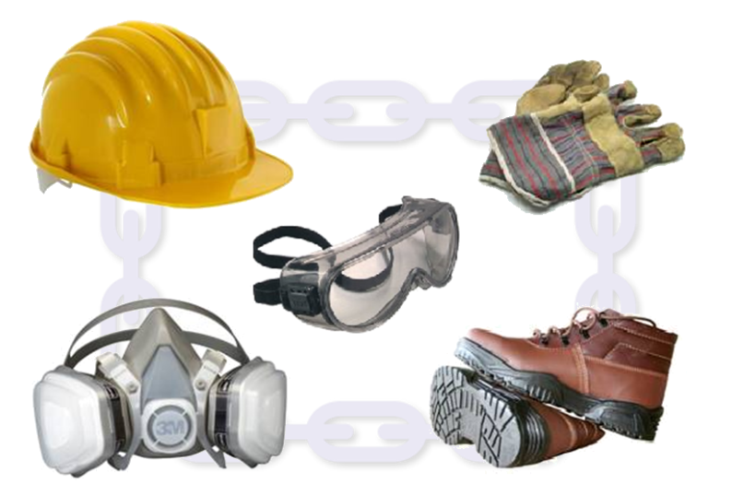
PERSONAL PROTECTIVE EQUIPMENT

Slide 9
Types of ppe
Head Protection – hard hats
Hand and Arm Protection – gloves
Lung Protection – dust mask or respirator
Foot Protection – steel-toed boots – most common PPE
Eye/Face Protection – safety googles or face shields
Ear Protection – earplugs or earmuffs

Slide 10
Equipment safety features
Restraints – wheel chocks or trailer restraints
Communication Lights – in and outside the warehouse
Interior Communication Lights – notify location of trucks and railcars
Exterior Communication Lights – green if safe to dock vehicle
Capacity Rating – limit based on weight/volume
Audible Alarms – sound when door is about to open or close

Slide 11
EQUIPMENT MAINTENANCE
Also known as Equipment Repair
Form of Preventive Maintenance – Operating Equipment Checklist – usually performed by maintenance crew

Slide 12
Slide 1
Quality Control Principles
Chapter 6
Notes:
These can be changed to reflect your school’s specific rules.

Slide 13
What is quality?
Quality control revolves around basic objectives for material handling:
Accurate
On Time
Damage Free

Slide 14
Elements of quality
Elements:
Plan – identify and meet customer demand
Control – statistical process control (ex. Pick accuracy)
Improvement – find better ways to meet customer demand

Slide 15
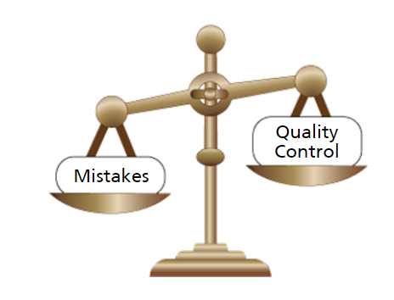
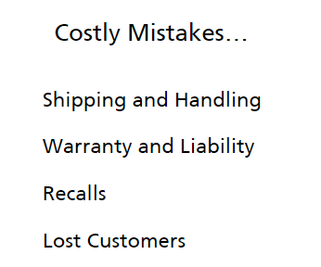
Quality and cost

Slide 16
Knowledge check

Slide 17
Quality control systems
Lean
Six Sigma
Total Quality Management

Slide 18
LEAN
Lean is a practice to eliminate waste.
Apply lean principles to logistics process by:
Reducing Inventory – can accomplish by cross-docking and just-in-time delivery
Reducing Waste – amount of travel time used by order picker, smaller package sizes, and transportation costs
Reducing Mistakes – use of technology (bar codes, RFID)

Slide 19
Lean Eliminates waste

Slide 20
Six sigma
To achieve Six Sigma, process must produce no more than 3.4 defects per million opportunities.

Slide 21
Total quality Management
A system built around an effort to improve quality, to involve everyone in the organization and most importantly, to ensure customer satisfaction.
Requires that the company:
Find out what the customer wants
Design product to meet or exceed customer needs
Design process to operate without need for corrective action
Kaizen

Slide 22
iso – international organization of standardization
ISO’s goal is to promote worldwide standards to improve operating efficiency and productivity and to reduce costs.
ISO publishes the ISO 9000, a family of international standards that apply to the design and implementation of quality systems.

Slide 23
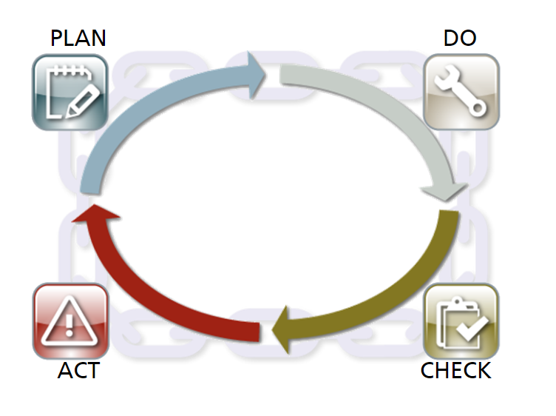
Pdca cycle
Plan:
Identify potential improvement
Generate ideas for change
Anticipate problems so no costs are added through waste of labor, time or materials
Do:
Implement change slowly to avoid major disruptions
Check:
Measure to find out whether change has accomplished objective
Act:
If small change was effective, involve everyone in process
Implement change on large scale
Plan for next change if necessary

Slide 24
Knowledge check

Slide 25
Role of frontline workers – reporting problems

Slide 26
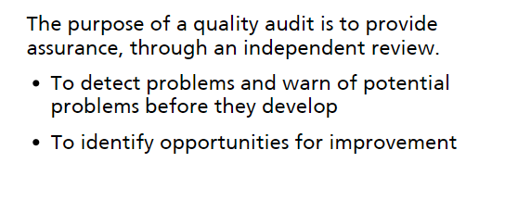
Quality audit

Slide 27
Quality audit objectives

Slide 28
Knowledge check

Slide 29
Types of quality audits

Slide 30
Non-conforming materials

Slide 31
Knowledge check

