Slide 1
Certified logistics associate prep

Slide 2
Slide 1
Work Communication
Chapter 7
Notes:
These can be changed to reflect your school’s specific rules.

Slide 3
Effective communication
Speaking Skills
Consider the audience
Check for understanding
Speak clearly
Use appropriate tone
Writing Skills
Identify the purpose
Consider the audience
Clarity
Proofread
Reading Skills
Preview
Question
Visualize
Re-read (if necessary)
Listening Skills
Look at the speaker
Ask questions
Don’t interrupt
Restate in your own words

Slide 4
Types of communication

Slide 5
Steps in the communication process
Sender has idea to convey
Sender encodes message in written, verbal, or sign language
Sender sends the message
Receiver then sees or hears the message
Receiver interprets meaning of the message

Slide 6
Knowledge check

Slide 7
Slide 1
Teamwork and Good Workplace Conduct
Chapter 8
Notes:
These can be changed to reflect your school’s specific rules.

Slide 8
teams
TEAM: group of people who work together toward a common goal, to complete a specific task within a specific time frame
HIGH-PERFORMANCE TEAM: emphasizes cooperation and collaboration to improve company performance

Slide 9
Cross Functional Team

Slide 10
Characteristics of a High-Performance teams
Define roles and responsibilities clearly
Emphasize respect
Understands importance of critical feedback
Understands importance of training
On-Site
External
Online
Understands importance of cross-training (prepare to work in multiple areas)

Slide 11
Benefits of teamwork

Slide 12
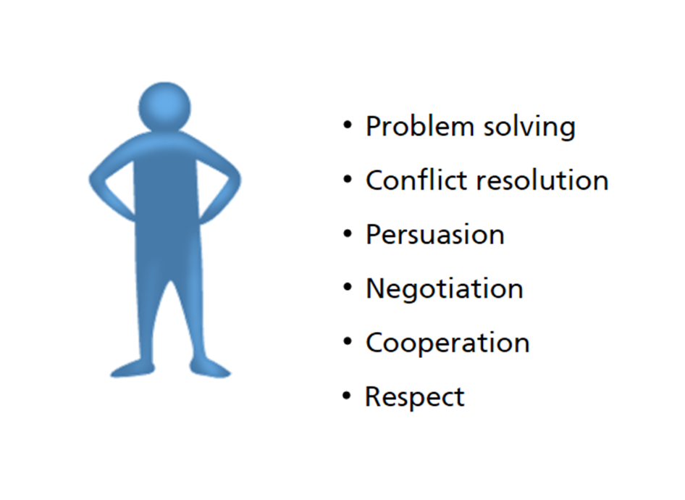
Characteristics of an effective team member
Working in a team helps the following interpersonal skills:

Slide 13
Contribute to team building

Slide 14
Effective team members

Slide 15
Smart goals

Slide 16
Problem solving as a team
Define the problem
Analyze the problem – why is problem occurring
Generate alternative solutions – brainstorming
Choose the best solution
Test the solution
Monitor and evaluate
Implement the best solution

Slide 17
Building consensus
Several ways that a team can make a decision:
Manager can decide
Team leader can decide
Team on majority vote
Team member with most expertise can decide

Slide 18
Conflict resolution

Slide 19
misconduct

Slide 20
Slide 1
Using Computers
Chapter 9
Notes:
These can be changed to reflect your school’s specific rules.

Slide 21
Computer systems
Internet – connection of millions of computers – allows for the exchange of large amounts of info – most common use in logistics is purchasing and transportation
Email – most frequently used application on the Internet
Username – assigned by individual
Domain Name – registered name of organization (gmail.com or yahoo.com)
Word Processing – computer app used for composing, editing, formatting, and printing a document
Spreadsheet – computer app that simulates paper worksheet – used in logistics to analyze operations, show inventory status or indicate transport modes

Slide 22
Warehouse management system

Slide 23
Wms con’t

Slide 24
Customer relations management software

Slide 25
Transportation management systems

Slide 26
Capturing logistics information

Slide 27
Capturing logistics information

Slide 28
Capturing logistics information

Slide 29
Capturing logistics information
MAGNETIC STRIPE

Slide 30
Capturing logistics information

