Slide 1
Creating the effective resume

Slide 2
How long do employers typically look at a resume?
A. Less than 30 seconds
B. 3 Minutes
C. 1 Minute

Slide 3
If you answered “A”, you are correct!!

Slide 5
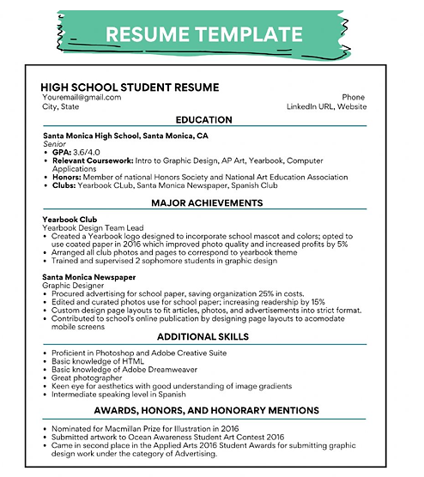

Slide 6
What should you include in a resume?
Heading –
Your Formal Name
Address
Phone Number
Email Address

Slide 7
Objective
Employers often say this is the most important part of a resume.
Generally one sentence explaining the type of job your are seeking.
Should be fairly specific.

Slide 8
Education
On the first line, give the school’s name and city/state address.
On the second line, list any classes or activities you participated in that would help you get the job.

Slide 9
Experience
Should include previous employers, their locations, your dates of employment, and your job title.
You may have to create a job title if you did not have one.
Should include at least two one-line descriptions of what your job duties and responsibilities were.
Use action verbs to start each of these descriptions.

Slide 10
Activities
Employers like to see people who have been involved in school or community activities.
List special activities you participated in (prom committee) and organizations you joined (drama club, key club, baseball team, etc.).
Include years in which you participated.
Be aware, that eventually some employers may view this information as irrelevant. As high school students, this should not be a concern.

Slide 11
Summary of skills
Should be relevant to the job
Type 60 words per minute
Fluent in French
Proficient in Photoshop

Slide 12
References
Common practice is to put “References Available Upon Request” at the bottom of the resume.
Most career advisors say that this is unnecessary.
Type a printed list of personal references with you to the interview if you do not have them listed on your resume.

Slide 13
You should have people who have observed your work habits (employers, teachers, coaches)
You should have people who can speak of your character.
Make sure you ask permission to include them as references.
Include their job titles and phone numbers.

Slide 14
How important is the format?
The importance in the format lies in the consistency.
There is no one best format.
Use white or off-white professional weight paper and black ink.

Slide 15
Resume tips and suggestions
Make sure your resume is PERFECT!
It only takes one error in spelling, punctuation, or grammar to cause an employer to stop reading.
Ask people to proofread your resume.
Limit your resume to one page. Only people with a great deal of experience should have resumes longer than one page.
One inch margins around the page and blank lines between sections with a 10-point font size minimum.

Slide 16
Since you probably have little work experience, you will want to emphasize your accomplishments in and out of the classroom.

Slide 17
Should you use complete Sentences?
Not usually.
Use action phrases instead.
Do not use “I”.

Slide 18
Sell yourself! Create a first good impression by highlighting skills and abilities appropriate to the position.
If you don’t sell yourself, your resume will stay in the pile with all the others.
Tell the truth and nothing but the truth! Employer’s will pick up on “little” white lies when they interview you.

Slide 19
Choose your words carefully.
Need to sound positive and confident.
Each description of your responsibilities should begin with a verb.

