Slide 1
E-COMMERCE
Supply Chain I
Ms. Biba S. Kavass

Slide 2
Objectives
Define E-Commerce
Analyze the growth of E-Commerce
Describe how E-Commerce has changed traditional supply chains
Analyze how continual changes in technology have affected delivery of goods and services in both BTB/BTC segments of the supply chain

Slide 3
TN State CTE Standards
Trends #22:
Describe how eCommerce has changed traditional supply chains. Analyze how continual changes in technology have affected the delivery of goods and services in both the business-to-business and business-to-consumer segments of the supply chain.

Slide 4
E-Commerce
Electronic commerce or internet commerce
- buying and selling of goods or services using the internet, and the transfer of money and data to execute these transactions

Slide 5
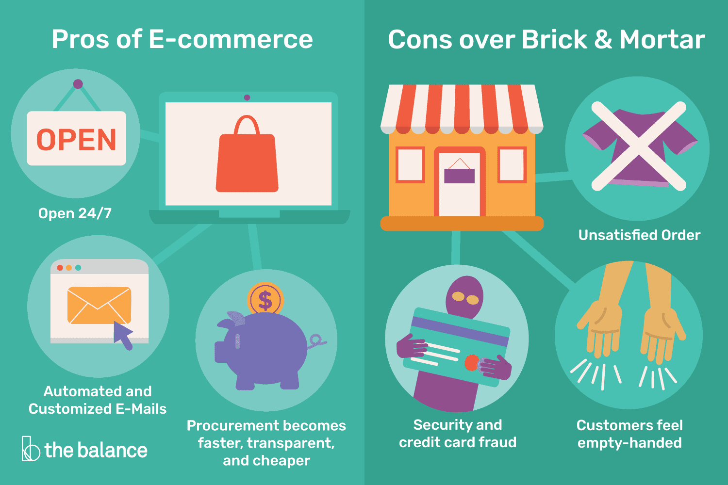
E-Commerce Applications

Slide 6
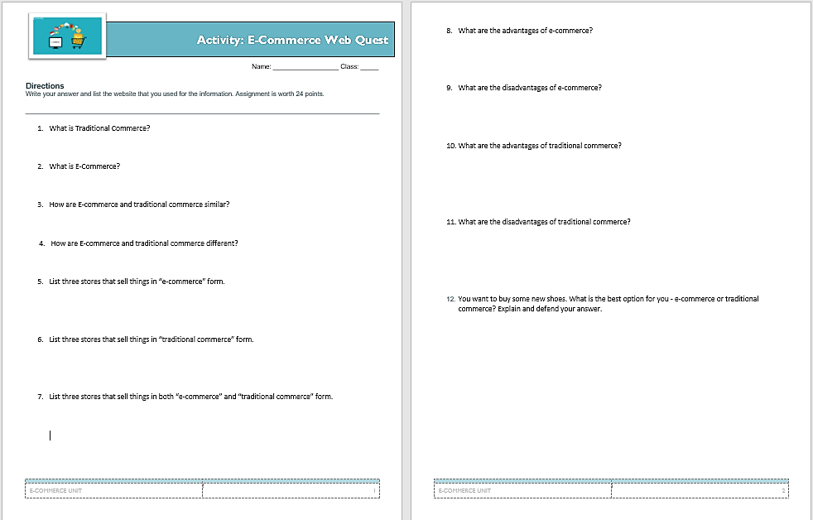
Activity: E-Commerce WebQuest

Slide 7
How is E-Commerce Changing Retail Sales?
Read the case study “Girl Scout Cookie Sales Go Digital and Milk E-Commerce Innovation” and answer the corresponding questions

Slide 8
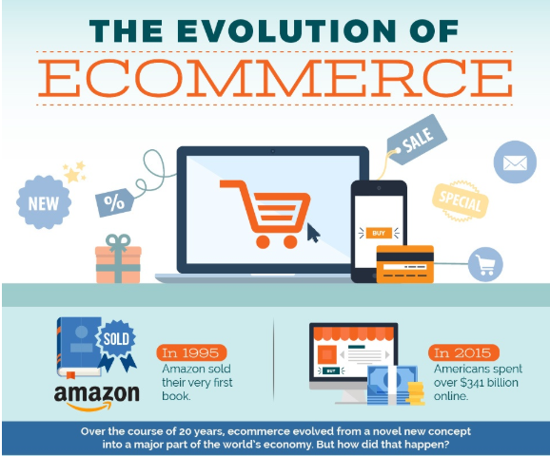

Slide 9
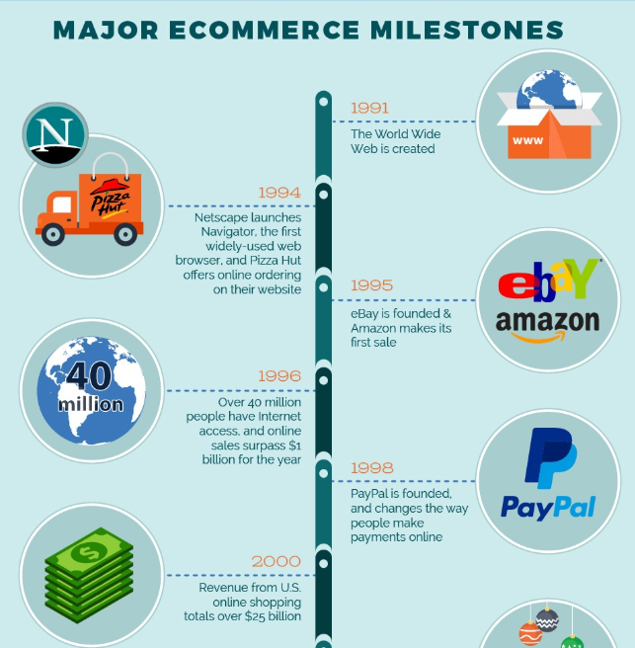

Slide 10
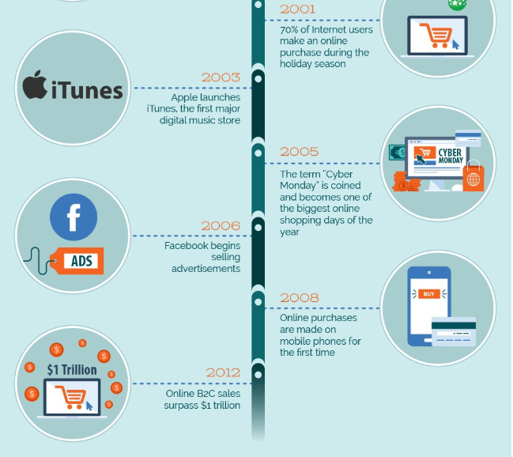

Slide 11
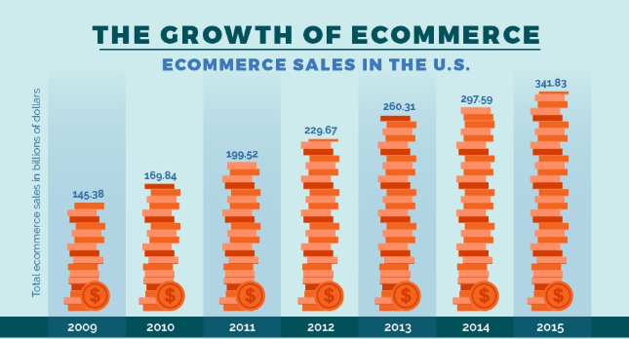

Slide 12
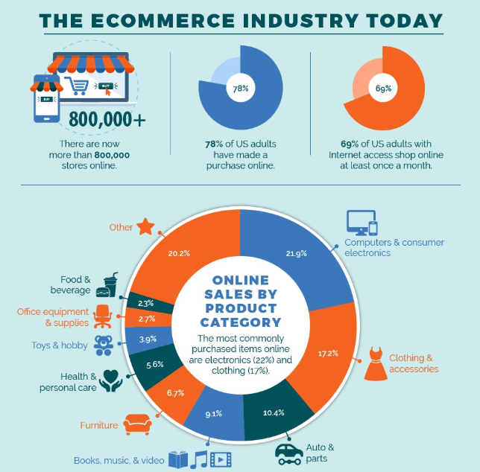

Slide 13
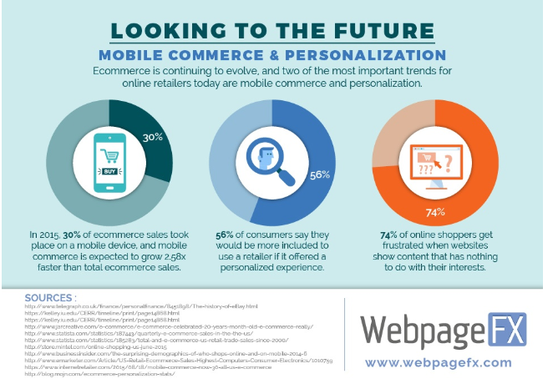

Slide 14
Major Business Markets
Consumer Market
Purchases made for personal use
Industrial Market
Business to business market
Purchases made for business use
Global Market
International trade
Exchange of goods and services between nations

Slide 15
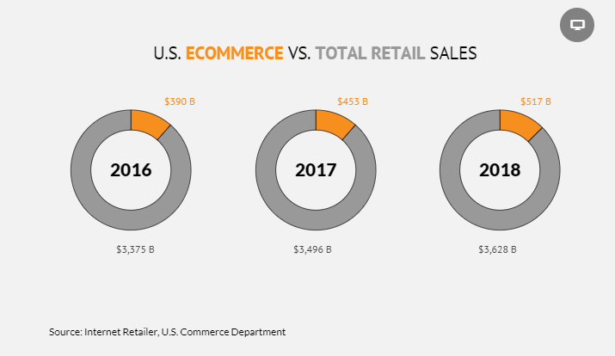
E-Commerce Today
Ecommerce represented 14.3% of total retail sales in 2018, according to Internet Retailer’s analysis. Amazon accounts for 40% of U.S. online retail.

Slide 17
Home Depot’s New Strategy Tied to E-Commerce Growth

Slide 18
Case Study: How Amazon is Changing Supply Chain Management
“Amazon.com has changed the face of retail through its use of bold supply chain strategies and its deployment of innovative technologies. In this article, we explore some of the ways that Amazon has shaped its supply chain, leaving competitors scrambling to catch up.”

Slide 19
Activity: Amazon Presence in TN
Research and map out all the Amazon facilities in the state of Tennessee

Slide 20
Global Web Sales
Global web sales neared $3 trillion in 2018, increasing online's share of total retail sales to north of 15%.
The world’s two largest economies—the United States and China—dominate global online retailing. Together, these two powerhouses accounted for more than half of worldwide e-commerce sales of physical goods in 2017, which is the last full year for which data has been reported.

Slide 21
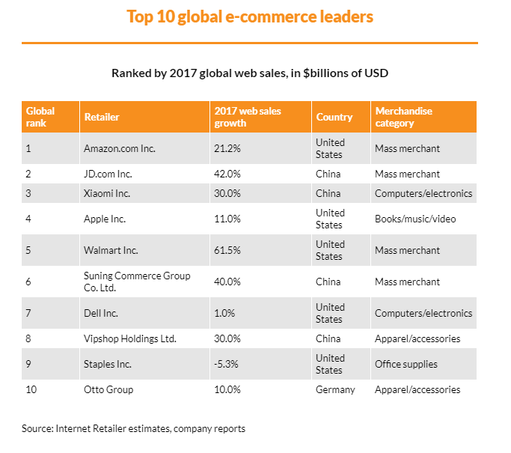

Slide 22
READING: E-Commerce Spurring Changes for Logistics Managers
E-commerce is booming in the United States and around the globe, driven in part by the growth of mobile devices such as smartphones and tablets. The U.S. Department of Commerce reported retail e-commerce sales of $71.2 billion in the United States for the first quarter of 2014, an increase of 2.8% from the fourth quarter of 2013 and a 15% jump from the first quarter of 2013. In contrast, total retail sales rose 0.2% from the fourth quarter of 2013 and 2.4% from the first quarter of 2013
Read the article and answer the questions at the end.

Slide 23
Activity: What am I? (Vocabulary Review)

Slide 24
READING: How Covid-19 is Changing the E-Commerce Supply Chain
The coronavirus pandemic is causing whiplash within many supply chains, especially those of e-commerce companies. Dramatic spikes in orders follow reductions in manufacturing and shipping lanes, along with an expected slowdown in orders as products go out of stock and marketplaces prioritize the goods they deem essential.
Upheaval is here, and e-commerce companies along with their supply-chain partners are going to have to think of new ways to respond. Here are a few big-picture observations that can guide individual action toward mitigating risk and help prepare for today’s unfamiliar environment.
Read the article and answer the questions at the end.

Slide 25
Future of E-Commerce
Supermarket in Virtual Reality
https://www.youtube.com/watch?time_continue=138&v=-2UT2KcnJiE

Slide 26
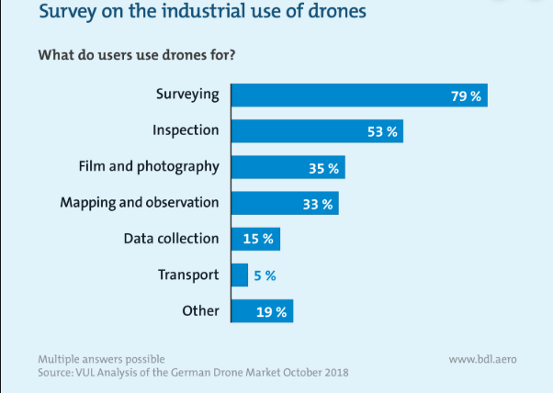
Drones as a New Mode of Transportation?
https://www.youtube.com/watch?v=vd8HmgkDhoU

Slide 27
Project: Impact of E-Commerce on Shipping and Transportation Infographic

