Slide 1
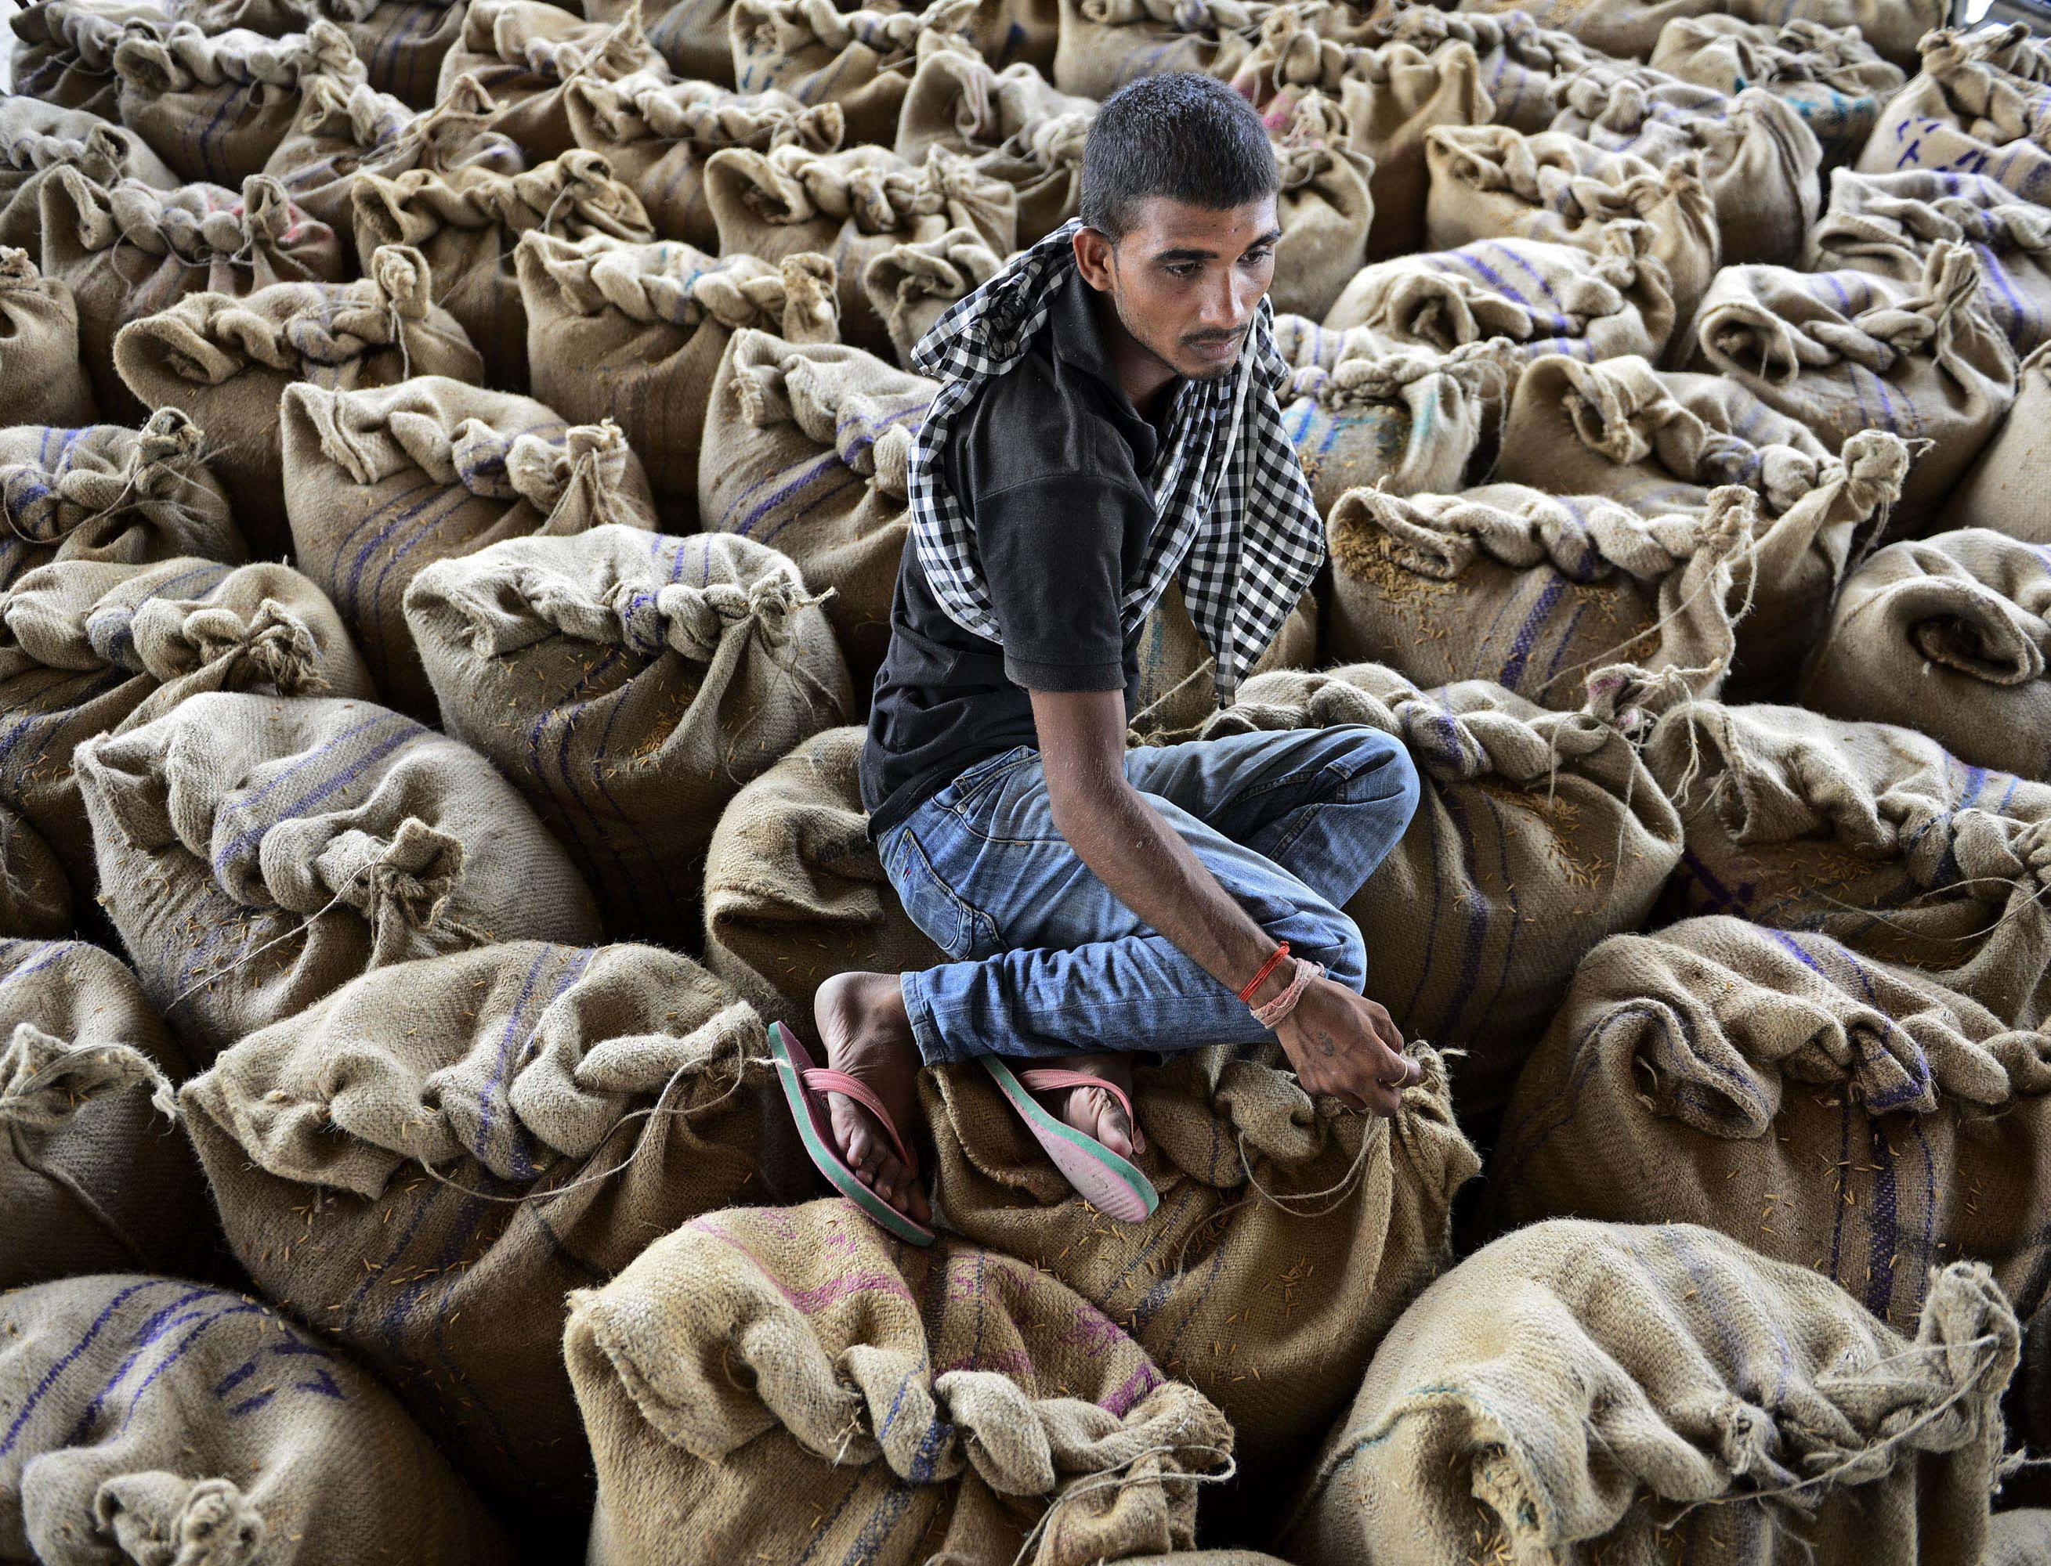
Economy
Lesson 4
V5.0
Notes:
Time
30­–45 minutes
Activity Expectations
Students will be able to:
Explain why economics are important to sustainability;
Describe the relationship between a sustainable economy and the environment;
Develop a model demonstrating how agricultural production creates a ripple effect that impacts local and global economies and social stability; and
Discuss how investments build an economy.
Materials
Economy PowerPoint
Economy video (https://youtu.be/d1ogX94qJIg)
Sustainability Farming Game Level 4: Economy
Computer or tablet device for each student
Optional: Ripple Effect Infographic, 1 per student
Key Terms
Markets, Economy, Infrastructure, Global Citizen, Ripple Effect

Slide 2
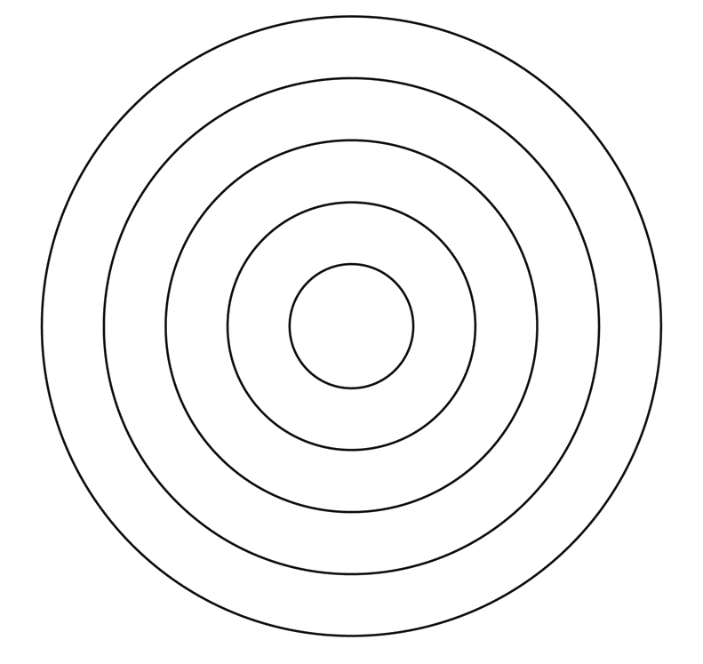
“How does agriculture create ripples in the world?”
What else does agriculture impact?
Agriculture
Notes:
Ask your students, “How does agriculture create ripples in the world?”
(Just like a ripple in a pond, changes in the agricultural industry impact many other things. When agricultural markets are strong and there is high demand for agricultural products, the cost of food will rise. If an agricultural market is flooded, the price of food will drop. In addition to direct food markets, other industries rely on agricultural commerce for business, so their markets will also fluctuate along with the agricultural market.)

Slide 3
What impacts agriculture, creating ripples in the industry?
Agriculture
???
Notes:
Ask your students, “What impacts agriculture, creating ripples in the industry?”
(Many outside factors impact agriculture. For example, if fuel prices are high, it costs farmers more money to grow, harvest and transport their products to a final buyer, thus potentially decreasing their overall profit. Weather could be another factor. An unusually wet summer could create ideal grazing for livestock, improving their growth rates and potentially leading to a higher paycheck because the animals are sold by the pound. On the contrary, a year of drought can diminish overall harvest if there isn’t enough water available to maximize crop growth.)
Allow students to offer their answers. Inform them that throughout this lesson they are going to take a closer look at how the planting of a seed creates a ripple across the farm, community and country. They will also learn that we all play a role in the ripple effect.

Slide 4
Watch the Journey 2050 Economy Video
As you watch, discover:
What is the foundation for an economy?
What is a market?
How does the increased wealth that comes from a strong market impact a community as a whole?
Notes:
Play the Journey 2050 Economy video (https://youtu.be/d1ogX94qJIg, 4:47). Prepare students for the video by asking them to discover three things: 1) What is the foundation for an economy? 2) What is a market? 3) How does the increased wealth that comes from a strong market impact a community as a whole?

Slide 5
What is the foundation for an economy?

Slide 6
What is the foundation for an economy?
Earning money and creating jobs
Notes:
Ask students, “What is the purpose of the foundation of a house?”
As a class, discuss the purpose and function of a building’s foundation.
Then ask, “What is the foundation for an economy?”
As students offer answers, direct their comments to earning money and creating jobs.

Slide 7
What is a market and what are the benefits of a farmer having a good crop?

Slide 8
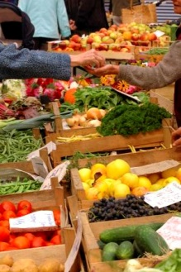
What is a market?
A place where goods or services are bought and sold
Notes:
Define the term market.
Determine if students have background knowledge about the law of supply and demand. Provide some explanation or clarification if needed or ask a student to summarize for the class.

Slide 9
What is a market?
Supply and Demand
What if…
Milk was no longer served in school cafeterias?
Supply:
Demand:
Market Price:
Notes:
To evaluate and apply students’ knowledge of the law of supply and demand, give three example scenarios of fluctuations in agricultural food markets
Present the scenario and then ask students how it would impact the supply, demand and market price of the commodity. Instruct students to respond orally, with a hand signal (such as “thumbs up” if the supply will rise or “thumbs down” if it will fall) or with arrows drawn on paper.

Slide 10
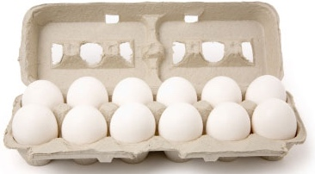
What is a market?
Supply and Demand
What if…
A disease spread through most of the chicken farms, killing many hens that lay eggs?
Supply:
Demand:
Market Price:
Notes:
Present the scenario and then ask students how it would impact the supply, demand and market price of the commodity. Instruct students to respond orally, with a hand signal (such as “thumbs up” if the supply will rise or “thumbs down” if it will fall) or with arrows drawn on paper.

Slide 11
What is a market?
Supply and Demand
What if…
A late frost killed more than half of the peach blossoms decreasing the harvest by 50 percent?
Supply:
Demand:
Market Price:
Notes:
Present the scenario and then ask students how it would impact the supply, demand and market price of the commodity.

Slide 12
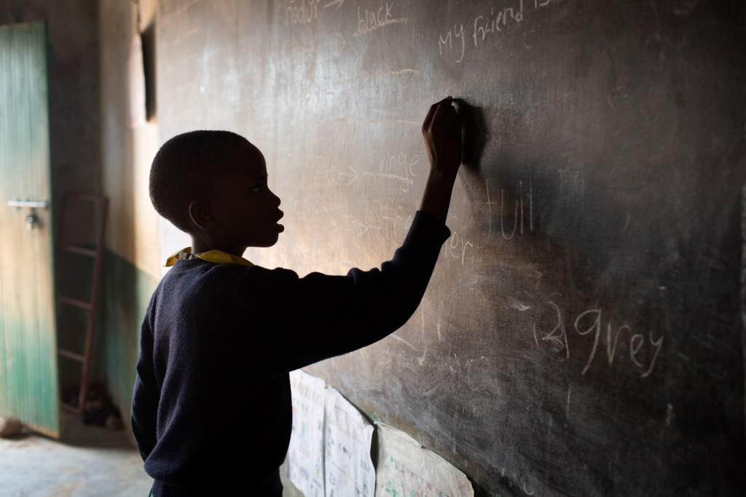
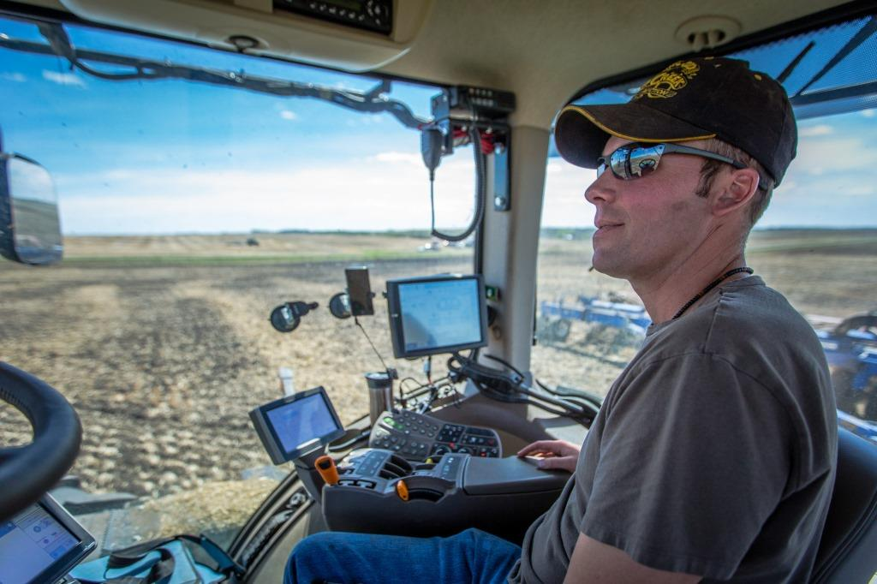
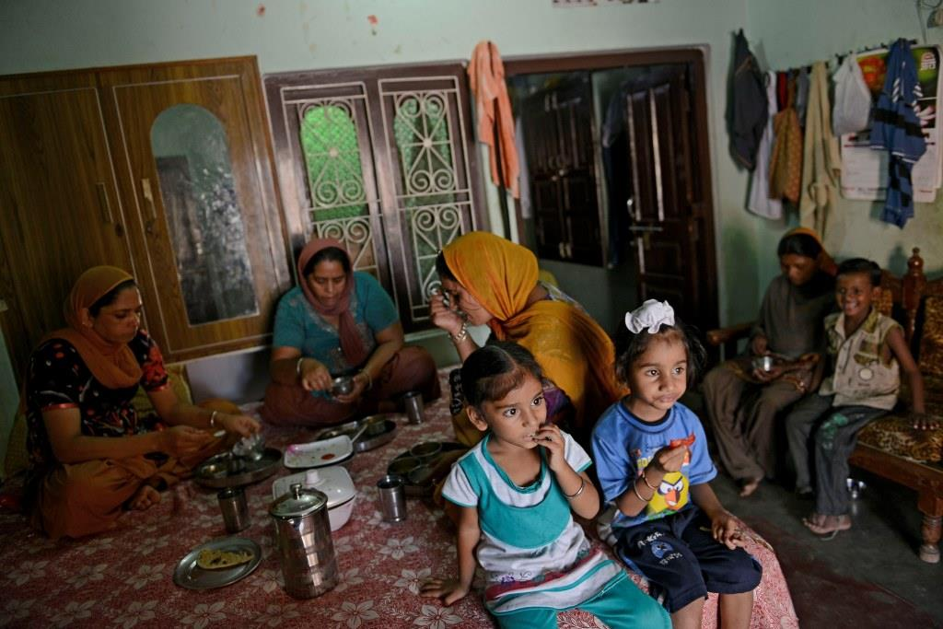
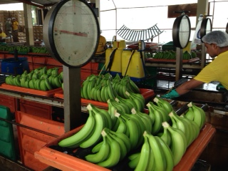
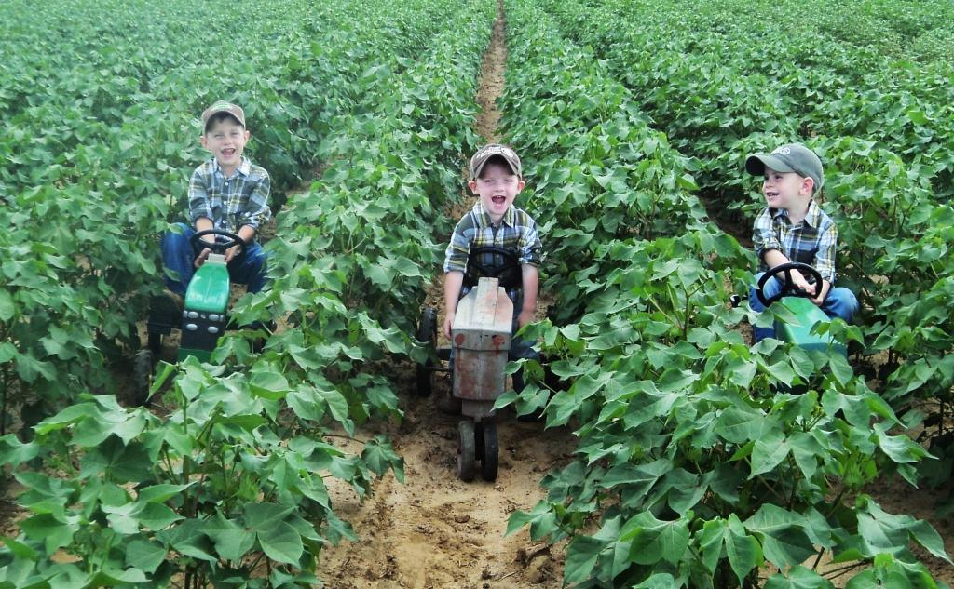
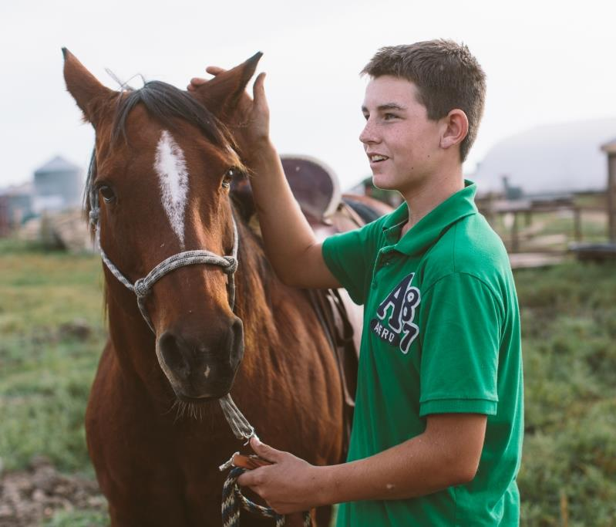
As you play Consider… How does a sustainable farm impact the farm family, their community and their country?
Notes:
Present this question to students and inform them that it will be discussed more after playing level 4 of the game.

Slide 13
Sustainability Farming Game Level 4 Economy
Play the game!
Introduction
Nutrients
Water
Economy
Land Use
World
(Optional)
Careers
Notes:
Open level 4 of the Sustainability Farming Game on each student’s computer or device. Explain that in this level of the game they will be farming in all three countries (Kenya, India and Canada). Prepare students for the game by informing them of the following:
You will have investment opportunities to further the ripple effect in the community. These are examples of real-life investments that exist in each country.
You will have an opportunity to sell your crops in the marketplace. Prices fluctuate and the amount of crop sold depends on your growing practices. (The more ‘best’ practices used the higher the crop yields, the more money you will make, and the more final product will be available. Students will be exposed to examples of both edible and non-edible items that agriculture produces)
NOTE: In India, if students plant sugarcane a disease, known as Redrot, will hit their crop causing significant damage. (If you’d like to do a case-study review of how diseases and pests impact farmers refer to Lesson 2, Student Handout 5 – Pests and Diseases).
This is the last round for the game.
Total game time is 18 minutes (6 minutes per country)
For a future point of reference, identify 3-5 students whose farms have generated the greatest amount of income in the game and 3-5 students whose farms have generated the least amount of income so far. (Students can find a dollar figure in the top left hand corner of their screen when they open the game.) Make a list of the high-income farmers and the low-income farmers.
Allow time for students to play the game.

Slide 14
Follow-Up Discussion

Slide 15
Follow-Up Discussion
What was the highest crop yield % you received? How did you achieve high results? What choices did you make in the market when you sold your crop?
What investments were made by the students with the higher income farms? What investments were made by the students with the lower income farms?
What happens to your harvest when a random event such as hail or a crop disease hits your farm? What is the impact on the local and global market?
Did anyone plant sugarcane in India? What happened to your crop yield?
How does a sustainable farm impact the farm family, their community and their country?
Notes:
Once students have completed the game, ask the students, “What was the highest crop yield % you received? How did you achieve high results? What choices did you make in the market when you sold your crop?”
Call on the high- and low-income farms that were identified in step 2. Compare the number and types of investments that were made by each group.
Ask students, “What happens to your harvest when a random event such as hail or a crop disease hits your farm?” What is the impact on the local and global market?”
Did anyone plant sugarcane in India? What happened to your crop yield?
As a class discuss the question, “How does a sustainable farm impact the farm family, their community and their country?”

Slide 16
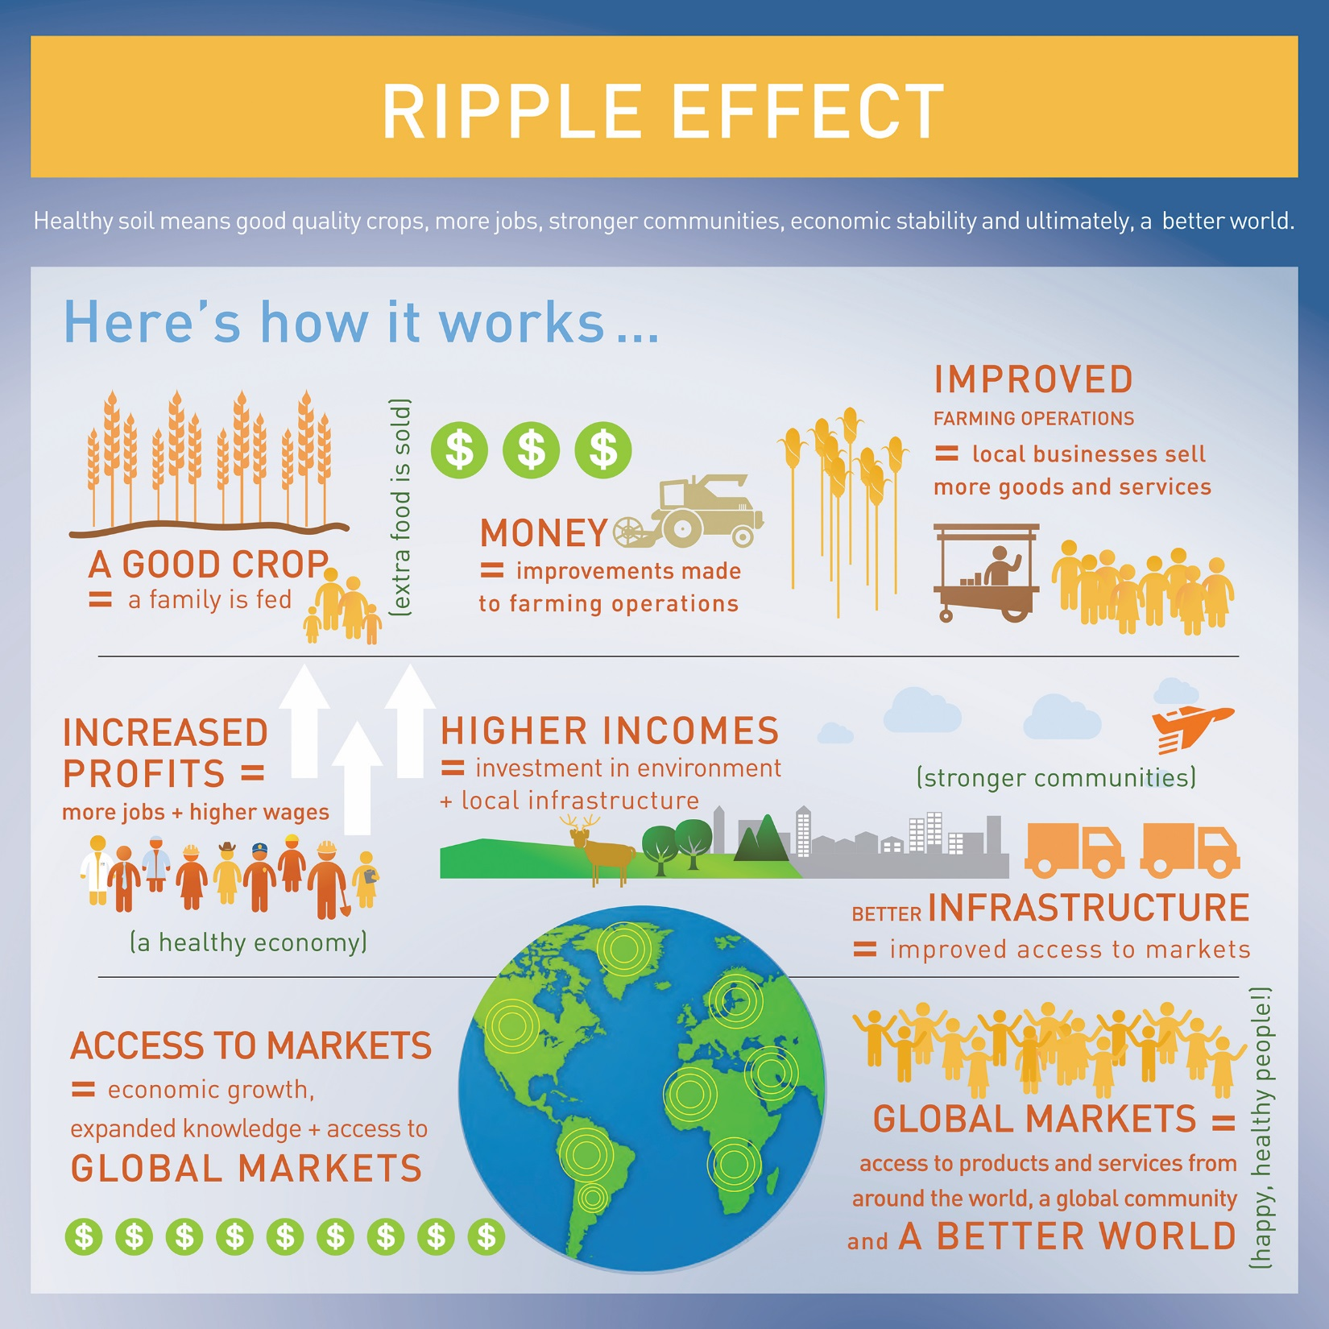
Notes:
Display or print and distribute the infographic to summarize the principles.
Ripple Effect video (https://youtu.be/MzF8LPlaIcY)

Slide 17
Wrap-Up
Earning money and creating jobs are two factors important to a strong economy.
A market is a place where goods and services are bought and sold. Market prices fluctuate based on the principles of supply and demand.
When harvests and markets are strong, farmers earn more money. When earnings increase, the farmer can invest in making improvements on the farm and provide a positive ripple effect throughout their community and the world.

Slide 18
Questions?
Journey2050@nutrien.com

Slide 19
Enriching activities
What do people in New York think the world will look like in 2050?
Watch this video to hear their ideas.
Notes:
What do people in New York think the world will look like in 2050: https://www.youtube.com/watch?v=LOnMWSJBQ70

Slide 20
Brought to you in collaboration
www.Journey2050.com
Notes:
Brought to you by community partners around the world.

