Slide 1
Financial Concepts Unit
Intro to Business and Marketing

Slide 2
Objectives
State the importance of financial statements
Examine the components of each type of financial statement
Calculate net worth
Calculate interest rates on loans
Prepare financial documents
Plan a budget for a project

Slide 3
TN CTE State Standards
15) Define and furnish examples of foundational financial concepts and terminology, including but not limited to financial statements, revenue, expenses, assets, liabilities, equity, net worth, profit, and net loss. Demonstrate financial literacy and quantitative reasoning when discussing these concepts in the context of business operations (for example, when interpreting a business’s financial plan). Apply basic numeracy skills to understand financial phenomena such as interest and savings.
16) Differentiate between fixed and variable expenses on a business’s balance sheet. Select three of the expenses listed, draw conclusions as to their importance to the business, and analyze cost-cutting strategies a company might take to minimize expenses in each of the chosen categories.
17) Prepare a mock purchase order, invoice, and/or sales receipt (including shipping and taxes) for a sample product/package. Explain the elements that comprise the financial document and be able to identify any mistakes and miscalculations in order to assist a mock client.
18) Plan a budget for an upcoming community service project or career and technical student organization (CTSO) event. Create a comprehensive budget narrative to accompany the budget, including both a written statement and a summary worksheet listing all expenses, justifying each cost with evidence for why it is needed to successfully complete the project. Detail estimated and actual costs as well as differences in cost in terms of dollars and percentages.

Slide 4
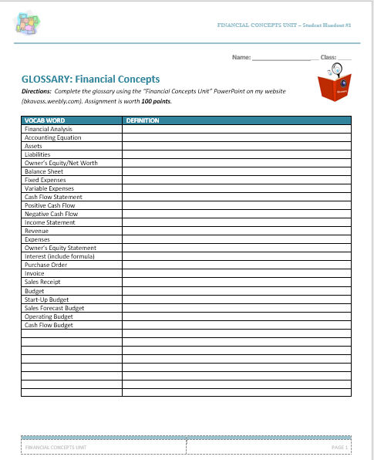
Activity - Glossary
Complete the Glossary for this unit. Assignment is worth 100 points.

Slide 5
Financial Statements
Analysis of Financial Statements:
Financial analysis is designed to determine the relative strengths and weaknesses of a company
Investors need this information to estimate both future cash flows from the company and the riskiness of those cash flows
Information is provided by analysis both to evaluate a company’s past performance and to map future plans
Types of Financial Statements
Balance Sheet
Cash Flow Statement
Income Statement
Owner’s Equity Statement

Slide 6
Accounting Equation
Assets = Liabilities + Owner’s Equity:
Assets: resources a business owns—cash, inventory, equipment, real estate, etc.
Liabilities: firm’s debt—borrowed money it owes to others that must be repaid
Owner’s Equity: aka Net Worth - what would be left for the owners if the firm’s assets were sold and the money used to pay off liabilities

Slide 7
Practice - Net Worth
You have assets of $15,000 (car), $5,000 (savings), $1,000 (cash value of life insurance), $1,700 (cash), and personal property worth $2,500. What are your total assets?
You have liabilities of $10,000 (car loan), $5,000 (student loan), and $1,500 (credit card balances). What are your total liabilities?
What is your net worth?

Slide 8
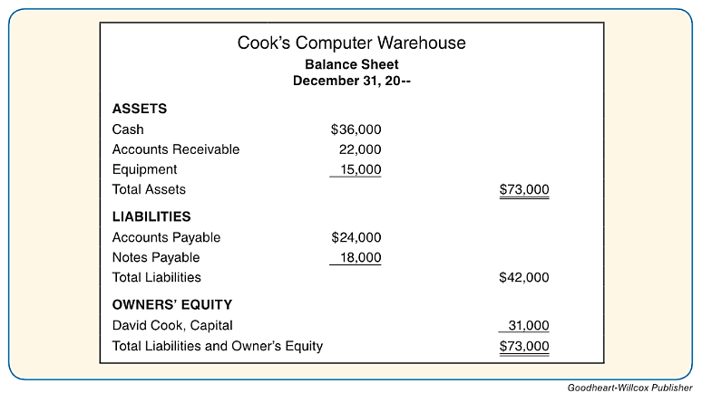
Balance Sheet
Reports the assets, liabilities, and owner’s equity – provides a snapshot of the financial condition of the business at a specific time

Slide 9
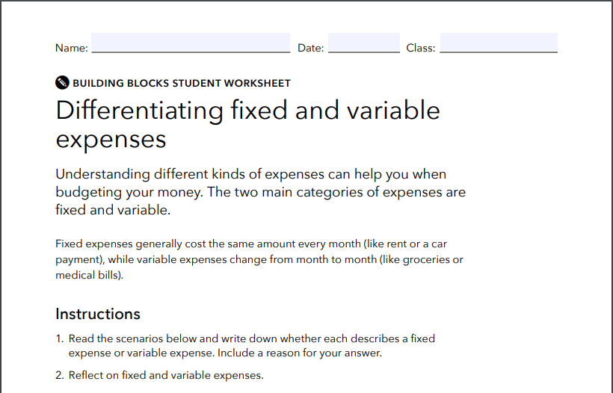
Balance Sheet - Expenses
Fixed Expenses – must be paid each month and generally cost the same amount – Ex. Rent/Lease
Variable Expenses – expenses that change in amount from month to month – Ex. Utility bills
ACTIVITY: DIFFERENTIATING BETWEEN FIXED AND VARIABLE EXPENSES

Slide 10
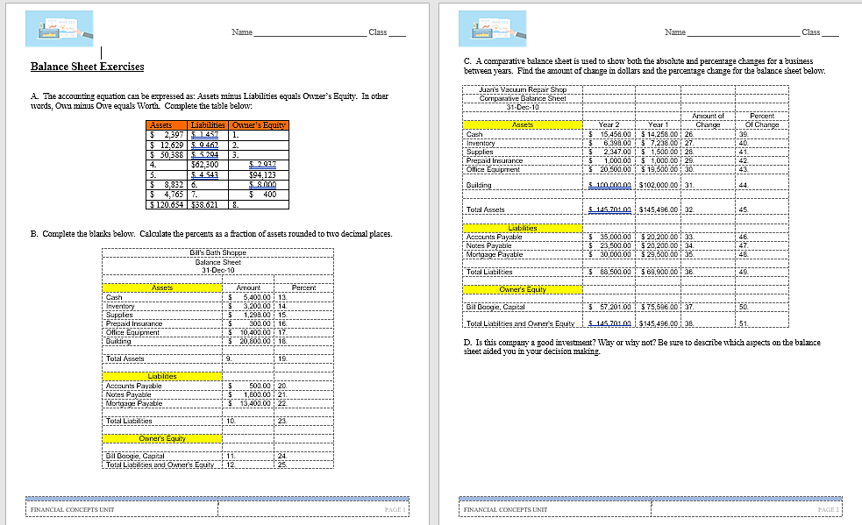
Activity: Balance Sheet Exercises

Slide 11
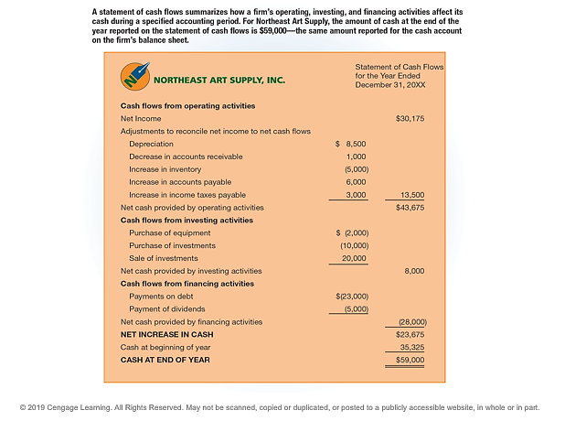
Cash Flow Statement
Shows how cash moves in to and out of a business
Positive – if receiving more cash than it’s spending
Negative – if spending more cash than it’s receiving

Slide 12
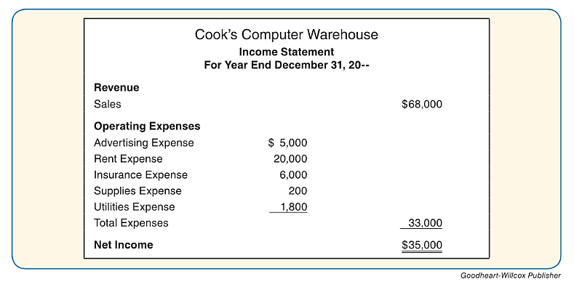
Income Statement
Profit and Loss Statement –reports the revenue and expenses of a business for a specific time period – shows net income or net loss
Revenue – total amount of sales for the period
Expenses – amounts incurred to keep the business operating

Slide 13
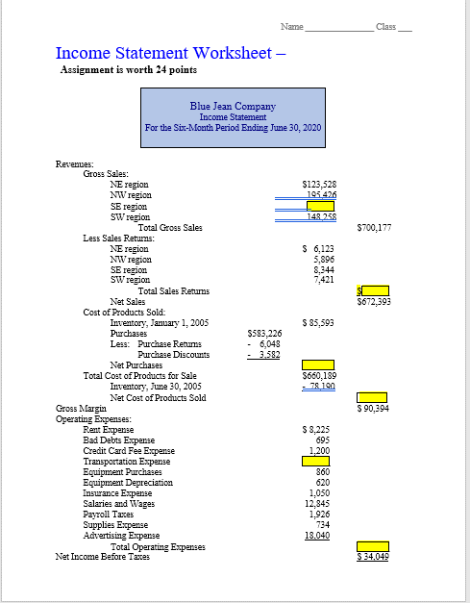
Activity: Income Statement Calculations

Slide 14
Owner’s Equity Statement
Summarizes changes in the owner’s equity during a fiscal period

Slide 15
Interest
Charge for the privilege of borrowing money, typically expressed as annual percentage rate (APR)

Slide 16
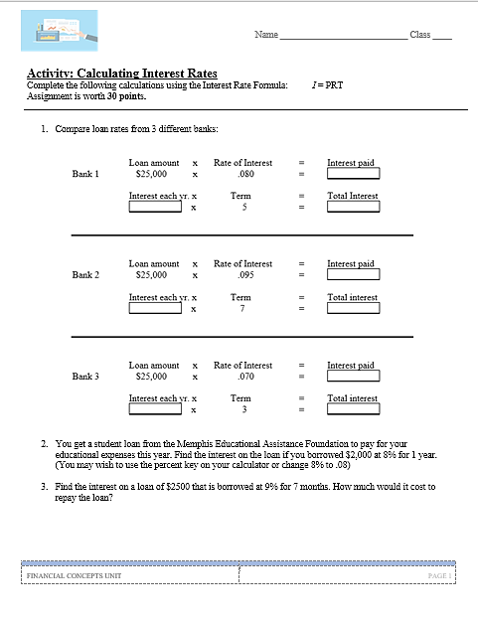
Activity: Calculating Interest Rates

Slide 17
Financial Statement Activities
Complete the following activities:
Balance Sheet Exercises
Fixed vs. Variable Expenses Worksheet
Income Statement Calculations
Best Interest Worksheet

Slide 18
Financial Documents
Purchase Order
Invoice
Sales Receipt

Slide 19
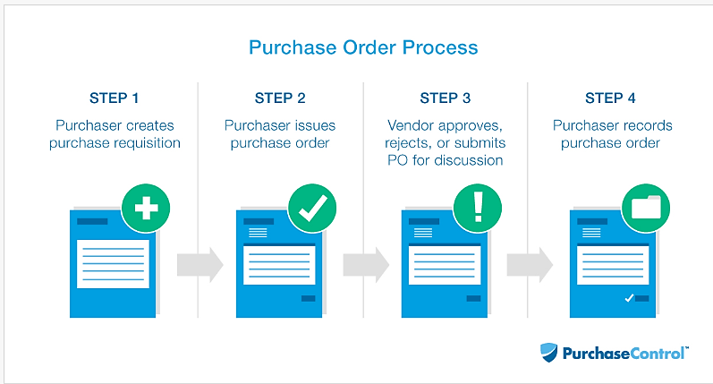
Purchase Order
A purchase order is the official confirmation of an order. It is a document sent from a purchaser to a vendor that authorizes a purchase.

Slide 20
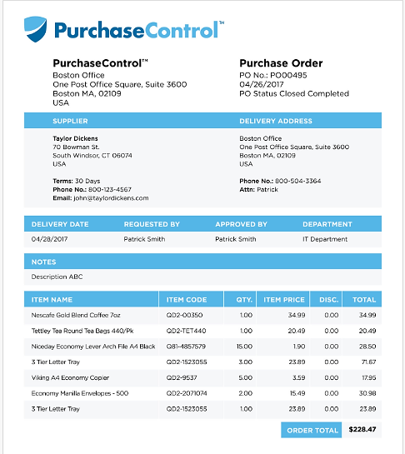
Purchase Order - Example

Slide 21
Activity: Create a Purchase Order
You are planning an after-school party for your DECA Club. You need to purchase snacks, drinks, and serving items from Sam’s Club.
Go to Sam’s Club website and select your items (must have a minimum of 6 items). Then, create a purchase order using MS Word to turn in to your Club Advisor.
Email your MS Word Purchase Order to kavasschs@gmail.com. Assignment is worth 30 points.

Slide 22
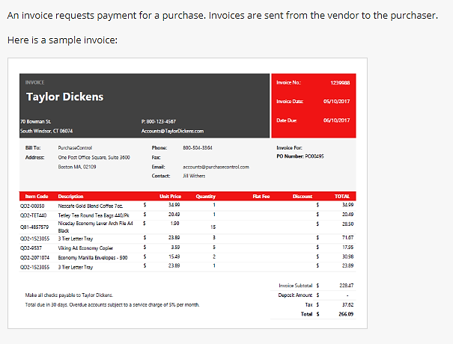
Invoice

Slide 23
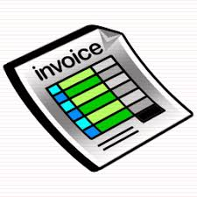
What is the difference between a purchase order and an invoice?
Key difference – purchase order confirms that an order has been placed while an invoice requests payment for an order

Slide 24
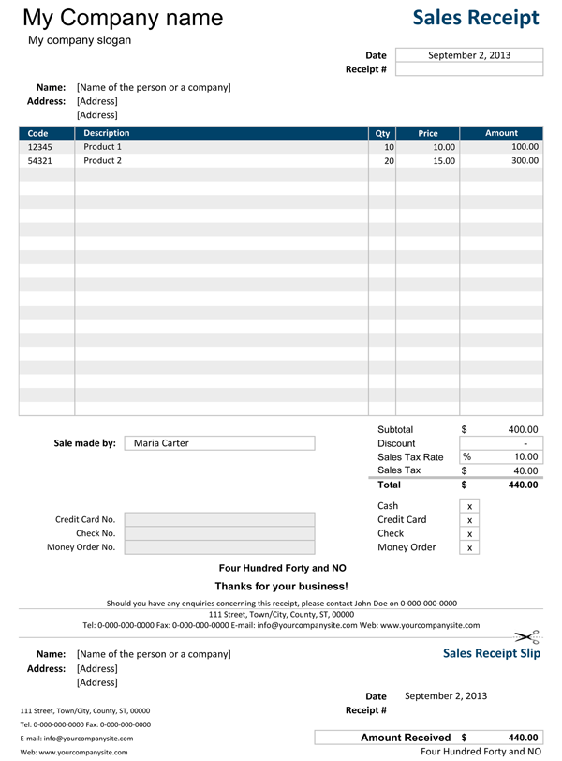
Sales Receipt
Sales receipt is the customer's proof that a purchase was made, what they bought and how much they paid.

Slide 25
Budgets
Estimate of income and expenditure for a set period of time
Start-Up Budget
Projects amount of money needed for onset of business activities
Sales Forecast Budget
Predicts how much revenue will come into a business within a period of time
Operating Budget
Predicts how much revenue will be generated and how much in expenses businesses will pay in the future
Cash Budget
Projects cash flow

Slide 26
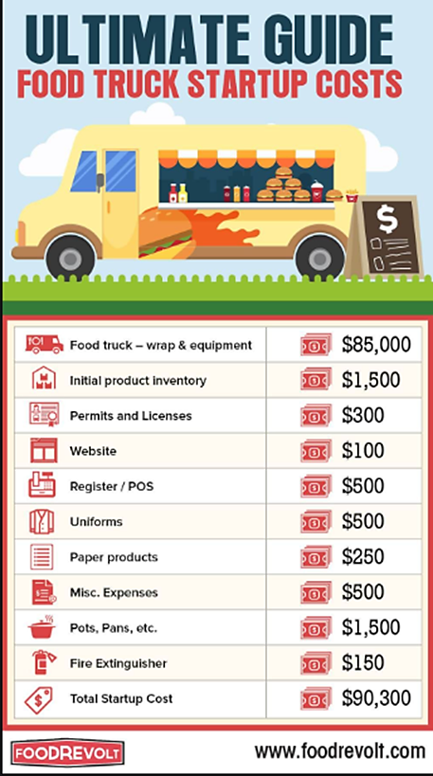
Project: Start-Up Budget for Popcorn Business
You will need develop a start-up budget for your popcorn business. You may “google” start-up budget templates and use one that you like.
Email your Start-Up Budget to kavasschs@gmail.com. Assignment is worth 50 points.

