Slide 1
INTRO TO LOGISTICS
Ms. Biba S. Kavass

Slide 2
TN CTE State Standards
Supply Chain Functions #4: Define the term supply chain and determine the role supply chain management decisions have on cost-effective ways of delivering a product or service to consumers. Identify the supply chain processes that are required to fulfill a customer request, including but not limited to: new product development, planning, buying, manufacturing operations, marketing, distribution, and customer service. Develop a graphic illustration of a selected product and map the movement of primary inputs and outputs on a global or local scale.
Supply Chain Functions #8: Create a glossary of terms related to supply chains and their management. Include acronyms. Add new terms to the glossary as they are encountered.
History and Development of Distribution and Logistics #19: Synthesize research from informational texts to create an annotated timeline on the history of distribution and logistics. Using descriptive text, identify cultural, social, economic, and technological factors that have influenced the development of distribution and logistics.

Slide 3
WOLF, GOAT AND CABBAGE PUZZLE
A man has to take a wolf, a goat, and some cabbage across a river. His rowboat has enough room for the man plus either the wolf or the goat or the cabbage. If he takes the cabbage with him, the wolf will eat the goat. If he takes the wolf, the goat will eat the cabbage. Only when the man is present are the goat and the cabbage safe from their enemies. All the same, the man carries wolf, goat, and cabbage across the river. How?
Notes:
The wolf does not eat cabbage, so the crossing can start with the goat.
The man leaves the goat and returns, puts the cabbage in the boat and
takes it across. On the other bank, he leaves the cabbage but takes the
goat.
He leaves the goat on the first bank and takes the wolf across. He leaves
the cabbage with the wolf and rows back alone.
He takes the goat across.

Slide 4
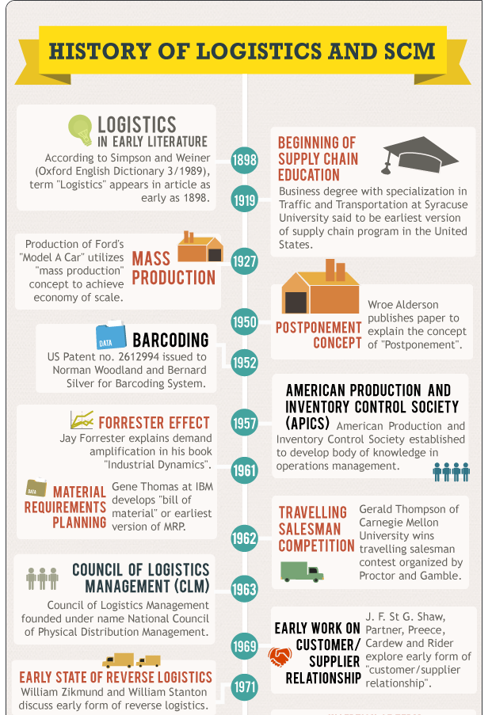
Project: History of Distribution and Logistics
OBJECTIVE:
Research and create a timeline infographic of significant developments in transportation, distribution and
logistics from the 1950s to present time.

Slide 5
Operations Management
Operations Management – Planning, scheduling and control of the activities that transform inputs into finished goods and services
Elements:
Planning
Scheduling
Technology
Logistics – costliest part is transportation
Supply Chain Management
Quality Assurance

Slide 6
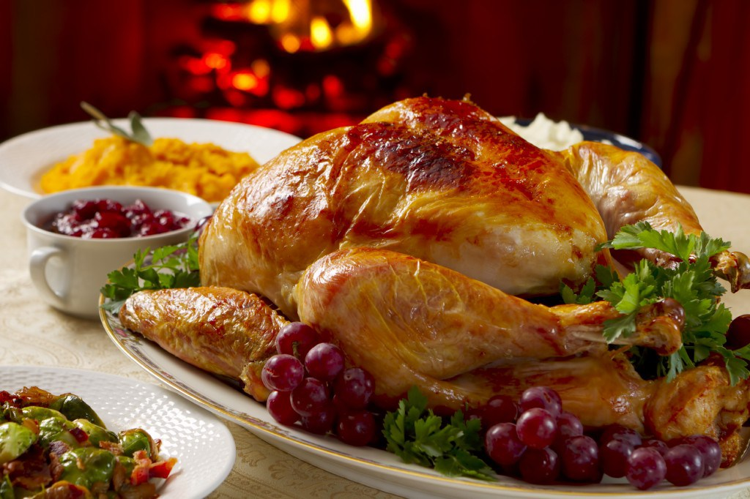
ACTIVITY: What Does it Take to Make Thanksgiving Dinner?
Operations management is just what it sounds like—managing the operations of the business. The role of an operations manager is broad and encompasses multiple operational areas. While other employees can focus on a specialized area of operation (for example, finance and marketing), an operations manager wears many hats and does a bit of everything. While the term may be unfamiliar, you have probably already seen operations management in action—it even played a role in creating the beautiful turkey dinner in the photo below.
What does it take to make Thanksgiving dinner happen? Planning, scheduling, technology, logistics, supply chain management, quality assurance—all the aspects of operations management.

Slide 7
DEFINITION
Logistics is defined as:
“that part of supply chain management that plans, implements, and controls the efficient, effective forward and reverse flow and storage of goods, services and related information from the point of origin to the point of consumption in order to meet consumers’ requirements.”

Slide 8
CORE OBJECTIVES OF LOGISTICS
Significantly reduce a supply chain’s operating costs
Increase customer service provided to the organization’s customers, including not only the immediate external customers, but also the internal customers and the product’s end users

Slide 9
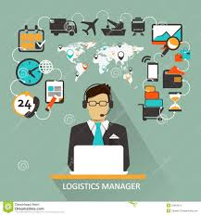
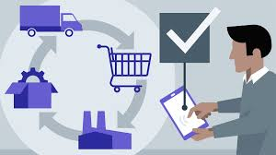
Supply Chain Manager vs. Logistics Manager
Supply Chain Manager:
Who – from whom products will be bought
What – what products are involved in the supply chain
When – when products will be bought
Logistics Manager:
Decides how – takes over to get the products from the seller to the buyer

Slide 10
Activity: What Does Logistics Make Possible?
For each of the areas below, detail how logistics provides those goods/services?
Breakfast, Lunch, and Dinner
Electronics
Healthcare
Sports
Mail
Entertainment
Sustainability

Slide 11
Activity Answer Key

Slide 12
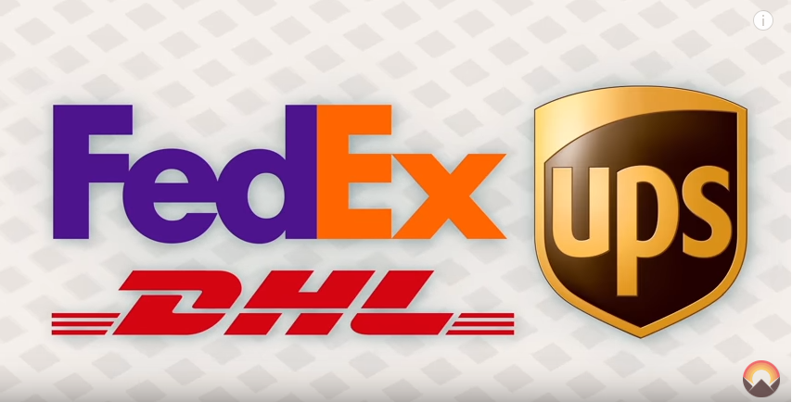
LOGISTICS AT ITS BEST
https://www.youtube.com/watch?v=y3qfeoqErtY

Slide 13
Economic Impact of Logistics
Logistics alone accounts for more than 9.5% of U.S. Gross Domestic Product!
Approximately 10 million logistic jobs in the US
Expected job growth rate of 7% through 2024
Average annual earnings per worker in 2020 for the Transportation and Logistics Sector averaged $74,260 which was 12% higher than average earnings per worker for all US industries
Over $1.3 trillion is spent on transportation, inventory, and related logistics activities.
Source: Council of Supply Management Professionals

Slide 14
The leading logistics companies in the United States in 2020, based on North American net revenue* (in million U.S. dollars)

Slide 15
DISTRIBUTION AND LOGISTICS EMPLOYMENT BY COUNTY
Source: https://tnecd.com/industries/distribution-and-logistics/

Slide 16
ACTIVITY: Can You Solve This?
Puzzle #1: Warehousing – Space Out of Nowhere
Puzzle #2: One Smart Move
Puzzle #3: Freight Services – Let’s Turn This Thing Around
Puzzle #4: Value-Added Services – Breaking Down the Boxes

Slide 17
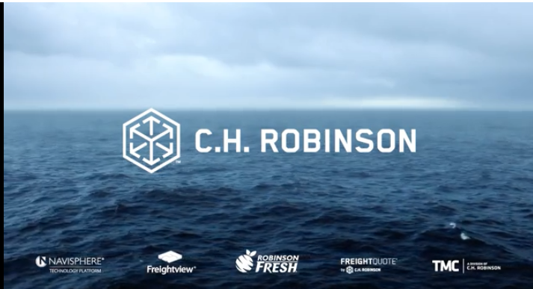
Logistics in the Global Supply Chain
https://www.chrobinson.com/en-us/resources/videos/see-things-differently/

Slide 18
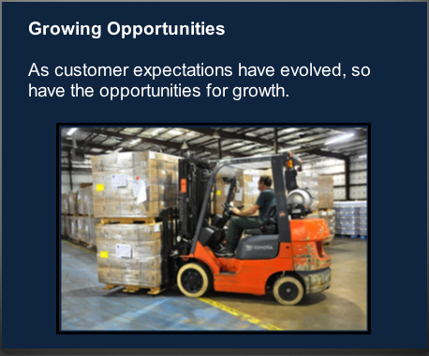
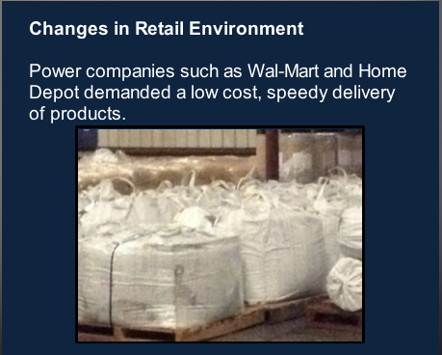
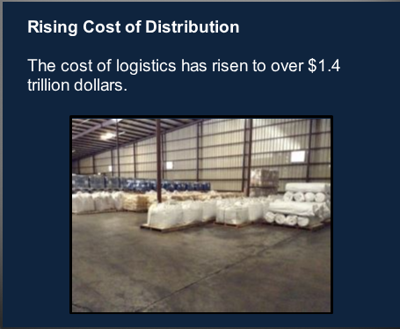
Factors - Increased Use of Logistics

Slide 19
Case Study: Blue Ridge Product Solutions
CONSOLIDATING VENDORS FOR A GROWING COMPANY
Blue Ridge Product Solutions is an online retailer based in Richmond, Virginia. They manufacture, import, and distribute consumer products, including home décor; furniture; kitchenware; sporting goods; and patio, lawn, and garden items. They have offices in Ningbo and Guangzhou, China. They also offer distribution services out of Valencia, California.

Slide 20
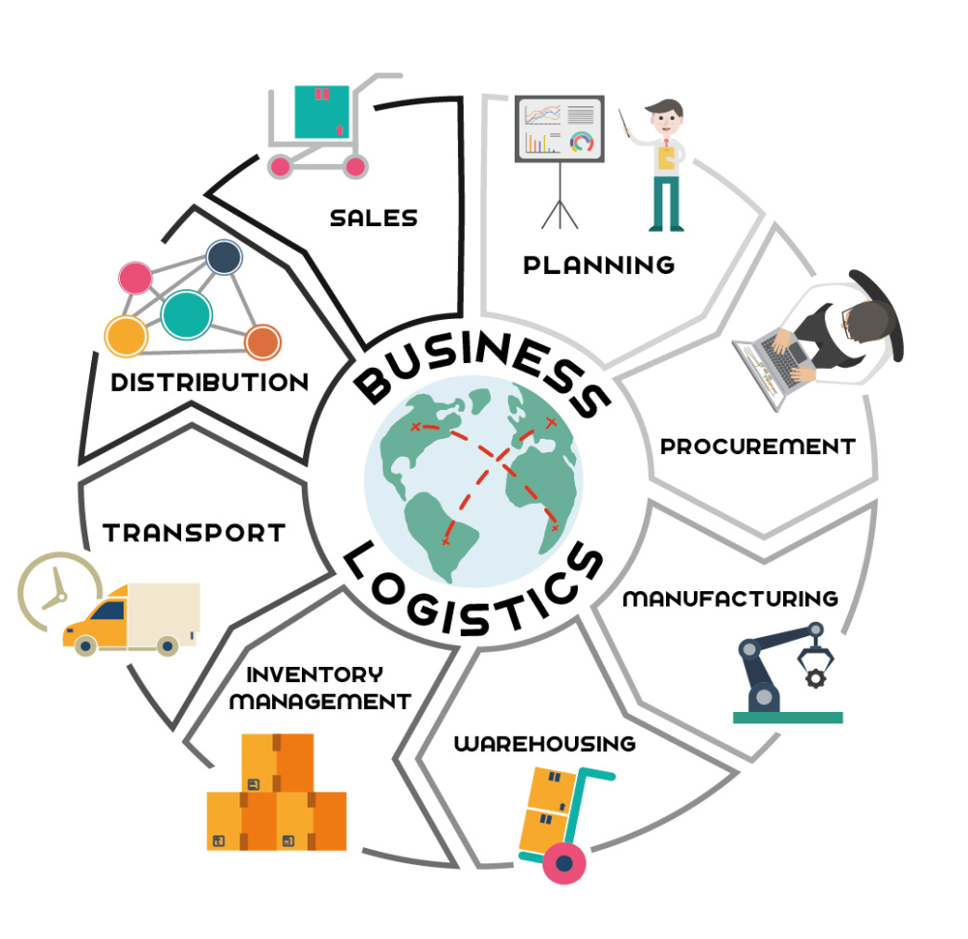
Activity – What is Included in Logistics?
Activity:
Define each area of business logistics in your own words.

Slide 21
Types of Logistics
Business Logistics – That part of the supply chain that plans, implements, and controls the efficient, effective, flow and storage of goods, services, and related information from point of origin to point of consumption in order to meet customer requirements.
Event Logistics – Network of activities, facilities, and personnel required to organize, schedule, and deploy the resources for an event to take place and to efficiently withdraw after the event.
Military Logistics – Design and integration of all aspects of support for the operational capability of the military forces (deployed or in garrison) and their equipment to ensure readiness, reliability, and efficiency.
Service Logistics – Acquisition, scheduling, and management of facilities, assets, personnel, and materials to support and sustain a service operation or business.

