Slide 1
INTRO TO LOGISTICS
Ms. Biba S. Kavass

Slide 2
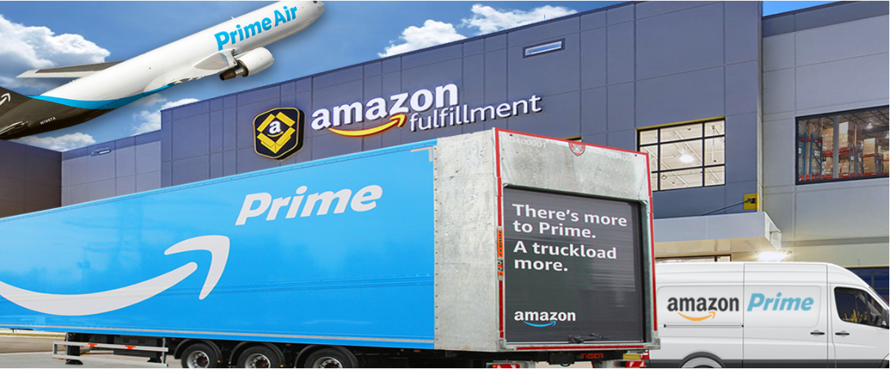
Reading: Taking a Look at Why Amazon is Bringing Logistics
In-House
https://www.youtube.com/watch?time_continue=614&v=Efs3PyR8iBw

Slide 3
LOGISTICS MANAGEMENT
Materials Management: involves the bringing of raw materials and supplies to where they are used to produce products and merchandise, usually a manufacturing company, and moving them through the company until they become finished products – inbound logistics
Physical Distribution Management: involves the movement of finished products and merchandise from the end of the production line to the consumer – outbound logistics

Slide 4
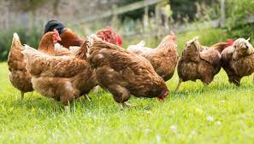
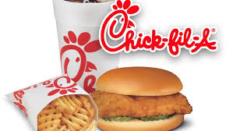
Movement of Goods/Services
Point of Origin – when and where manufactured or processed
Point of Consumption – when and where received by end user

Slide 5
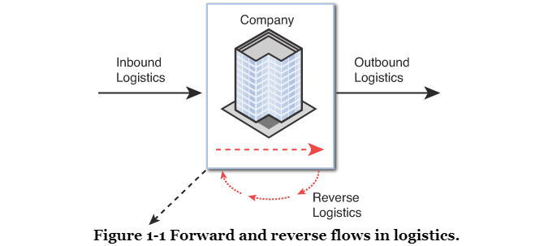
FLOWS IN LOGISTICS
FLOW:
Transportation represents flow of inventory from points of origin in supply chain to destinations, or points of use and consumption.

Slide 6
TYPES OF FLOWS
Forward Flow:
  Inbound – procurement of materials and goods from supplier locations
  Outbound – distribution of materials and goods to customer locations
Reverse Flow:
  Product returns, recycling, reuse of materials, repair and waste disposal

Slide 7
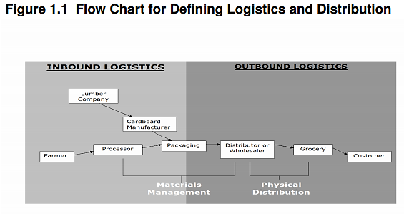

Slide 8
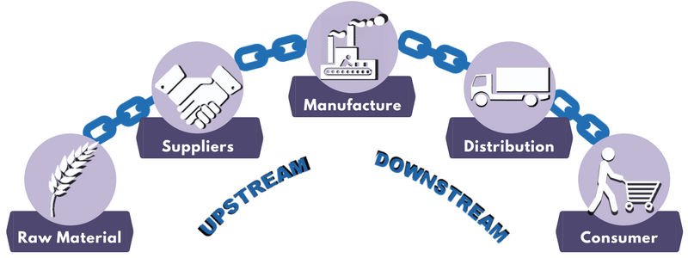
Supply Chain Network
Midstream/Internal – transformation of raw materials into semi-or finished products - manufacturer
Upstream – material flow from suppliers to manufacturer - activities occur before main organization (to the left – inbound)
Downstream – distribution of products to customers - activities occur after main organization (to the right – outbound)

Slide 9
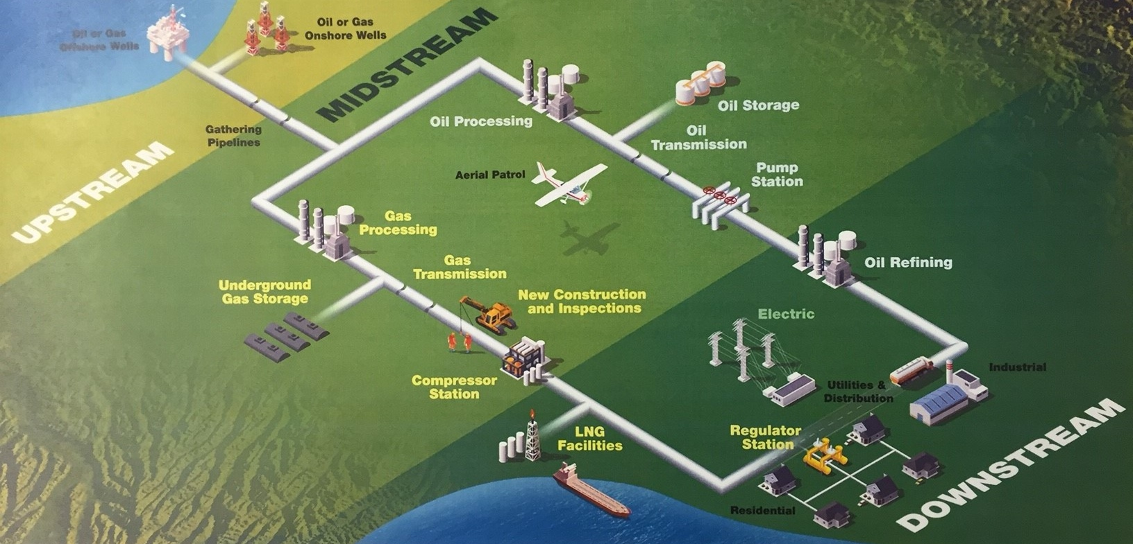
Upstream, Midstream, and Downstream
Notes:
Label the following: Tier I Supplier, Tier II Supplier, Connects Upstream to Midstream, What level is underground gas storage, Name 2 customers

Slide 10

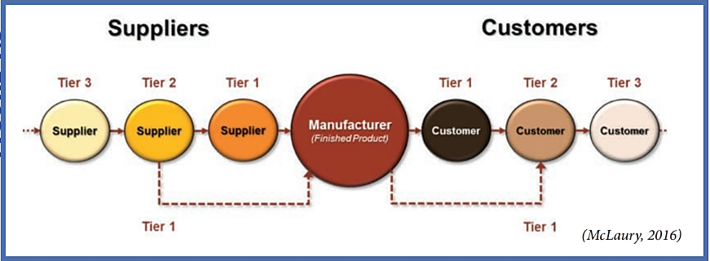
Level of Suppliers
Tier I Suppliers – provides products or services directly to manufacturer
Tier II Suppliers – provides products or services directly to Tier I supplier

Slide 11
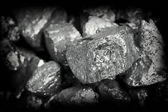
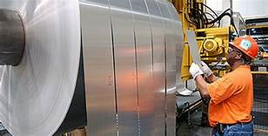
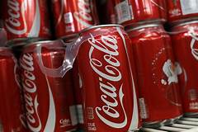

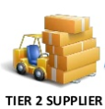
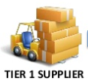
Example of Supplier Levels
Manufacturer
The Coca-Cola Company
Alcoa Corporation
Ball Corporation

Slide 12
Who is the 1st Tier Supplier?
In the SweetAction supply chain, the cows produce milk. The farmer collects the milk and sends it to Daisy, Inc. for the milk to be processed. Daisy, Inc. sends the processed milk to Breyer’s Ice Cream. Breyer’s turns the milk into vanilla ice cream and sends it to DOT Foods Distribution Center. DOT Foods distributes the vanilla ice cream to Kroger’s in Cordova, TN. Kroger’s sells the vanilla ice cream to Mr. Jones.
Who is the 1st Tier Supplier?
Notes:
Daisy, Inc.

Slide 13
Activity: Flows and Tiers in Logistics
Complete the Student Handout Activity on Flows and Tiers in Logistics

Slide 14
Distribution Centers
Distribution Centers – emphasize rapid movement of products through a facility -
offers value-added services like product mixing, order fulfillment, cross docking, packaging, etc.
Warehouse – emphasizes storage of products – usually doesn’t serve external customers
Fulfillment Centers – represent a special type of distribution center that is focused on e-commerce orders (ex. Amazon)
Hub - refers to a central warehouse that's used to cater various destinations that may be customers, stores or other smaller warehouses

Slide 15
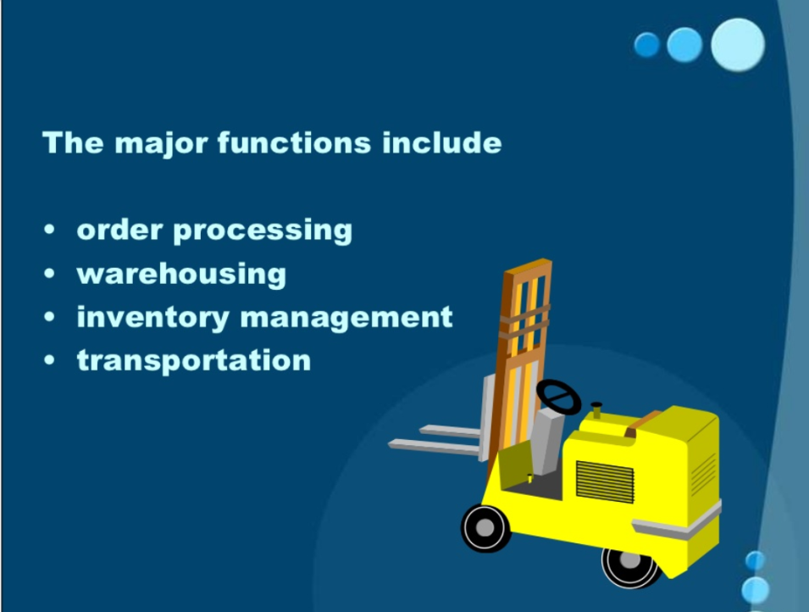
Major Functions of Distribution Centers

Slide 16
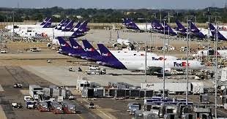
FEDEX WORLD HUB
https://www.youtube.com/watch?v=v-Q7Tmw85Xs

Slide 17
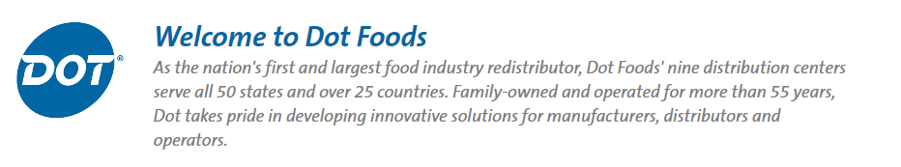
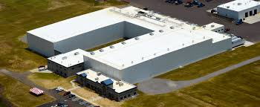
PROJECT: DOT Foods – America’s Largest Food Re-Distributor
https://www.youtube.com/watch?v=4ECUHJ9cJI8

Slide 18
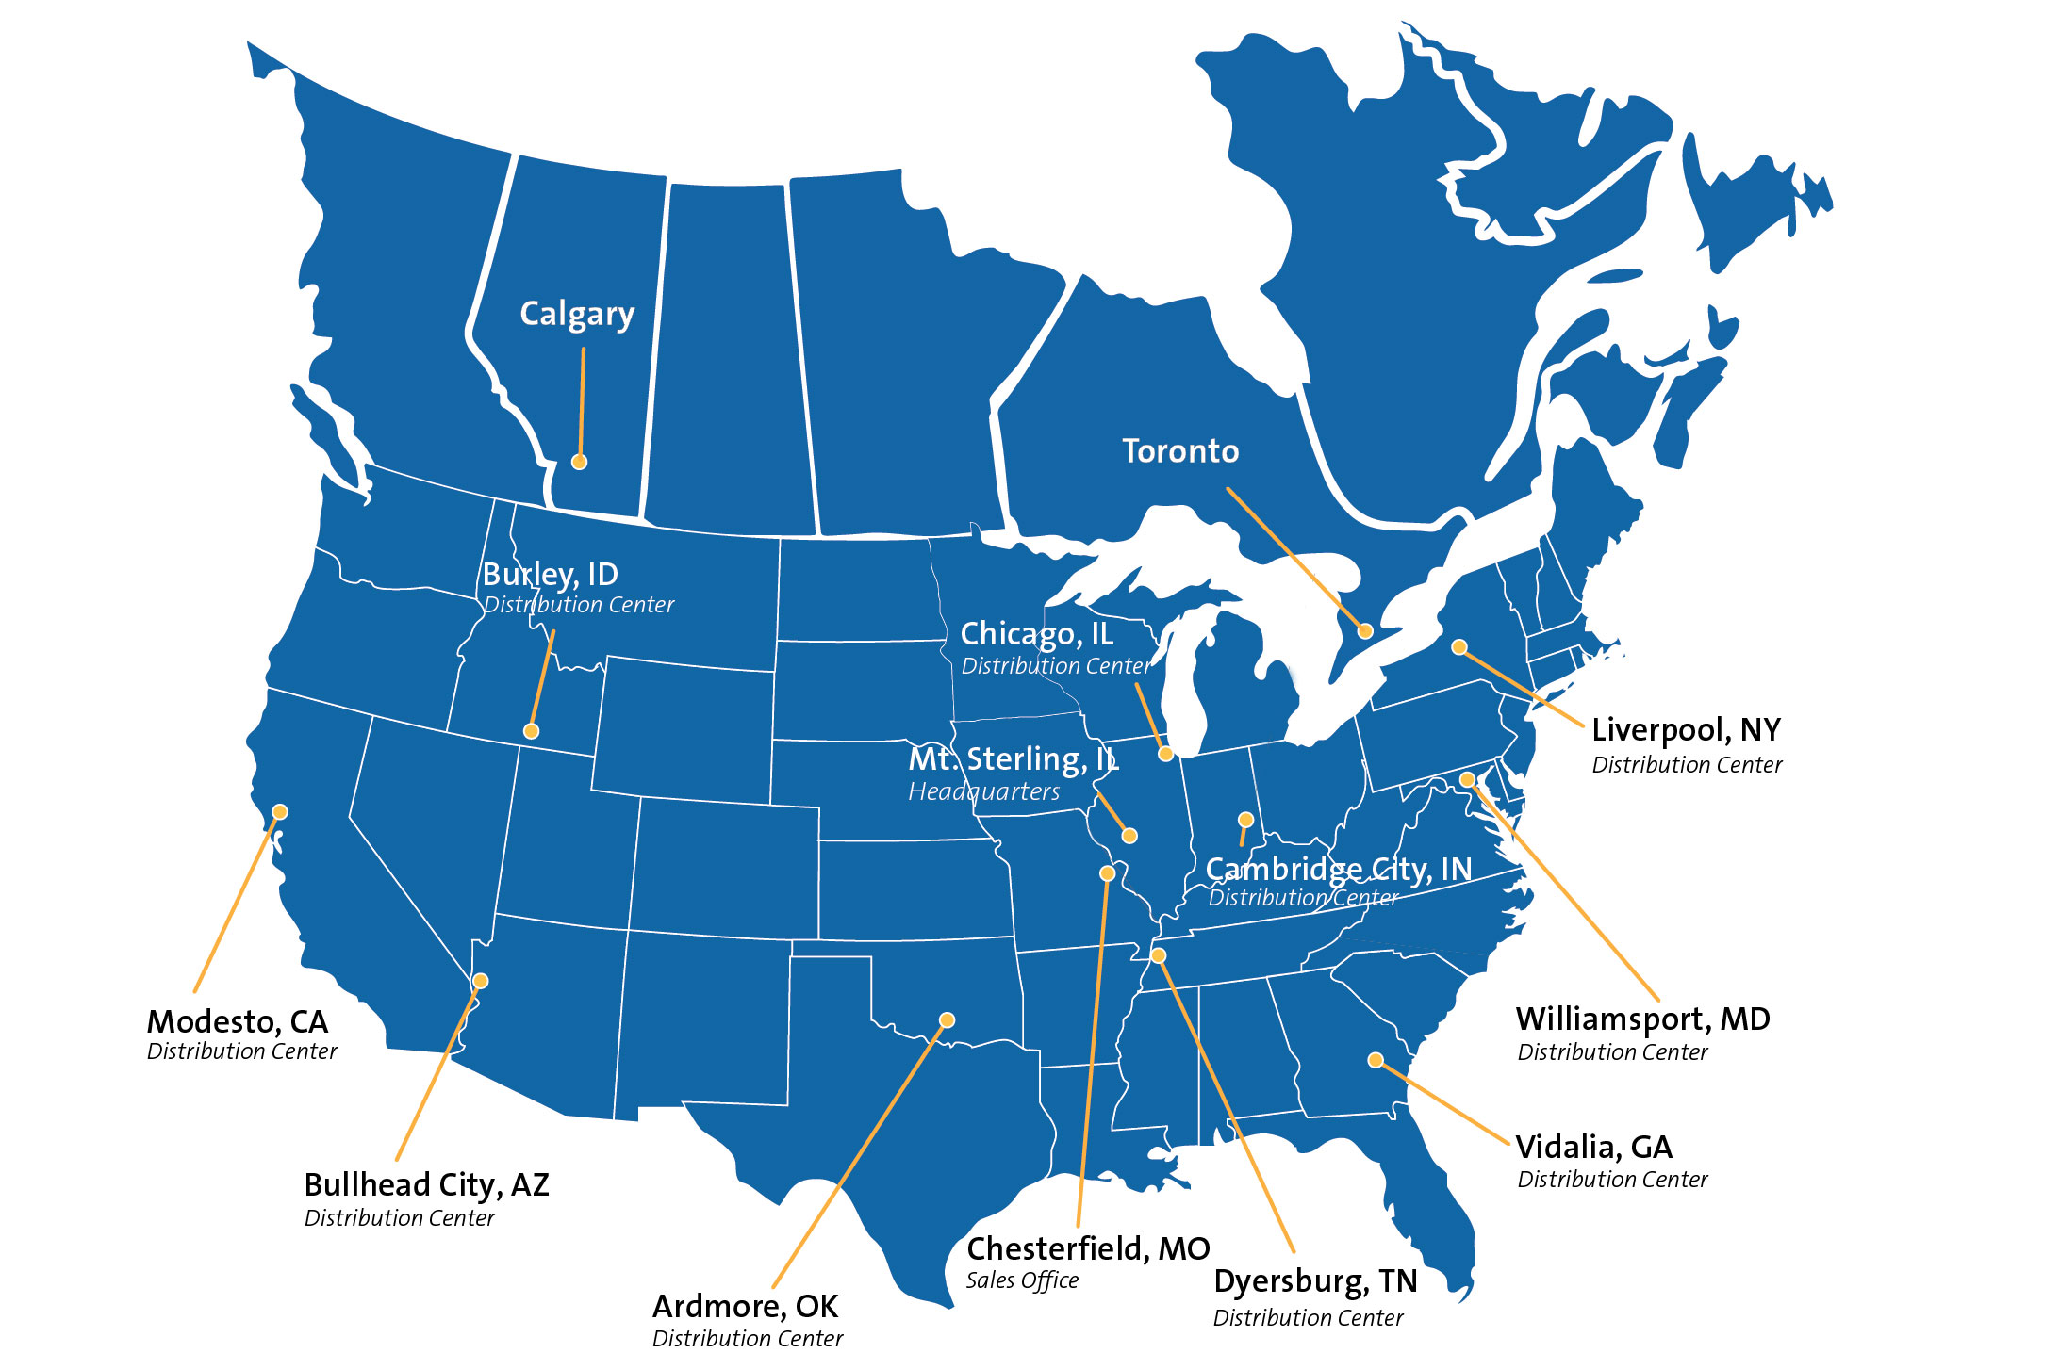
https://www.youtube.com/watch?v=8akN70cDnp8

Slide 19
DOT FOODS REGIONAL DISTRIBUTION CENTERS
Directions:
On your US Interstate Maps, map out the locations of ALL 11 Dot Foods Regional Distribution Centers using shapes
Indicate which location is the headquarters
If you were going to add a new Regional Distribution Center, where would you locate it? Flag your new Regional Distribution Center on the map and write down 3 reasons that you selected that location

Slide 20
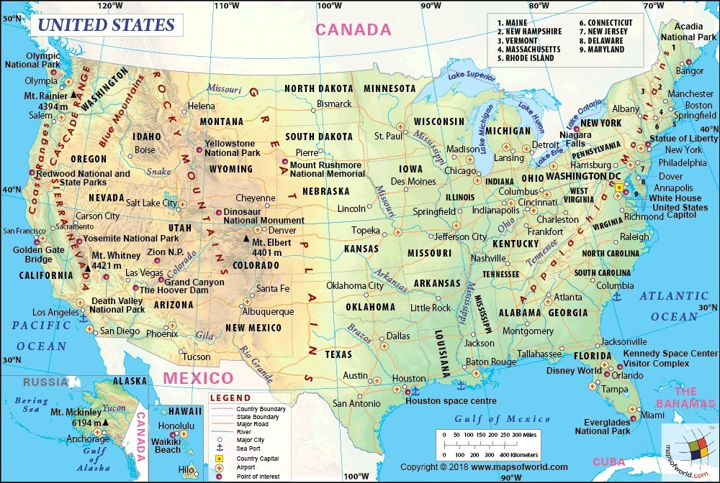

Slide 21
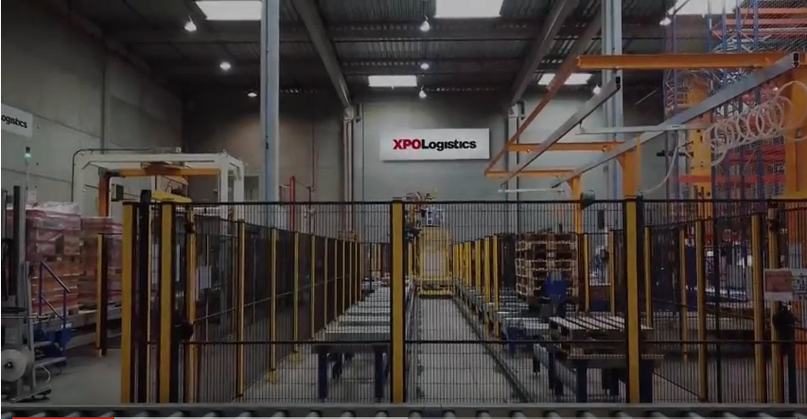
The Future is Now
https://www.youtube.com/watch?time_continue=79&v=ZpRzAzPi_T8

Slide 22
CLA Review
Module 2 – Logistics Environment

Slide 23
Security Requirements in Logistics
Fences and Gates
Security Guards
Lights and Alarms
CCTV – Closed Circuit TV

Slide 24
International Security
Customs-Trade Partnership Against Terrorism (C-TPAT)
1st major global supply chain security initiative
Established by U.S. Bureau of Customs
Chief goal – create an environment of close co-operation between U.S. importers, carriers, and international exporters to the US
Free Trade Zones – areas within a country where barriers to trade are relaxed or removed (tariffs, regs, etc.)

Slide 25
International Security
Free and Secure Trade (FAST)
Trade initiative between Canada, US, and Mexico
Main benefit – faster clearance to C-TPAT members’ cargoes at these US borders
Container Security Initiative (CSI)
Establish criteria to identify high-risk containers
Pre-screen containers before arrive at US ports
Pre-screen high risk containers
Develop more secure containers

Slide 26
International Security
Advanced Manifest Regulations
Send info electronically in advance of shipment
  Sea vessels – 24 hours
  Aircraft – 4 hours
  Rail – 2 hours
  Trucks – 1 hour – FAST trucks only ½ hour

Slide 27
Environmental Impact
ISO 14000 – series of standards that outlines system for best measure to protect environment at each link of supply chain
Environmental Protection Agency (EPA) – responsible for enforcing environment regulations
Clean Water/Air Act – regulate industrial waste disposal and other activities that impact water and air
Hazardous Materials (Hazmat) – agency responsible is US Department of Transportation (DOT)
  Must register as hazmat if:
    Radioactive materials
    Explosives – more than 55 pounds
Recycling – products collected and used to make another product

Slide 28
Physical Layout
Warehouses and Distribution Centers
  Receiving Dock
  Storage Area
  Picking Area
  Staging Area
  Loading Dock
  Throughput – volume of goods expected to move through a warehouse

Slide 29
Physical Layout
Types of Docks
Flush Docks – most common – outside wall of building is flush with dock
Open Docks – platform that extends out from the exterior building wall – safety is concern in bad weather
Enclosed Docks – provide the most security and most protection from weather – like a large garage
Rail Sidings – located away from main docks and have separate unloading and staging

Slide 30
ASSIGNMENTS
Complete the Intro to Logistics Learning Packet
Complete Module 2 – The Logistics Environment on OpusWorks
Take the Module 2 – Logistics Environment Quiz on quizizz.com – you must pass with an 80 or higher

