Slide 1
Intro to Supply Chain Ms. Biba S. Kavass

Slide 2
Think About This
How did the shoes that you are wearing get from the shoe manufacturer to your feet?
How do you order something online right now knowing that it will get delivered to your home tomorrow?
How many different types of soda are available for purchase?

Slide 3
Objectives and CTE State Standards
Define the term supply chain and determine the role supply chain management decisions have on cost-effective ways of delivering a product or service to consumers.
Identify the supply chain processes that are required to fulfill a customer request, including but not limited to: new product development, planning, buying, manufacturing operations, marketing, distribution, and customer service.
Develop a graphic illustration of a selected product and map the movement of primary inputs and outputs on a global or local scale.
Research and describe the four major flows—product flow, information flow, financial flow, and risk flow—that occur in a supply chain. Analyze the impact that each has on the supply chain as a whole and the interactions that must occur between the flows.
Demonstrate ability to use Microsoft Office to create documents used throughout the four major flows including: a. request for proposal (RFP) or request for quotation (RFQ). b. purchase order, c. invoice, d. inventory counts, e. delivery schedules, and f. payment schedules.
Differentiate between the internal supply chain and external supply chain of an organization, including internal and external customers. Write an informative paper and accompanying graphic that describes how the two chains are interrelated.

Slide 4
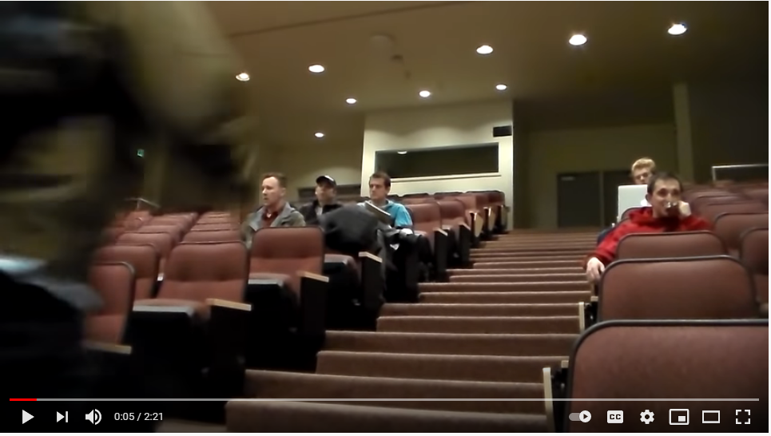
Life without a Supply Chain
https://www.youtube.com/watch?v=jaPBPxL4oTA

Slide 5
Supply Chain Management
Supply chain management is a process used by companies to ensure that their supply chain is efficient and cost-effective.
A supply chain is the collection of steps that a company takes to transform raw materials into a final product.

Slide 6
Supply Chain Components
Raw Materials – basic material used to produce goods
Supplier – procures raw materials
Manufacturer – converts raw materials into finished products
Distributor/Warehouse – moves/stores products to retailers or direct to consumers
Retailer – sells final products for consumer use
Consumer – buys final products for consumption
3 types of Consumers – Individual, Business, and Government

Slide 7
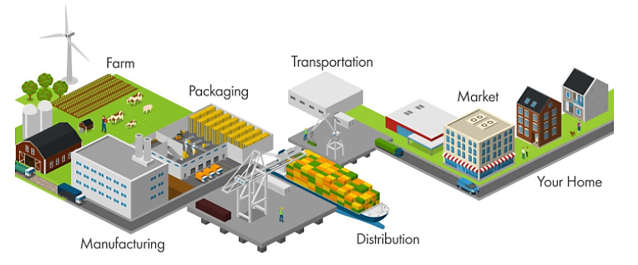
Supply Chain Example

Slide 8
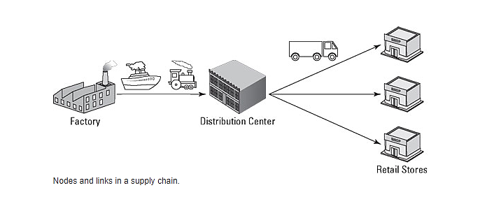
Links and Nodes in a Supply Chain
You can think of your supply chain as a network—made up of nodes and links.
Every stop that a product makes between raw materials and a customer is a node of the network. A factory is a node; so is a warehouse, a distribution center, and a retail store.
Nodes are connected by links—usually transportation, such as a ship, a railroad, a truck, or a drone. Products move through a supply chain, flowing through links and stopping at nodes.

Slide 9
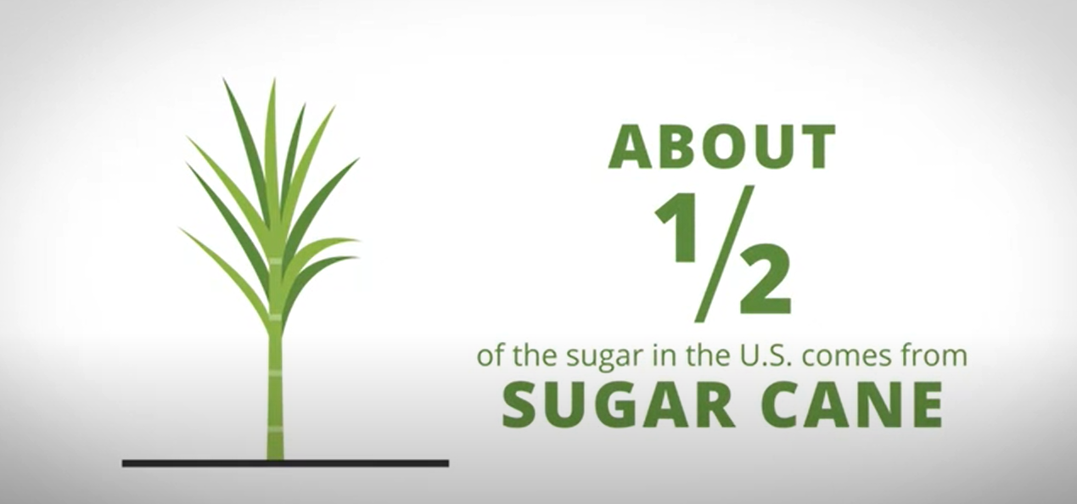
Processing Raw Materials
Raw materials are usually processed by the supplier before they are sent to the manufacturer. We call this node a Processing Facility and each type of raw material has a different type of processing facility.
For example, both sugar and flour are processed at a mill and then transported to the manufacturer.
https://www.youtube.com/watch?v=oMLvwbX-TUM
Notes:
Roaster, mill, mill, mill, dairy processing, refinery, water processing

Slide 10
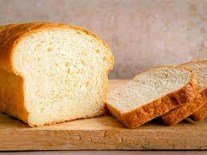
Let’s Practice
Draw the supply chain for bread. First, answer the questions below:
What is the main ingredient in bread? _____________________
Where does the main ingredient come from? ________________
How is the raw material processed? _______________________
Notes:
Flour – Wheat - Mill

Slide 11
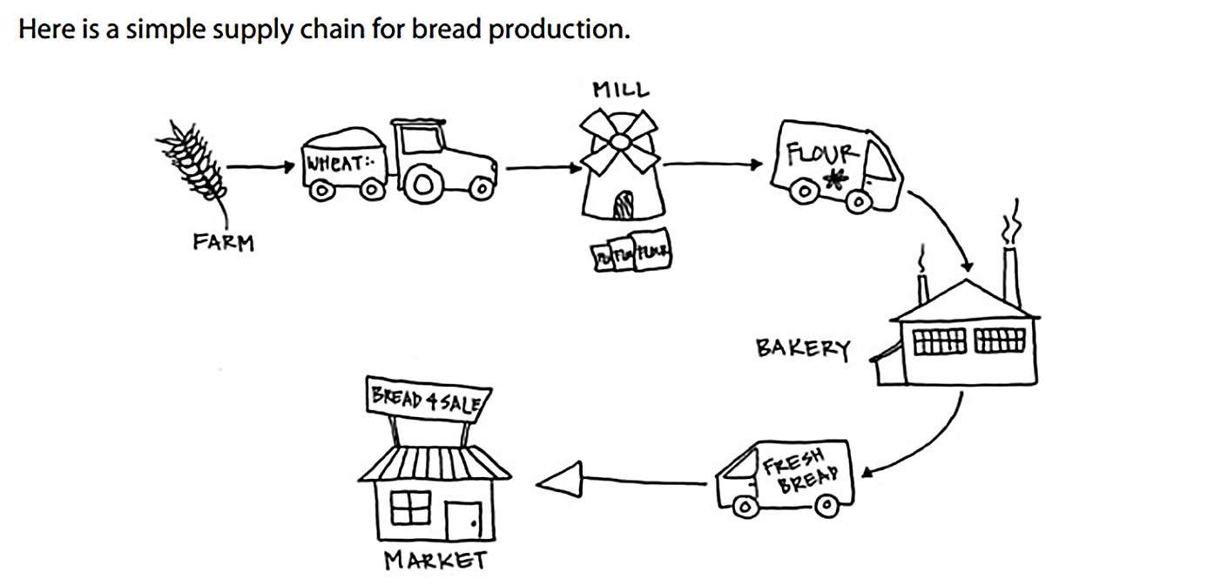

Slide 12
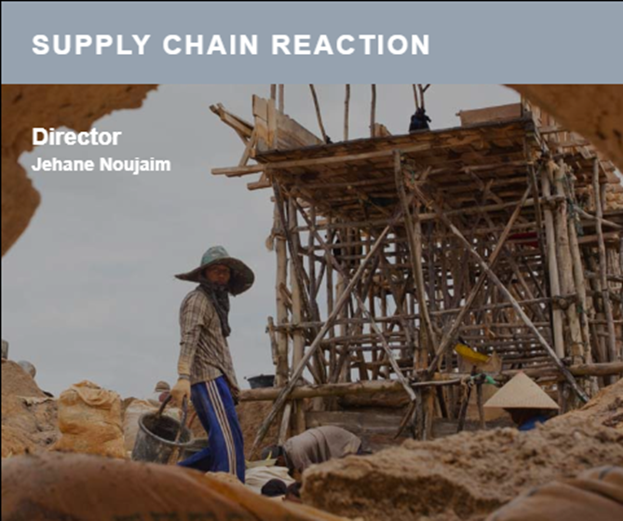
Supply Chain Reaction
Assignment
Directions: After watching the video “Supply Chain Reaction” (https://wetheeconomy.com/films/supply-chain-reaction/), complete the questions on the activity sheet.
https://wetheeconomy.com/films/supply-chain-reaction/?autoplay=yes

Slide 13
Benefits of Supply Chain Management
Develops better customer relationship and service.
Creates better delivery mechanisms for products and services in demand with minimum delay.
Improvises productivity and business functions.
Minimizes warehouse and transportation costs.
Minimizes direct and indirect costs.
Assists in achieving shipping of right products to the right place at the right time.
Enhances inventory management.
Assists companies in adapting to the challenges of globalization, economic upheaval, expanding consumer expectations, and related differences.
Assists companies in minimizing waste, driving out costs, and achieving efficiencies throughout the supply chain process.

Slide 14
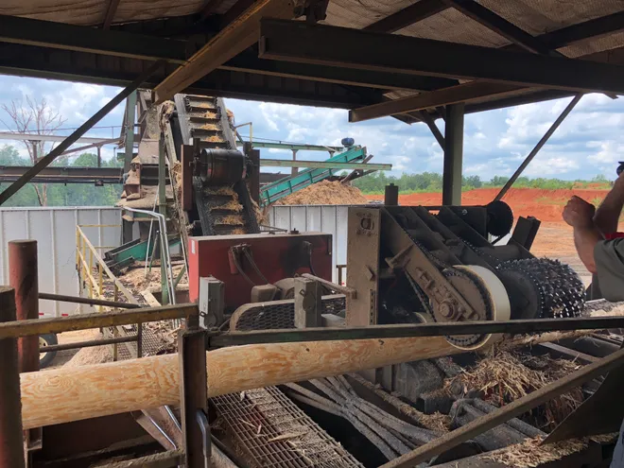
Reading: Summertime shortages: Why you can't find chicken wings, chlorine, or a new washer this summer. . .
Summertime is perfect for bike rides, cookouts, home improvements and relaxing by the pool.
But a COVID-19 hangover from 2020 is threatening many of those traditions as shop owners struggle with shortages and higher prices created by snarled supply chains.
Read the rest of the article and then participate in class discussion about supply chain shortages.
https://www.cincinnati.com/story/money/2021/05/31/chicken-wing-shortage-2021-chlorine-lumber-appliances/5241944001/

Slide 15
What is the Difference?
Operations Management
Set of activities that creates value in the form of goods and service by transforming inputs into outputs.
Examples:
Scheduling crews for an airline
Designing a new I-Phone
Supply Chain Management
Network of manufacturers, retailers, distributors, transporters, storage facilities, and suppliers that participate in the production, delivery, and sale of a product to the consumer
Example:
Supplying beet sugar from the farmer to the syrup producer to the bottler to the distributor to the store to the consumer
Logistics Management
Planning, execution, and control of the procurement, movement, and stationing of personnel, material, and other resources
Example:
Transporting a shipment of tomatoes from California to a Kroger in Memphis

Slide 16
Video Case Study: Frito-Lay: Operations Management in Manufacturing
Frito-Lay, the Dallas-based subsidiary of PepsiCo, operates 30+ manufacturing facilities across the U.S. and Canada, more than 200 distribution centers, and has approximately 55,000 employees. With over 15,000 routes they make over 500,000 weekly service calls on approximately 290,000 customers. Sales exceeded $15 billion in 2016.
Operations is the focus of the firm—from designing products for new markets, to meeting changing consumer preferences, to adjusting to rising commodity costs, to subtle issues involving flavors and preservatives—OM is under constant cost, time, quality, and market pressure.
Directions: After watching the video, work with a partner and answer the following questions:
What are some examples of operations management discussed in the video?
What are some examples of supply chain management discussed in the video?
What are some examples of logistics discussed in the video?
https://www.youtube.com/watch?v=BTE7Uvm60IM

Slide 17
Functions of a Business Organization
Marketing
Generates demand – nothing happens until there is a sale
Production & Operations
Creates, produces and delivers the product
Finance/Accounting
Tracks how the organization is doing collecting money and paying the bills
Management
Coordination and administration of tasks to achieve goal

Slide 18
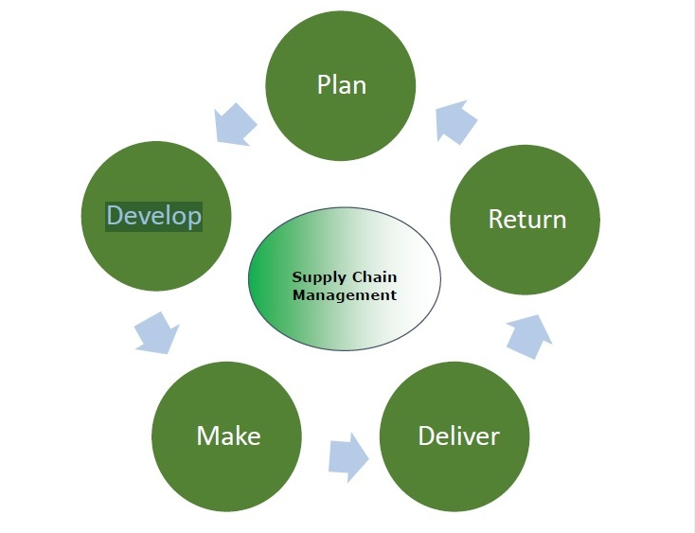
SCOR Model
Plan -develop a plan or strategy to address how
products and services will satisfy the demands and necessities of the customers.
Develop (Source) – establish strong relationships with suppliers to deliver the items and services required to make their product – arrange pricing, delivery and payment processes.
Make – manufacturing of products demanded by the customer – schedule all activities for manufacturing, testing, packaging and preparation for delivery.
Deliver - delivered to the customer at the destined location – referred to as logistics-COSTLIEST PART
Return - defective or damaged goods are returned to the supplier by the customer

Slide 19
Flows in Supply Chain
Product Flow
Reverse Product Flow
Money Flow
Information Flow
Product Flow – movement of items from the producer to the consumer
Reverse Product Flow – returns, defects – from the consumer to the producer
Information Flow – interactions flow both ways – orders, invoices, schedules, dispatch, etc.
Money Flow – movement of monies from the consumer all the way down to the supplier

Slide 20
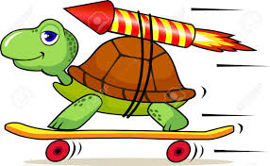
Activity: The Need for Speed
A Rose is a Rose, but Only If It is Fresh
Supply chains for foods and flowers must be fast, and they must be good. When the food supply chain has a problem, the best that can happen is the customer does not get fed on time; the worst that happens is the customer gets food poisoning and dies. In the floral industry, the timing and temperature are also critical. Indeed, flowers are the most perishable agricultural item—even more so than fish. Flowers not only need to move fast, but they must also be kept cool, at a constant temperature of 33-37 degrees. And they must be provided preservative-treated water while in transit. Roses are especially delicate, fragile, and perishable.
Eighty percent of the roses sold in the U.S. market arrive by air from rural Colombia and Ecuador. Roses move through this supply chain via an intricate but fast transportation network. This network stretches from growers who cut, grade, bundle, pack, and ship; to importers who make the deal; to the U.S. Department of Agriculture personnel who quarantine and inspect for insects, diseases, and parasites; to U.S. Custom agents who inspect and approve; to facilitators who provide clearance and labeling; to wholesalers who distribute; to retailers who arrange and sell; and finally to the customer.
Each and every minute the product is deteriorating. The time and temperature sensitivity of perishables like roses requires sophistication and refined standards in the supply chain. Success yields quality and low losses. After all, when it’s Valentine’s Day, what good is a shipment of roses that arrives wilted or late? This is a difficult supply chain; only an excellent one will get the job done.
Activity: Draw the supply chain for roses from Ecuador to Memphis, TN. Explain why there is such a need for speed in this supply chain.

Slide 21
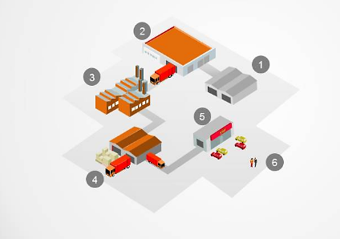
Quiz – Supply Chain Components
Label each part of the supply chain.
_________
_________
_________
_________
_________
_________

Slide 22
Functional Areas of Supply Chain
Purchasing: activity of acquiring goods or services to accomplish the goals of an organization
Manufacturing: production of merchandise for use or sale using labor and machines, tools, chemical and biological processing, or formulation
Inventory Management: Activities employed in maintaining the optimum number or amount of each inventory item
Demand Planning: process of forecasting customer demand to drive execution of such demand by corporate supply chain and business management
Warehousing: Performance of administrative and physical functions associated with storage of goods and materials
Transportation: movement of people, animals and goods from one location to another – costliest activity
Customer Service: process of ensuring customer satisfaction with a product or service

Slide 23
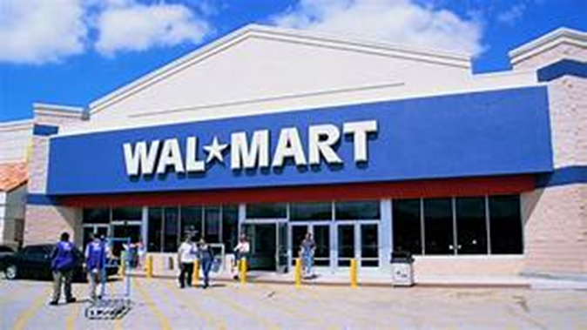
Activity: Supply Chain Functions for Wal-Mart
DIRECTIONS: Read the article. Then find an example of each of the 7 Supply Chain Functions in the article (circle or underline it – also label it with the specific function.)

Slide 24
Project: Journey of Peanut Butter
OBJECTIVE(S)
Analyze the production of Skippy Peanut Butter from the peanut to the grocery shelf
Map the supply chain of Skippy Peanut Butter
Explain how the supply chain functions work together to support getting the final product to the consumer

Slide 25
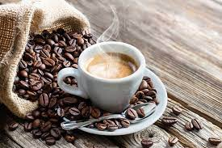
The Story of Coffee
Supply Chain—From Bean to Cup

Slide 26
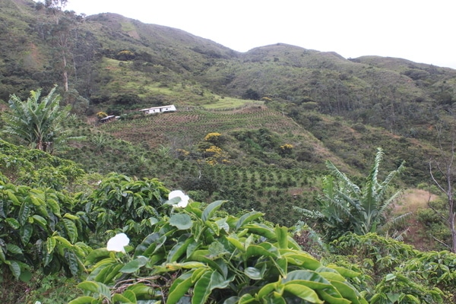
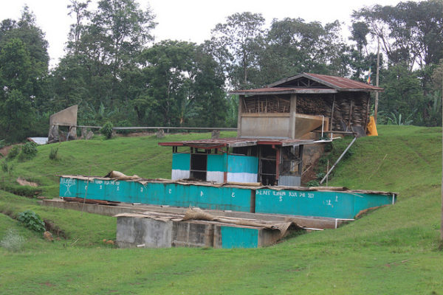
How does coffee get from a farm to your cup?
Coffee grows best in countries near the equator - Central/South America, Africa, and the Pacific.
Coffee grows on trees—and is usually harvested once per year. Coffee farms can range from very-small to very-large, often influenced by the history of land ownership in the country of origin. Smaller farms often use family or community-based labor, while larger farms hire a combination of permanent and seasonal workers.
When coffee is picked, it looks like a bright red berry and is what we call a coffee “cherry.” The part of this we actually brew is the seed inside the coffee cherry, so the next step after picking is getting those seeds separated out. We call this “processing,” and it can take a few different forms. The majority of the coffee we sell uses a washed process, which separates seeds—often referred to as beans—from coffee cherries using water in a wet mill. Sometimes this washing step happens on the farm itself. In other cases, farmers deliver their coffee cherries to a cooperative or buying station for processing.
https://www.youtube.com/watch?time_continue=2&v=xD-pLgLgZGo

Slide 27
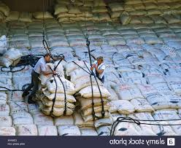
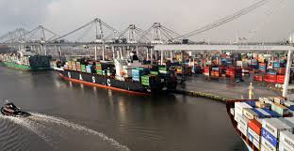
Coffee—Farm to Cup
Once washed coffee beans are dry, they’re still not 100 percent separated from the coffee cherry material. Washed coffee beans still have a papery parchment layer and naturally processed coffees have the entire cherry still surrounding the bean. The dry mill completes the separation process, removing any remaining layers from the coffee bean. The dry mill then sorts coffee into different grades based upon the physical attributes of the beans, like density and color. Dry mills are often owned and managed by exporters.
Once incoming coffee clears customs, it is stored in a warehouse near the port until we need it. This helps us maintain a smaller on-site inventory and helps us make sure all of the unroasted, called “green” coffee, is stored in optimal conditions. We evaluate our roastery inventory weekly and typically request 1–2 shipments from the port warehouse every week. Most of our coffee comes in and is warehoused in Charleston, SC, with a smaller portion coming in through Oakland, CA.
Except in extremely rare cases of air shipment, all of our coffee comes to the U.S. via container ship. In countries that border the ocean, coffee generally goes directly from the dry mill to the port. In the case of landlocked coffee-producing countries, the coffee has a bit more of a journey before it hits the water—like in the case of Rwandan coffee shipped out of Kenya. The amount of time the coffee spends on the water ranges widely, from a few weeks in the case of coffee from Central America to a few months for coffees from Papua New Guinea.

Slide 28
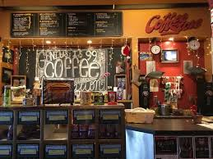
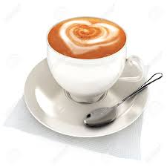
Coffee—Farm to Cup
Pulling from our roastery supply which we get from the ports, we roast coffee every weekday based on the orders we receive the day before. Coffee orders are roasted, bagged, and shipped all on the same day.
CONSUMER

Slide 29
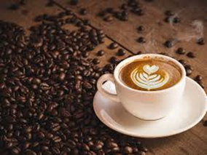
Practice: Draw Coffee Supply Chain
Directions:
Draw the supply chain for coffee—from farm to cup. Make sure to include all 6 components—label your links and nodes.

