Slide 1
Activity: How McDonald's Makes Its Fries
McDonald's Canada has put together a run-through of how it makes its fries as part of an initiative to answer questions from customers.
Complete the activity on How McDonald’s Makes it Fries

Slide 2
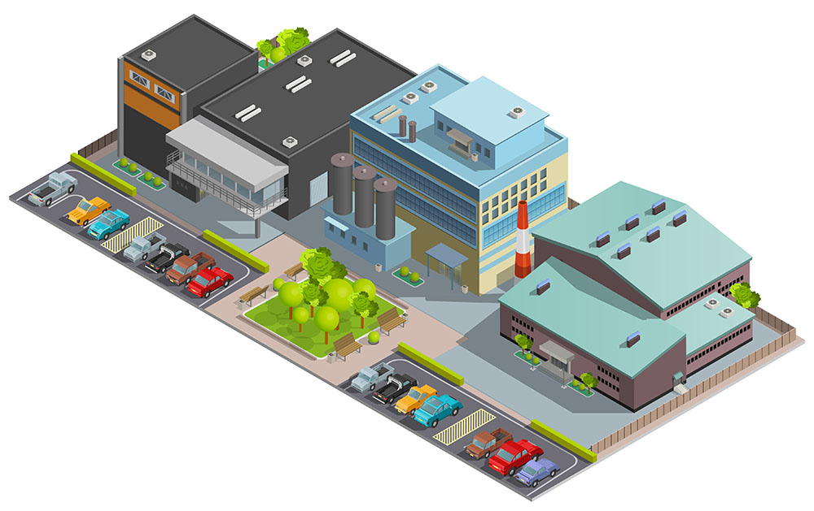
Internal vs. External Supply Chain
Internal Supply Chain refers to the chain of activities within a company, specifically, purchasing, production, sales and distribution. The internal supply chain has a significant impact on a company’s success; operations need to run smoothly in order to create a harmonized working environment and an efficient workflow.
External Supply Chain refers to the network of activities outside of a company such as transportation, and the environmental factors, which can have a direct or indirect effect on operations e.g. supplier failure, changes in laws and natural disasters.

Slide 3
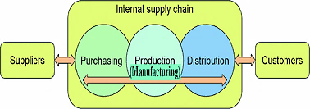
Importance of Internal Supply Chain:
Impact on the final product and its ultimate delivery to the consumer through optimized operations and on-time production
Threats to Internal Supply Chain:
Fluctuating Customer Demand
Equipment Breakdowns
Changes in Technology
Question: Which is more important—the internal or external supply chain?

Slide 4
Reading: How Important is the Internal Supply Chain?
Directions:
Read the article and then write an informative paper that describes how the internal and external supply chains are interrelated and how they are different. Paper must be typed in MS Word and include a graphic illustrating the relationship between the two supply chains. Include any sources you used at the end of the paper in APA style.
Grading:
Assignment is worth 100 points and will be graded using the Informative Essay Rubric.

Slide 6
Common Documents Used in Supply Chain

Slide 7
Request for Proposal (RFP) or Request for Quotation (RFQ) -company solicits select suppliers and contractors to submit price quotes and bids for the chance to fulfill certain tasks or projects
Purchase Order - legal document a buyer sends to a supplier or vendor to authorize a purchase
Invoice – document that itemizes and records a transaction between a buyer and a seller.
Inventory Counts - practice of counting your retail products in person
Delivery Schedules - specifies the time for delivery of goods or services from a supplier to a customer
Payment Schedules - agreed timings of payments from one party to another.

Slide 8
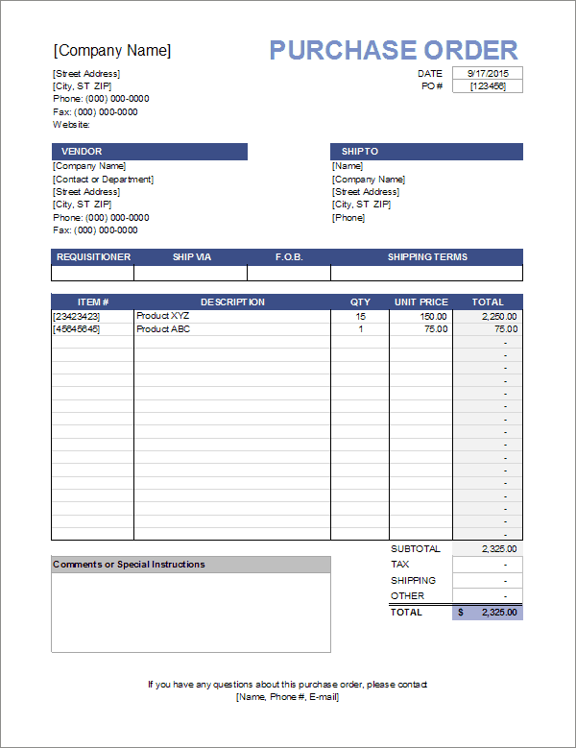
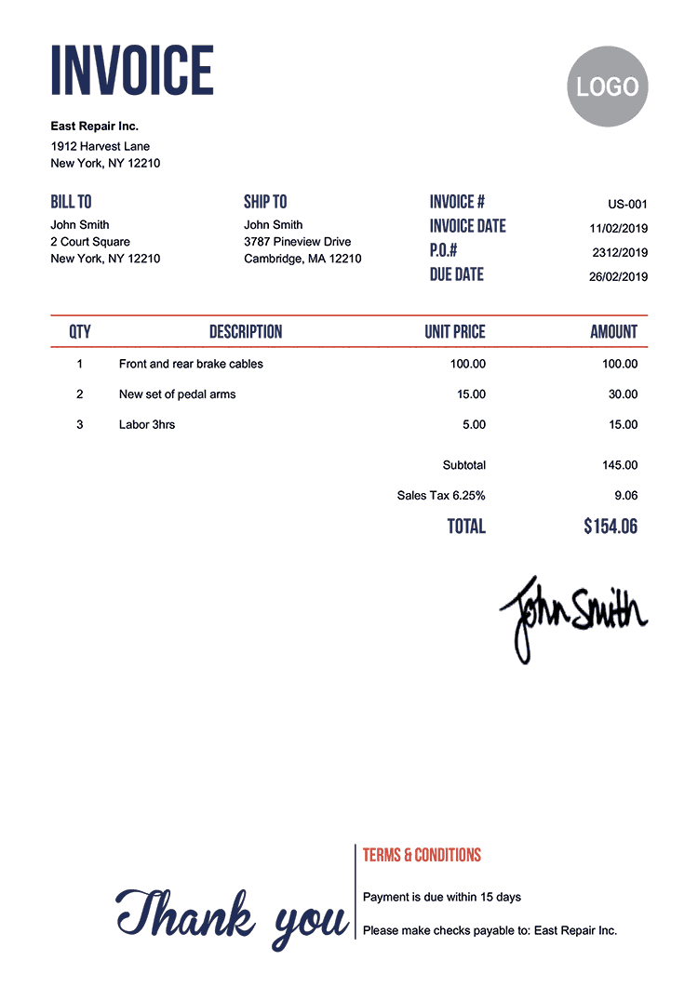
Activity: Documents Used in Supply Chain

Slide 9
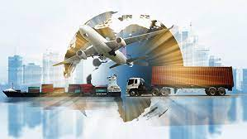
CLA Review Chapter 1 – Global Supply Chain Logistics

Slide 10
Logistics – link between nodes in a supply chain - transportation
Supply Chain Logistics – efficient flow of materials from the point of origin to the point of consumption within a network of connected facilities—A chain is only as strong as its weakest link
Demand - a customer's need for a particular product, service, or component.
Global Supply Chain Logistics – process of moving materials across international boundaries
Customer/Consumer – drives a product through its life cycle (supply chain)
Inventory (Stock):
Raw materials – materials ready for use in production
Work-in-Process (WIP) – materials currently being processed
Finished Goods – products ready for storage or shipment
In-transit – in process of being transported from a supplier to a customer

Slide 11
Warehouse/Distribution Center Functions:
Receiving – physical receipt, identify, inspect, and dispatch goods – 1st step in logistics operation – MOST critical
Stocking – assigning products to proper location
Order Processing – assembling products from various locations for a specific customer order (picking items)
Cross Docking – goods transferred direct from incoming to
outgoing without being placed in storage
Shipping – loading is main function

Slide 12
Vital Role of Distribution Centers
Handle and store more items
Execute more transactions in less time
Provide more product and service customization
Process more returns
Order Cycle Time – time it takes to process an order from the time the order is received from the customer until the order is delivered.
Productivity – critical measure of performance throughout supply chain logistics
Main measurement – efficiency at order fulfillment

Slide 13
Transportation
Air
Rail
Water
Truck
Pipeline

Slide 14
Assignments
Complete the Intro to Supply Chain Learning Packet
Complete Module 1 – Global Supply Chain Logistics on OpusWorks
Take the CH 1 – Global Supply Chain Quiz on quizizz.com – you must pass with an 80 or higher

Slide 15
Thanks!
Any questions?

