Slide 1

Lean, Green and Sustainable
Ms. Biba S. Kavass

Slide 2


TN State CTE Standards
Supply Chain Functions – (7)
Research the following terms as related to supply chains: lean, green, and sustainable. Define and describe each term and give examples of ways they are implemented in a supply chain.

Slide 3

KEY TERMS
Lean Supply Chain - streamline processes by eliminating waste and non-value-added activities
Green Supply Chain – integrating environmental thinking
Sustainable Supply Chain - involves integrating environmentally and financially viable practices into the complete supply chain lifecycle

Slide 4
Corporate Social Responsibility (CSR)
Corporate Social Responsibility (CSR)
Managerial decision making that considers environmental, societal, and financial impacts.
Shared Value
Developing policies and practices that enhance the competitiveness of an organization while advancing the economic and social conditions in the communities in which it operates.
  Example:
  Dow Chemical finds social benefits and profit in Nexera canola and sunflower seeds. These seeds yield twice as much cooking oil as soybeans, enhancing profitability to the grower. They also have a longer shelf life, which reduces operating costs throughout the supply chain. As an added bonus, the oils have lower levels of saturated fat than traditional products and contain no trans fats. A win–win for Dow and society.

Slide 5
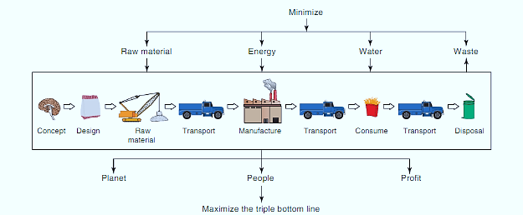
Sustainability Triple Bottom Line:
People, Planet, and Profit

Slide 6
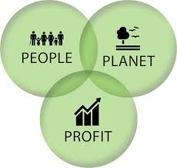
Activity: How Does This Support the Triple Bottom Line?
Directions: Read the examples and outline how the company is supporting People, Planet, and Profit.

Slide 7
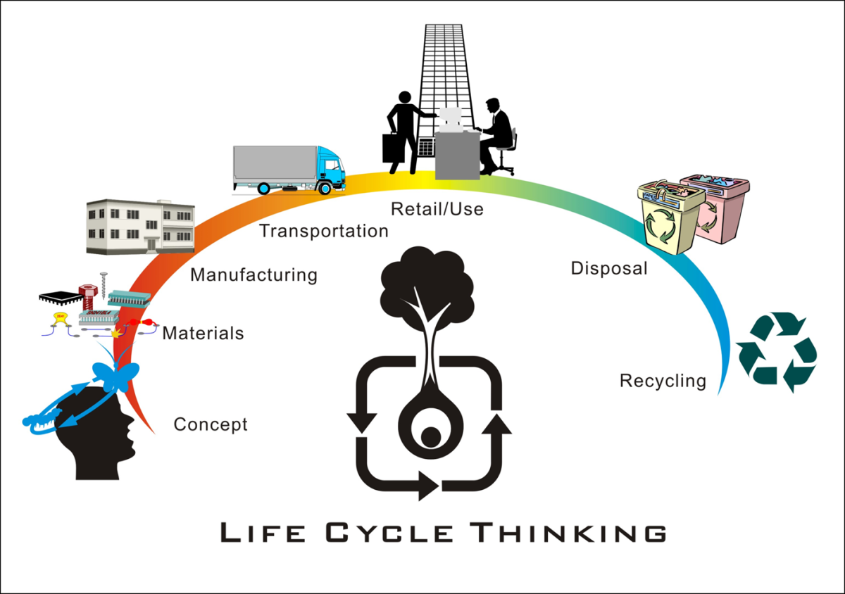
Life Cycle Thinking

Slide 8
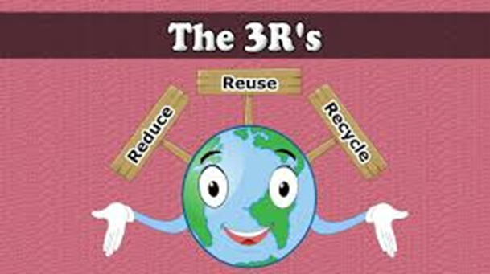
3 R’s - Examples
Mercedes is building some car exteriors from a banana fiber that is both biodegradable and lightweight.
Some Fords have seat upholstery made from recycled plastic soda bottles and old clothing.
Frito-Lay decided to extract water from potatoes, which are 80% water. Each year, a single factory processes 350,000 tons of potatoes, and as those potatoes are processed, the company reuses the extracted water for that factory’s daily production.
UPS has found that making left turns increases the time it takes to make deliveries. This in turn increases fuel usage and carbon emissions. So UPS plans its delivery truck routes with the fewest possible left turns. Likewise, airplanes fly at different altitudes and routes to take advantage of favorable wind conditions in an effort to reduce fuel use and carbon emissions.

Slide 9
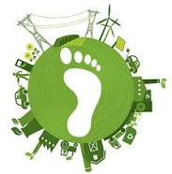
Carbon Footprint in Supply Chain
Definition: a measure of the total greenhouse gas (GHG) emissions caused directly and indirectly by an organization, a product, an event, or a person.
Managing the carbon footprint of a product means minimizing the carbon emissions required to deliver that product to the end consumer. The carbon footprint of a product is the carbon dioxide emitted across the supply chain for a single unit of that product.
WHY SHOULD WE CARE ABOUT OUR CARBON FOOTPRINT?

Slide 10
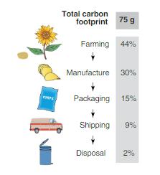
Carbon Footprint of a 34.5-gram Bag of Frito-Lay Chips

Slide 11
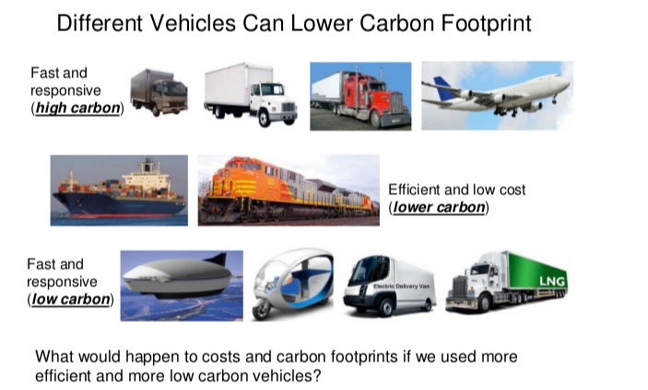
Lowering Carbon Footprint

Slide 12
ACTIVITY: WHAT IS YOUR CARBON FOOTPRINT?
Complete the Carbon Footprint Worksheet
Answer the following questions:
In what ways can you influence others to reduce their carbon footprints?
How does technology influence a person’s carbon footprint?
In what ways could your school reduce its carbon footprint?

Slide 13
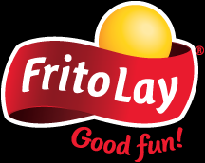
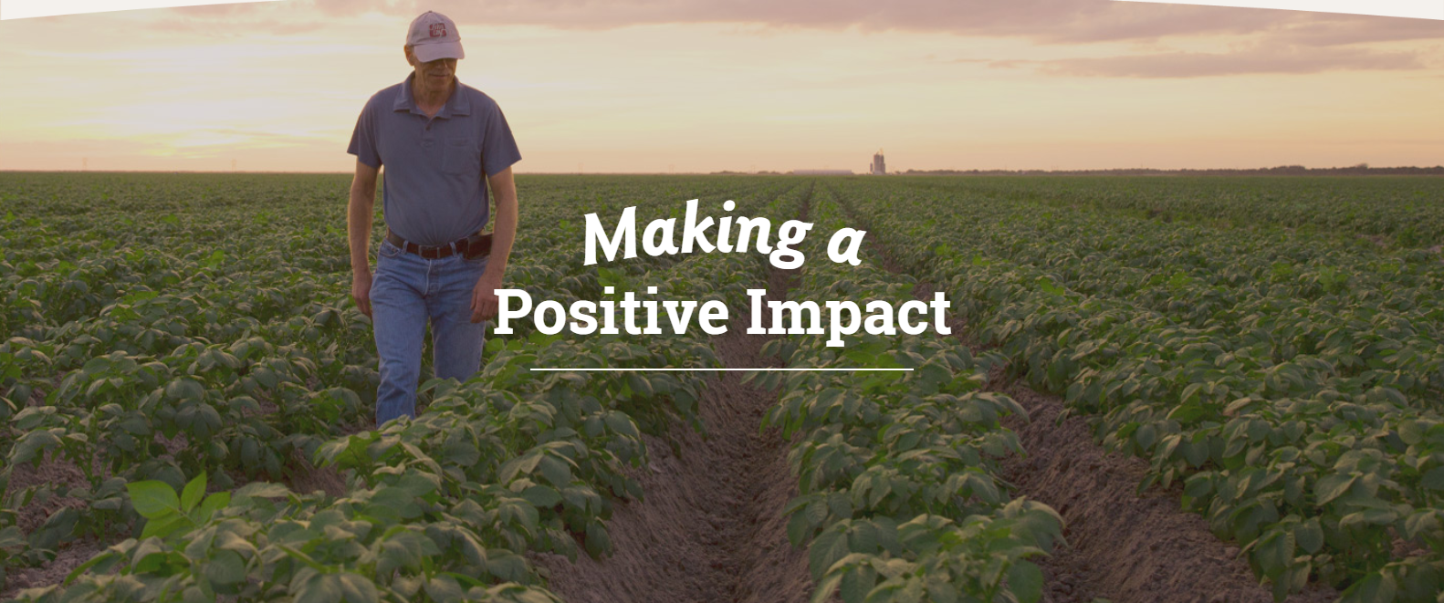
PROJECT: Green Manufacturing and Sustainability at Frito-Lay
As part of PepsiCo, we are always looking for ways to reduce our environmental impact as we grow our business. Since day one, our snacks have been made with ingredients that come from the Earth such as potatoes and corn which are grown by farmers across the country in the most sustainable way possible. This respect for the environment extends to our manufacturing processes and the way we bring products to store shelves.
We are always looking for ways to advance farming practices to optimize crop yields and replenish more water than we use in water-stressed areas, so we can assure business continuity, while positively contributing to our communities.

Slide 14
California Transparency in Supply Chains
Act 2010
An estimated 21 million people – 11.4 million women and girls and 9.5 million men and boys – are victims of forced labor around the globe. These victims work in virtually every industry and across sectors, including manufacturing, agriculture, construction, entertainment and domestic service. California, which boasts the world’s seventh-largest economy and the country’s largest consumer base, is unique in its ability to address this issue, and as a result, to help eradicate human trafficking and slavery worldwide.
In passing the Transparency in Supply Chains Act, the Legislature declared the intent of the State of California to ensure that large retailers and manufacturers provide consumers with information regarding their efforts to eradicate slavery and human trafficking from their supply chains, educate consumers on how to purchase goods produced by companies that responsibly manage their supply chains, and, thereby, improve the lives of victims of slavery and human trafficking.
Source: https://oag.ca.gov/SB657

Slide 15


BLOOD DIAMONDS
Blood diamond, also called conflict diamond, as defined by the United Nations (UN), any diamond that is mined in areas controlled by forces opposed to the legitimate, internationally recognized government of a country and that is sold to fund military action against that government.
https://www.youtube.com/watch?v=Zdtt1WWuMBM

Slide 16
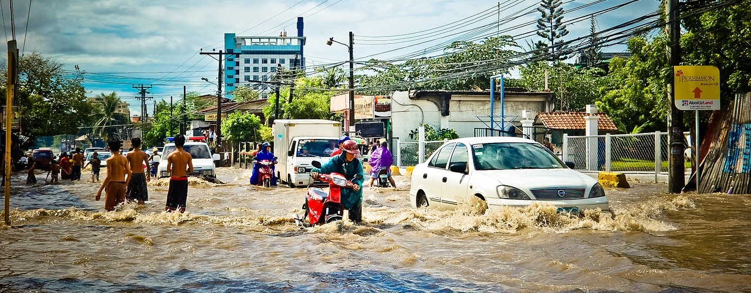
GLOBAL CLIMATE CHANGE
Climate Change (also known as Global Warming) is the name given to long term changes to temperature on and around the Earth’s surface, which causes long term shifts to weather patterns.
Climate Change isn't limited to one region, it impacts the whole of the Earth. It is causing polar ice sheets and glaciers to melt; and sea levels to rise. Extreme weather events such as typhoons and hurricanes are becoming more common in some regions of the world, while other regions experience more punishing droughts and heat waves.

Slide 17

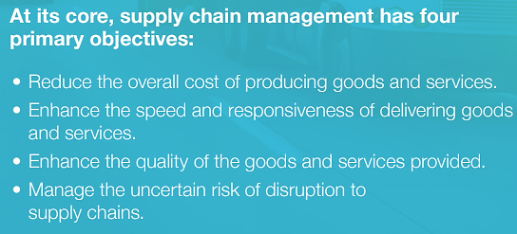
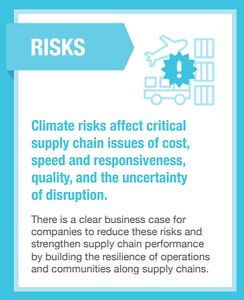

Slide 18
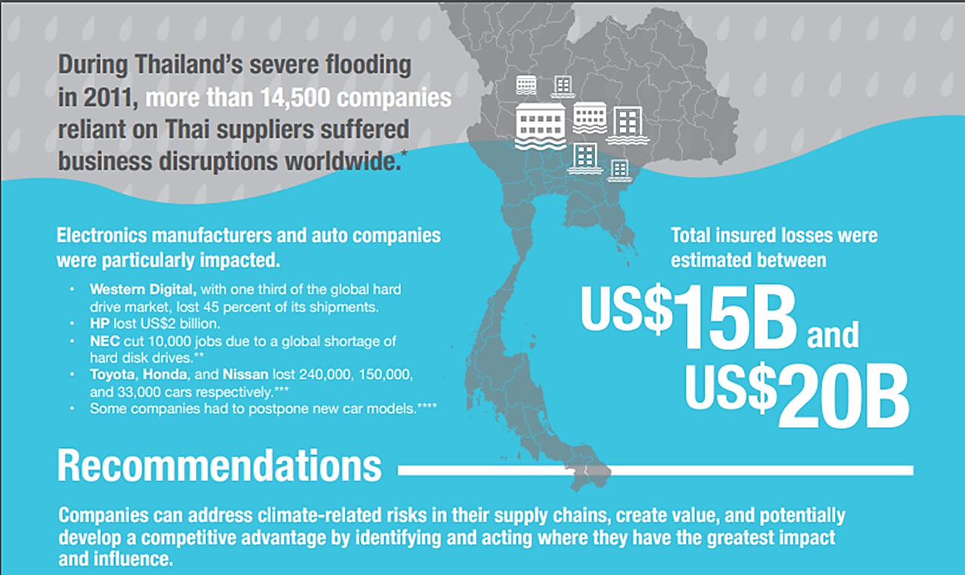

Slide 19
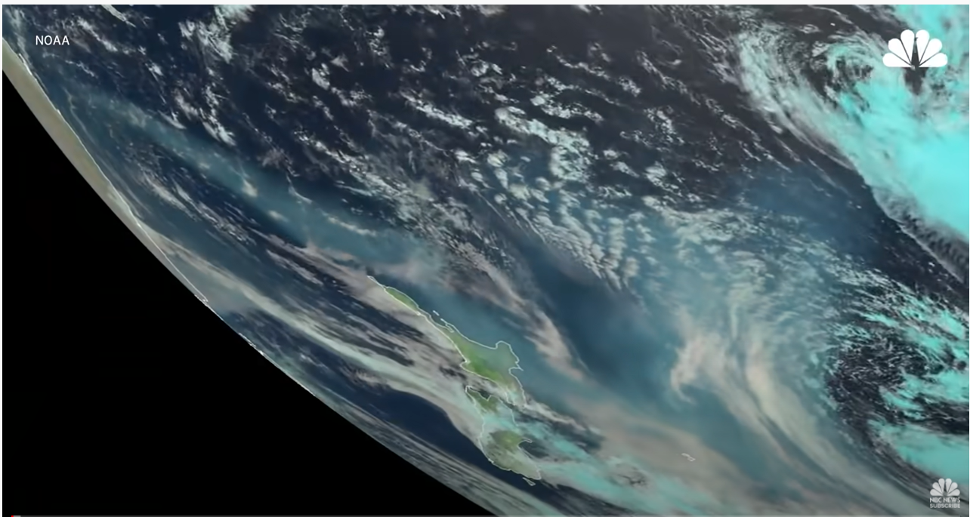
2020: Year of Climate Extremes
https://www.youtube.com/watch?v=g6H9Q8wB4h8

Slide 20
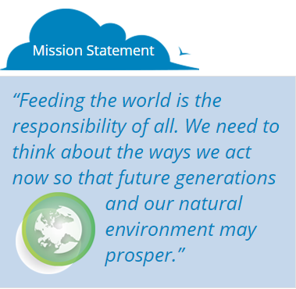
PROJECT: JOURNEY 2050
Journey 2050 takes students on a virtual farm simulation that explores world food sustainability. Using an inquiry-based approach the program encourages students to make decisions and adjust them as they see their impact on society, the environment and the economy at a local and global scale. The students hear from farmers across the globe.
As the student interacts with each family, they learn the role of best management practices in feeding the world, reducing environmental impacts and in improving social performance through greater access to education, medical care and community infrastructure. Our Journey to feeding the world has started. Join us.
https://www.journey2050.com/

Slide 21
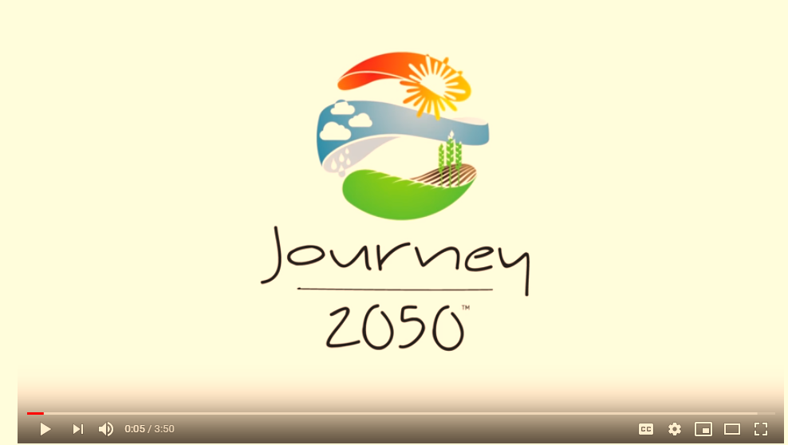
JOURNEY 2050 - INTRODUCTION
https://www.youtube.com/watch?v=zYecU_gJdxA&feature=youtu.be

Slide 22
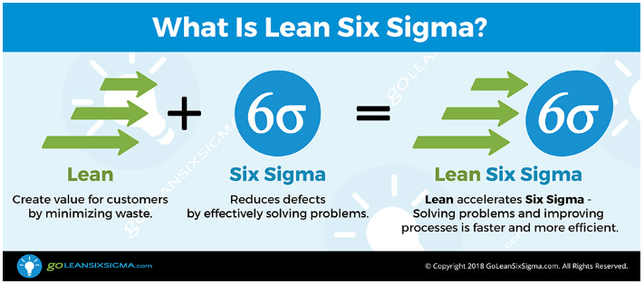
Lean Six Sigma is a combination of two powerful process improvement methods: Lean and Six Sigma.
Lean Six Sigma decreases your organization’s costs by:
  Removing “Waste” from a process. Waste is any activity within a process that isn’t required to manufacture a product or provide a service that is up to specification.
  Solving problems caused by a process. Problems are defects in a product or service that cost your organization money

Slide 23
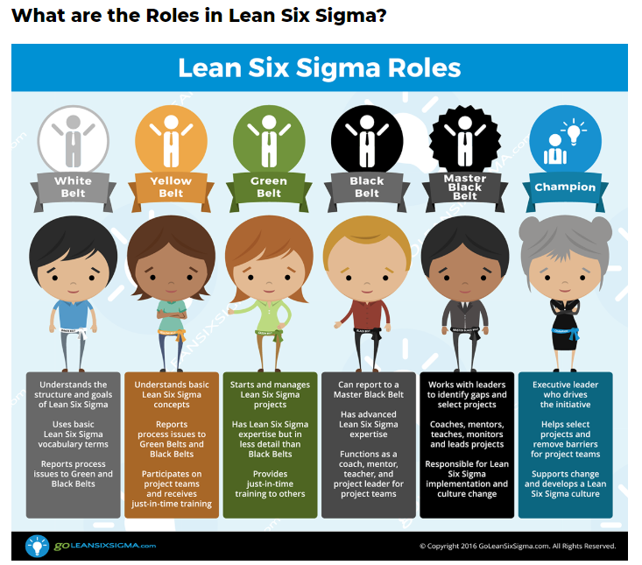

Slide 24
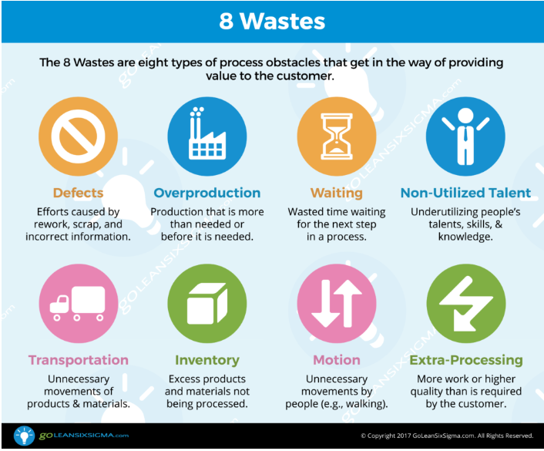
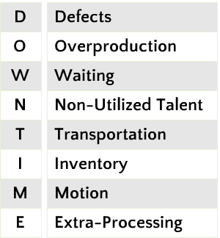

Slide 25

ACTIVITY: LEAN SIX SIGMA GAMES
Game 1 – Cross Your Arms
Game 2 – Change Your Seat
Game 3 – Tennis Ball Game

Slide 26
CASE STUDY: BUCKEYE TECHNOLOGIES
Buckeye Technologies is a manufacturer of semiconductors for mobile consumer electronic devices, such as laptop computers, smart phones, and digital cameras. Ms. Sabina Norton has been working at Buckeye Technologies for about a year as a production manager.
The volatile demand of the semiconductor industry has been an obstacle in designing an accurate production schedule. The unstable demand causes the company to carry high amounts of safety stock and incur other types of wastes. Sabina is wondering if the operation can be modified to become more efficient.

Slide 27
CLA Review
Module 6 – Quality Control Principles

Slide 28
What is Quality Control?
Basic Quality Objectives of Handling of Material:
Accurate
On-Time
Damage-Free
Quality Control – process used to ensure that products meet or exceed customer expectations and are delivered on-time and without damage
Quality Planning – designing a process that is capable of meeting quality standards
Quality Improvement – finding a better way to meet customer needs

Slide 29
Quality Control Systems
Lean – practice that seeks to eliminate waste – reduce inventory, reduce waste, reduce mistakes
Six Sigma – business management strategy developed by Motorola
  Must produce no more than 3.4 defects per million
  DMAIC – define, measure, analyze, improve, and control
Total Quality Management (TQM) – improve quality, involve everyone in organization, ensure customer satisfaction
  Kaizen – Japanese for continuous improvement
ISO 9000 – international standards that apply to design and implementation of quality systems

Slide 30
Quality Control Systems
ISO 9000 – international standards that apply to design and implementation of quality systems

Slide 31

PDCA Cycle
Plan – identify potential improvement – generate ideas
Do – implement change
Check – measure to find out whether change has accomplished objective
Act – involve everyone in process to review and implement change on large scale

Slide 32
Types of Audits
Audit – examination of quality system by independent reviewer
Internal Audits – conducted by someone within the company
External Audits – conducted by someone outside of the company
Third-Party Audits – associated with a physical inventory process

