Slide 1
Marketing and the Supply Chain
Ms. Biba S. Kavass

Slide 2
Objectives
Students will define marketing and the role it plays in supply chain
Students will describe the core functions of marketing—focusing on channel management (distribution)
Students will examine core functions of marketing by creating a promotional and selling campaign for a new food item
Students will examine the marketing mix and the 4 P’s of marketing and utilize this information to explore the integration of product supply and demand

Slide 3
Glossary: Marketing and the Supply Chain

Slide 4
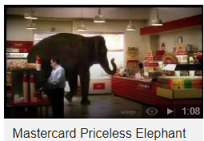
THE POWER OF MARKETING
Marketing changes how you think about things.
https://video.search.yahoo.com/search/video;_ylt=AwrE19Tm.kFbe6EA9z1XNyoA;_ylu=X3oDMTByMjB0aG5zBGNvbG8DYmYxBHBvcwMxBHZ0aWQDBHNlYwNzYw--?p=best+mastercard+priceless+commercial&fr=ush-mailn#action=view&id=10&vid=7c81b5f4c391c63f077ed99133c3b2a1
https://www.youtube.com/watch?time_continue=2&v=OAlyHUWjNjE

Slide 5
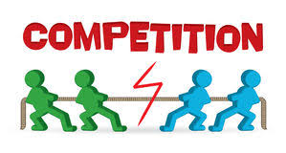
Competition Creates Marketing Opportunities
What if there were only one grocery store in your community?
What if you could buy a phone from only retailer?
What if only one dealer in your area sold cars?
Without competition, the grocer may have no incentive to lower prices. The phone shop may have no reason to offer a range of choices. The car dealer may not be motivated to keep its showroom open at convenient hours or offer competitive financing.
Competition in America is about price, selection, and service. It benefits consumers by keeping prices low and the quality and choice of goods and services high. Competition also encourages businesses to offer new and better products.

Slide 6
DEFINITION OF MARKETING
“Marketing is the activity, set of institutions, and processes for creating, communicating, delivering, and exchanging offerings that have value for customers, clients, partners, and society at large.”
(American Marketing Association)

Slide 8
ACTIVITY: SELL YOURSELF
All of us project an image that we want the world to see. What image do you want to project?
Directions: Sell yourself to the class by writing 1-2 paragraphs about who you are. You will then have 1 minute to present your summary to the class.

Slide 9
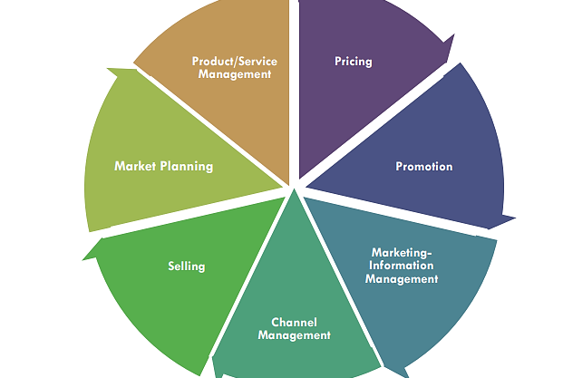
Core Functions of Marketing

Slide 10
Activity: Core Functions of Marketing
Directions:
Describe each core function of marketing and provide 2 examples of a task for each
Summarize how utilizing the core functions of marketing can lead to success in the marketplace
Label each core function of marketing on the Lemonade supply chain to indicate the relationship between marketing and supply chain

Slide 11
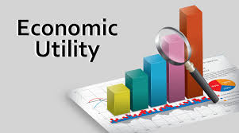
ECONOMIC UTILITY
One of the major tasks of marketing is to provide economic utility. Utility means usefulness—does the product satisfy human wants and needs.
The process of adding utility is often referred to as adding value. Adding value means enhancing a feature or service to inspire a customer to purchase.
Types of Economic Utility
Form Utility – change form to make it more useful
Place Utility – products available at convenient places
Time Utility – products made available at times that customers want them and need them
Information Utility – provides info about a product to the customer
Possession Utility – make it easier for a customer to acquire a product

Slide 12
Project: Economic Utility Storyboard
Select a specific product you plan to purchase
Go to https://www.storyboardthat.com/ and create a free account
Design a storyboard showing the 5 Economic Utilities for the purchase of that specific product (see example).
When done, SAVE your storyboard and email a copy (as an attachment) to kavasschs@gmail.com

Slide 13
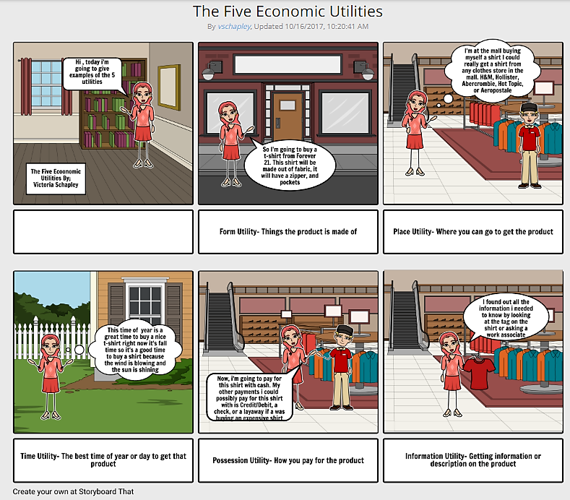
ECONOMIC UTILITY
EXAMPLE

Slide 14
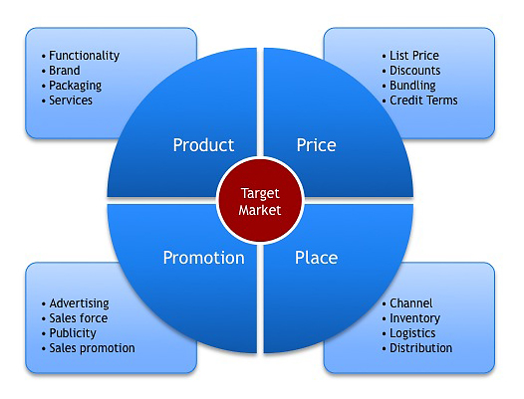
The 4 P’s of Marketing

Slide 15
Project: Marketing a New Energy Drink

Slide 16
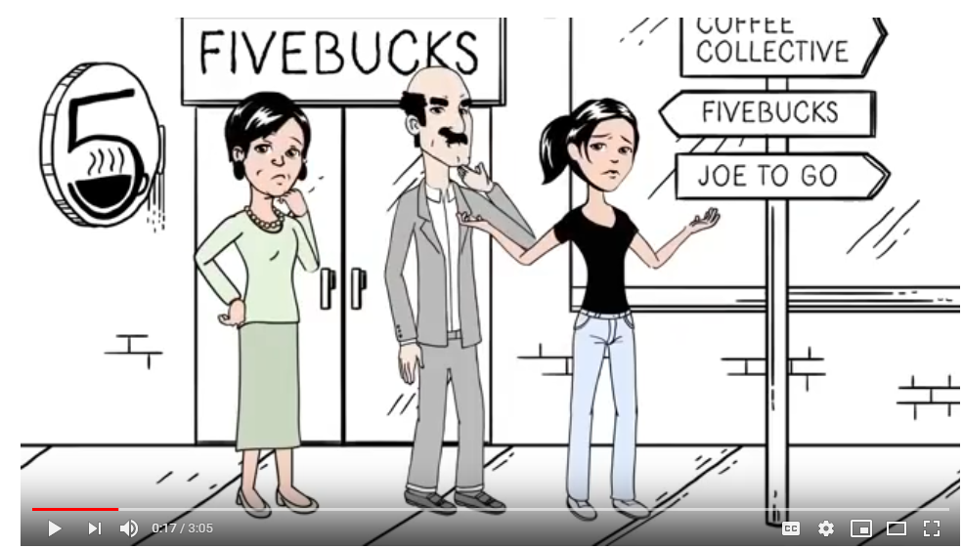
Value Creation Through the Marketing Mix
https://www.youtube.com/watch?time_continue=92&v=dNDSYW5Zu4E

Slide 17
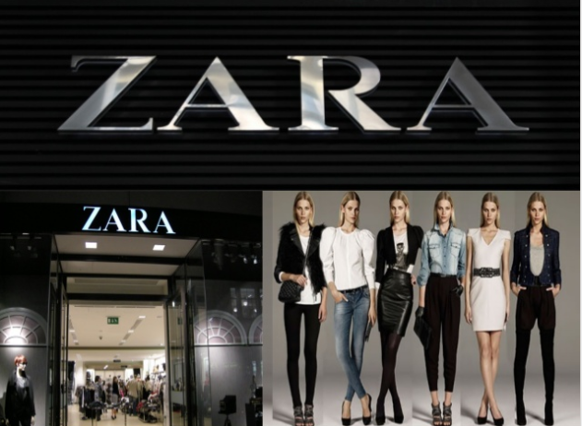
Reading: Marketing Excellence - ZARA
Directions:
If you are not familiar with the company, visit their website at https://www.zara.com/us/
Read the article
Answer the questions at the end of the article

Slide 18
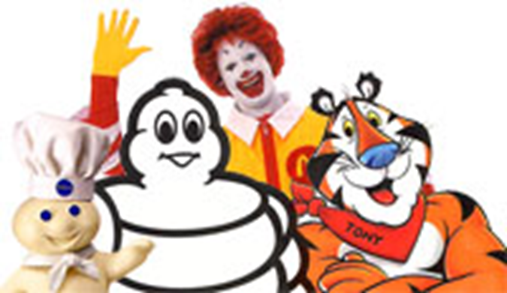
4 P’S OF MARKETING - PRODUCT
Product Planning - process of making decisions about features and benefits that will help a product be successful and about managing the product throughout its life cycle
Product Mix – all the goods and services a business sells
Ex. Grocery store carries bread, meat, fruit
Product Line – group of closely related products within the product mix
Ex. Apple carries I-Phones, I-Pads, Laptops
Product Item - specific model, color, or size of products in a line.
Select one of the ad icons in the picture and answer the following questions:
What is the name of the character?
What is the product/brand?
What is the product mix for that brand?
How will it satisfy the customers need?
What image is the product projecting?

Slide 19
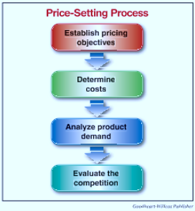
4 P’S OF MARKETING - PRICE
Price of a product:
Must cover the costs of producing and selling the product
Should generate the desired level of profit for the business
Must be what customers are willing to pay for the product
Pricing Strategies:
Value-Based Pricing – consider consumer perception about the value of the product
Premium Pricing – higher prices based on establishing products as higher in quality and value than competing products

Slide 20
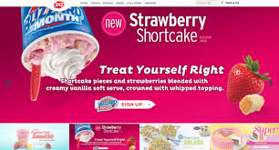
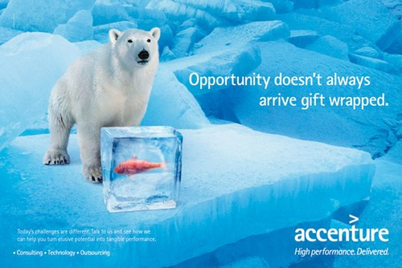
4 P’S OF MARKETING - PROMOTION
Types of Promotion:
Product Promotion –
promotes specific products
Institutional Promotion - promoting the company rather than its products

Slide 21
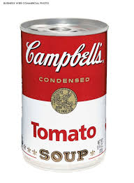
WHAT ARE THE PROMOTIONAL MESSAGES OF THESE PRODUCTS?
Notes:
Campbell Soup – Hm Hm Good
US Army – Be All You Can Be
Nike – Just Do It

Slide 22
4 P’S OF MARKETING - PROMOTION
Methods of Promotion:
Print Ads – magazines, newspapers, direct mail, billboards
Commercials – TV or radio
Social Media – Facebook, Instagram, Internet, Twitter, etc.

Slide 23
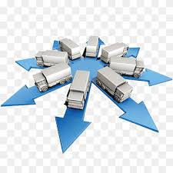
4 P’S OF MARKETING – PLACE/DISTRIBUTION
Place involves choosing the place where products are to be made available for sale. The primary motive of managing trade channels is to ensure that the product is readily available to the customer at the right time and place. It also involves decisions regarding the placing and pricing of wholesale and retail outlets.
Distribution Decisions:
Channel of Distribution
Market Coverage
Location
Logistics

Slide 24
Activity: Marketing Mix for Nike

Slide 25
Role of Marketing in Supply Chain Management
Marketing balances procurement by providing essential demand information and building the relationships that help improve the efficiency of supply chain operations. It helps companies and their partners become more focused on customers rather than on the production process.
Integration
Helps build the relationships between the channel partners through communication and support programs.
Contribution
Marketing provides information on products and availability, prices, order tracking, incentives, marketing campaigns and sales information. This increases understanding of market demand and marketing initiatives.
Growth
With the right level of market awareness, they can deliver added value and play a proactive role in providing products and services leading towards growth.
Brand
Marketing can help distribution partners benefit directly from the strength of a company brand. The brand differentiates a company from the competition when it communicates with potential customers.
Source: www.bizfluent.com

Slide 26
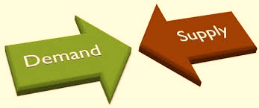
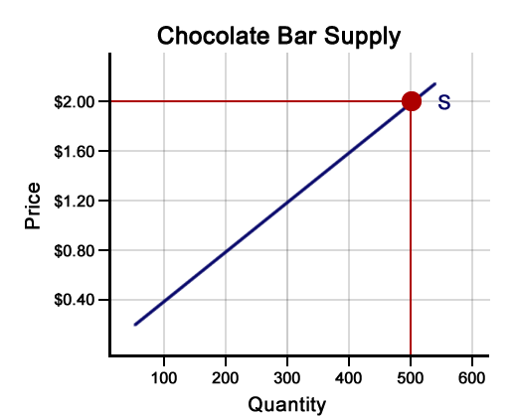
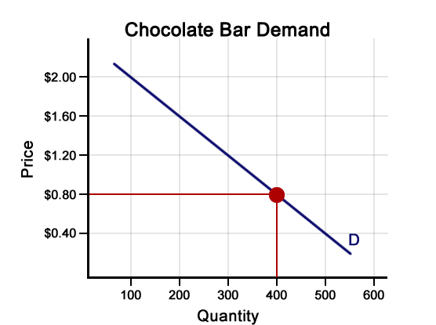
DEMAND AND SUPPLY
Demand – refers to how much (quantity) of a product or service is desired by buyers. The quantity demanded is the amount of a product people are willing to buy at a certain price. Supply represents how much the market can offer.
Supply – represents how much the market can offer. The quantity supplied refers to the amount of a certain good producers are willing to supply when receiving a certain price
https://www.econlowdown.org/supply_and_demand?module_uid=120&section_uid=291&page_num=2619&p=yes
https://www.econlowdown.org/supply_and_demand?module_uid=120&section_uid=290&page_num=2645&p=yes

Slide 27
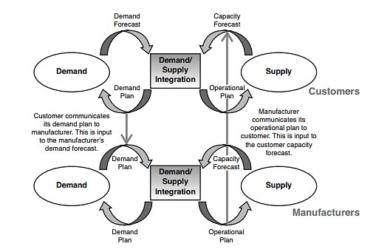
DEMAND/SUPPLY INTEGRATION ACROSS THE SUPPLY CHAIN

Slide 28
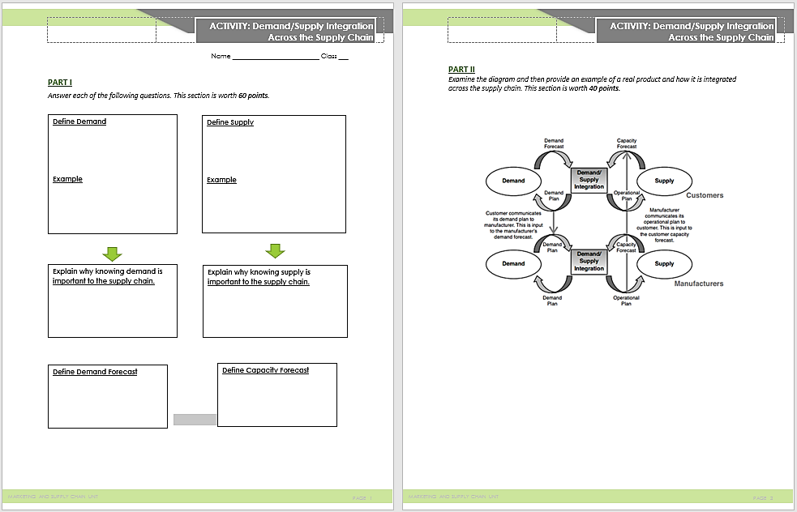
ACTIVITY: DEMAND/SUPPLY INTEGRATION

Slide 29
MARKETING DISTRIBUTION
Place = Distribution
Distribution brings the products that you want to the place where you want to buy them, at a cost that supports the customer and company price requirements.
Channel of Distribution
Path that goods take through the supply chain
Channel members are the organizations that help move products from their origination to the consumer
Channel members include producers and intermediaries
Producers – businesses that create goods or services
Intermediaries – business between the manufacturer/producer and the end user

Slide 30
FUNCTIONS OF INTERMEDIARIES
Intermediaries are important to the supply chain because they can add substantial value to a business by providing specialized services the business may not be able to afford or accomplish—increase number of consumers reached, increase market share, and help to reduce some costs by sharing responsibilities
Transactional Function
Typically the sales and marketing activities for the business—access to consumers and provide info about product
Logistical Function
Physically moving products through the supply chain—includes transportation
Facilitating Function
Involves actual selling of product or service to end users

Slide 31
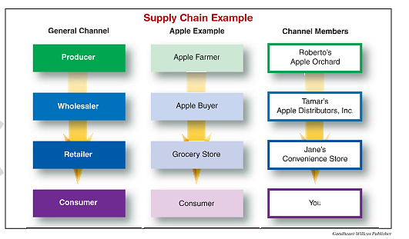
TYPES OF INTERMEDIARIES
Wholesaler or Distributor
Help move goods between producer and consumer
Retailers
Business that buys products from wholesalers or directly form producers and sells them to consumers to make a profit
Agents or Brokers
Bring buyers and sellers together—buy and sell goods for a commission and never take direct ownership of the products.
You could have bought the apple directly from the apple farmer. However, the apple buyer and the store made the apple more convenient for you to buy when you wanted it.

Slide 32
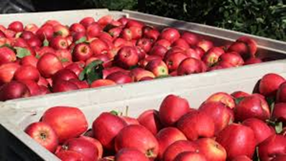
FUNCTIONS OF WHOLESALER/DISTRIBUTOR
Purchasing - purchase very large quantities of goods directly from producers or from other wholesalers. By purchasing large quantities or volumes, wholesalers can secure significantly lower prices
Warehousing and Transportation – get them to a place where they can be purchased by consumers.
Grading and Packaging - includes physically sorting, grading, and assembling the goods.
Bulk-Breaking: process of separating a large quantity of goods into smaller quantities for resale (Ex. More efficient to ship bushels of apples at one time rather than individual apples)
Marketing - fill a role in the promotion of the products that it distributes. This might include creating displays for the wholesaler’s products and providing the display to retailers to increase sales.

Slide 33
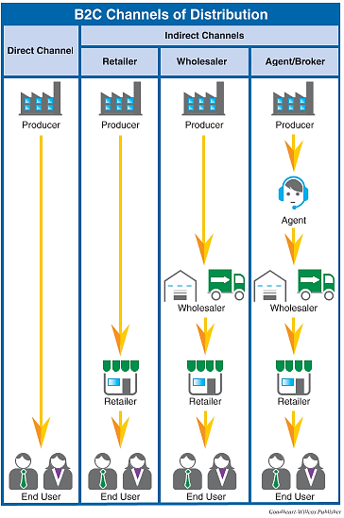
DISTRIBUTION CHANNELS
B2C = Business to Consumer

Slide 34
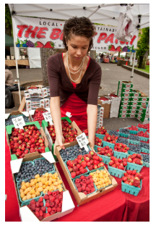
LET’S PRACTICE
Directions: Working with a partner, provide examples for each of the marketing channels for consumer products.
Marketing Channel | Example 1 | Example 2 | Example 3
Direct Channel
Retail Channel
Wholesale Channel
Agent/Broker Channel
Notes:
Direct: amazon, farmer’s market
Retail: Krogers, Walmart
Wholesale: Restaurant Food Suppliers
Agent: Real Estate, Exporter/Importer

Slide 35
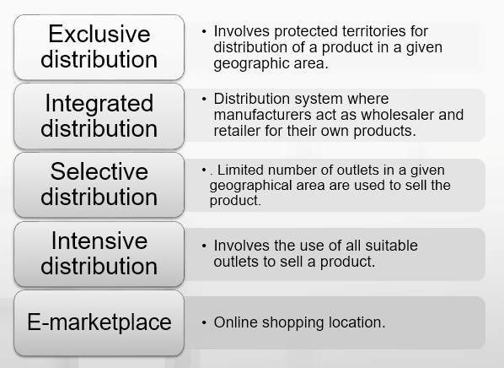
LEVELS OF DISTRIBUTION

Slide 36
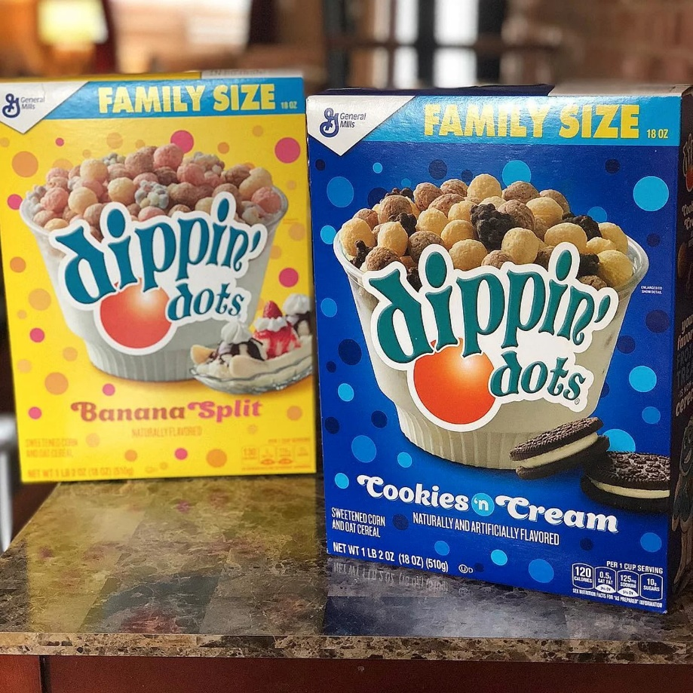
PROJECT: MARKETING DIPPIN’ DOTS CEREAL
Show Dippin’ Dots PPT

Slide 37
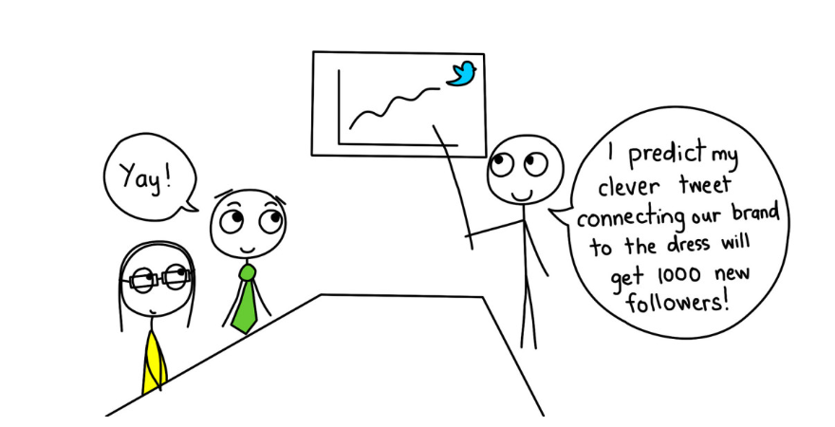
INTEGRATED MARKETING COMMUNICATION
The fourth P, promotion, focuses on communicating with target audiences about something: a product, service, organization, idea, or brand. Communication is how you let people know about your offering (product) and why it matters, how much it costs (price), and where to find it (place).
A very wide array of tools is available today to help marketers communicate with their target audiences. Selecting the right tools for the job and combining them into a successful marketing effort is a critically important task for modern marketers. In fact, it has a special name: integrated marketing communication (IMC).

Slide 38
COMMON METHODS OF MARKETING COMMUNICATION
Advertising: Any paid form of presenting ideas, goods, or services by an identified sponsor. Historically, advertising messages have been tailored to a group and employ mass media such as radio, television, newspaper, and magazines. Advertising may also target individuals according to their profile characteristics or behavior; examples are the weekly ads mailed by supermarkets to local residents or online banner ads targeted to individuals based on the sites they visit or their Internet search terms.
Public relations (PR): The purpose of public relations is to create goodwill between an organization (or the things it promotes) and the “public” or target segments it is trying to reach. This happens through unpaid or earned promotional opportunities: articles, press and media coverage, winning awards, giving presentations at conferences and events, and otherwise getting favorable attention through vehicles not paid for by the sponsor. Although organizations earn rather than pay for the PR attention they receive, they may spend significant resources on the activities, events, and people who generate this attention.
Personal selling: Personal selling uses people to develop relationships with target audiences for the purpose of selling products and services. Personal selling puts an emphasis on face-to-face interaction, understanding the customer’s needs, and demonstrating how the product or service provides value.
Sales promotion: Sales promotions are marketing activities that aim to temporarily boost sales of a product or service by adding to the basic value offered, such as “buy one get one free” offers to consumers or “buy twelve cases and get a 10 percent discount” to wholesalers, retailers, or distributors.

Slide 39
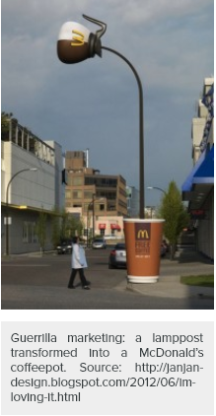
COMMON METHODS OF MARKETING COMMUNICATION
Direct marketing: This method aims to sell products or services directly to consumers rather than going through retailer. Catalogs, telemarketing, mailed brochures, or promotional materials and television home shopping channels are all common traditional direct marketing tools. Email and mobile marketing are two next-generation direct marketing channels.
Digital marketing: Digital marketing covers a lot of ground, from Web sites to search-engine, content, and social media marketing. Digital marketing tools and techniques evolve rapidly with technological advances, but this umbrella term covers all of the ways in which digital technologies are used to market and sell organizations, products, services, ideas, and experiences.
Guerrilla marketing: This newer category of marketing communication involves unconventional, innovative, and usually low-cost marketing tactics to engage consumers in the marketing activity, generate attention and achieve maximum exposure for an organization, its products, and/or services. Generally guerrilla marketing is experiential: it creates a novel situation or memorable experience consumers connect to a product or brand.

Slide 40
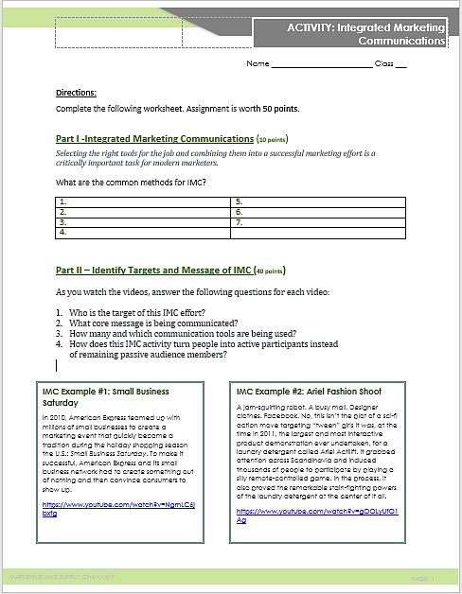
ACTIVITY: INTEGRATED MARKETING COMMUNICATIONS - EXAMPLES

Slide 41
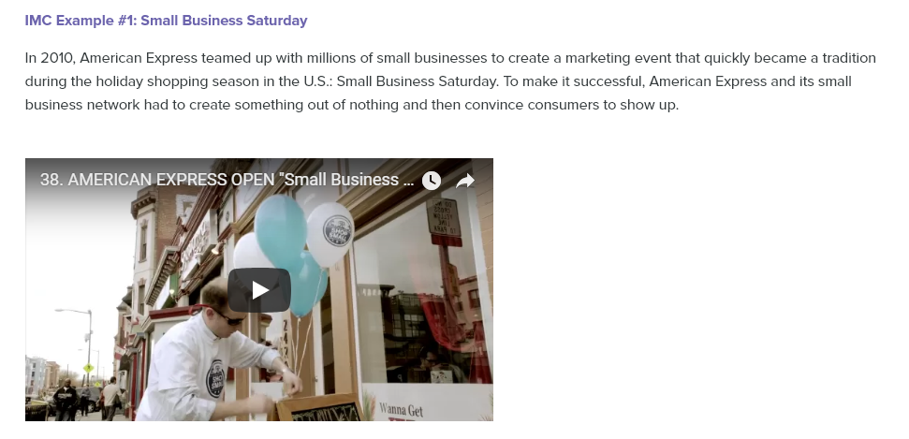
https://www.youtube.com/watch?v=NgmLC6jbxfg

Slide 42
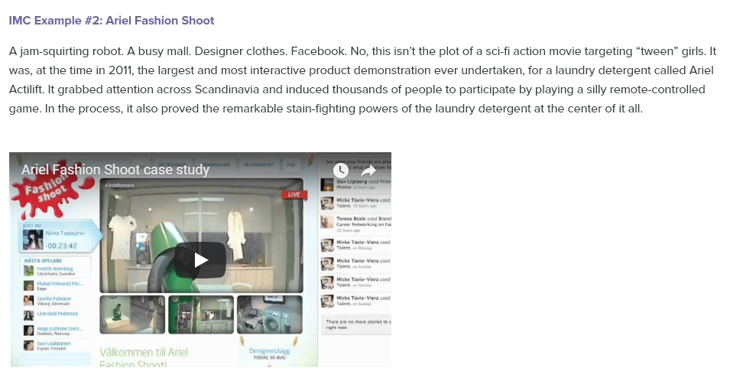
https://www.youtube.com/watch?v=gOOLyUfO1Ag

Slide 43
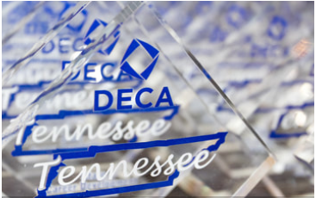
PROJECT: IMC AND DECA
Tennessee DECA prepares emerging leaders and entrepreneurs in marketing, finance, hospitality, and management.
Assignment:
Select a partner
Using various IMC methods, design and produce a marketing campaign for DECA membership at Cordova High School

