Slide 1
Project: Marketing Dippin’ Dots Cereal
Foundations of Supply Chain

Slide 2
DIPPIN’ DOTS HISTORY
The Dippin’ Dots story began more than a quarter of a century ago and continues to embody fun and excitement for fans across the globe.
In 1988, microbiologist Curt Jones used his knowledge of cryogenic technology to invent Dippin’ Dots – an unconventional ice cream treat that’s remarkably fresh and flavorful, introducing the world to beaded ice cream.
Dippin’ Dots Ice Cream proved to be irresistibly fun to eat. In the late 80’s and early 90’s the Dippin’ Dots dealer network began, and various theme and amusement parks discovered their customers’ love for the exciting new ice cream. In 1995 Dippin’ Dots were first introduced to an international market, making their debut in Japan. In 2000, the company’s dealer network evolved into what is now an award-winning franchise system with locations coast-to-coast. Today Dippin’ Dots can be found in more than 100 shopping centers and retail locations and in more than a thousand theme parks, stadiums, arenas, movie theaters and other entertainment venues across the country.
In 2012, Dippin’ Dots was purchased by Fischer Enterprises, a family owned company that has brought renewed strength and vitality to the Dippin’ Dots business. Under the direction of president Scott Fischer, availability of Dippin’ Dots products has increased through a variety of outlets including expanded e-commerce home delivery, thousands of new locations in the drug and convenience store channel, hundreds of additional fair, festival and event locations and a new co-branded mall model with its sister popcorn franchise, Doc Popcorn.
As the company grows, so does the fan base of millions that have fallen in love with the fun and fascinating Dippin’ Dots brand. Fans of all ages are compelled to share their Dippin’ Dots experience, from their first bite to the delight in finding the next, giving Dippin’ Dots an ever expanding social and digital presence.
After nearly 30 years of business, new generations of Dippin’ Dots fans emerge –influenced by their young adult parents who grew up eating Dippin’ Dots. Now catering to a generation who does not know a world without Dippin’ Dots, the company maintains its vision – Create fun, make memories.
Dippin' Dots are made at the company's Administrative, Sales, Franchising, and production headquarters in Paducah, Kentucky

Slide 3
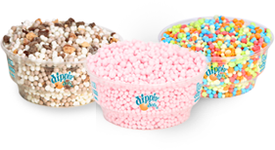
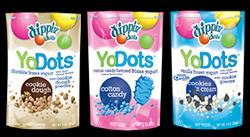
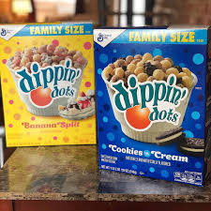
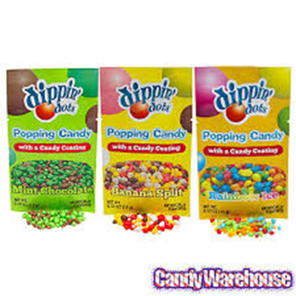
DIPPIN’ DOTS PRODUCTS
Ice Cream •Yo Dots •Cereal •Popping Candy

Slide 4
DIPPIN’ DOTS – BRAND PROMOTION
https://www.youtube.com/watch?v=qmEuUjCUI-M

