Slide 1
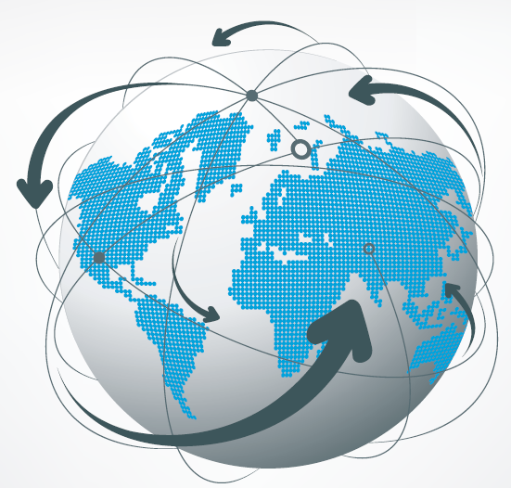
Review - Supply Chain Functions
Ms. Biba S. Kavass

Slide 2
Objectives
Students will differentiate between operations management, supply chain, and logistics Students will review foundations of supply chain management Students will examine all 7 areas of supply chain functions Students will analyze the transformation of Starbuck’s supply chain and present their findings Students will compare and contrast the four subdivisions of logistics

Slide 3
TN CTE State Standards
Logistics & Transportation #2: Research the four subdivisions of logistics in light of organizational management practices and prepare an explanatory paper or presentation that discusses the similarities and differences between the following subdivisions: a) business logistics, b) military logistics, c) event logistics, and d) service logistics. Logistics & Transportation #3: While variations exist from organization to organization, the following functions are often included under the logistics umbrella. Synthesize info from textbook(s), print, and online industry sources to describe each. Create a graphic illustrating how they interact with one another and write an accompanying explanatory narrative that indicates how each of the following affects product costs and profitability: a) transportation, b) warehouse and storage, c) intermodal freight transport, d) materials handling, e) inventory control, f) order fulfillment, g) inventory forecasting, h) production planning/scheduling, i) customer service, j) facility location, k) return goods handling, l) parts and service support, and m) salvage and scrap disposal.

Slide 4
Reading: Covid-19 Resets: Logistics Draws the Line
Opinion Essay
Utilizing information from the article, write an opinion essay on “How has Covid-19 changed supply chain and logistics?” Make sure to provide at least 3 examples from the article.
Essay must be typed in MS Word 2019 and emailed to kavasschs@gmail.com. Grading will be based on the Opinion Essay Rubric and will be worth 100 points.

Slide 5
What is the Difference?
Operations Management
Set of activities that creates value in the form of goods and services by transforming inputs into outputs
Example:
Scheduling crews for an airline
Designing a new I-Phone
Supply Chain Management
Network of manufacturers, retailers, distributors, transporters, storage facilities, and suppliers that participate in the production, delivery, and sale of a product to the consumer
Example: Supplying beet sugar from the farmer to the syrup producer to the bottler to the distributor to the store to the consumer
Logistics
Planning, execution, and control of the procurement, movement, and stationing of personnel, material, and other resources
Example: Transporting a shipment of tomatoes from California to a Kroger in Memphis

Slide 6
Supply Chain Components
Raw Materials – basic material used to produce goods
Supplier – procures raw materials
Manufacturer – converts raw materials into finished products
Distributor – moves/stores products to retailers or direct to consumers (Wholesaler – resells to retailers)
Retailer – sells final products for consumer use
Consumer – buys final products for consumption
- 3 types of Consumers – Individual, Business, and Government
Service Providers - designers, advertisers, market researchers, transport providers, etc.

Slide 7
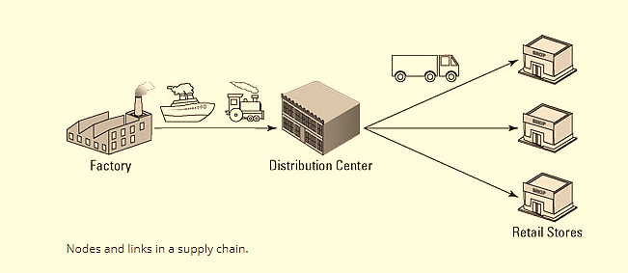
Supply Chain Nodes
Nodes – locations within the supply chain network (ex. factory, distribution center, retail store)
Links – connect the nodes through a form of transportation (air, sea, truck, or train)

Slide 8
Supply Chain Flows
Material/Product Flow – movement of goods from a supplier to the customer
Funds/Demand Flow – monies paid to all the supply chain partners that provide goods/services
Information Flow - customers place orders and suppliers provide information about the products and when they will be delivered

Slide 9
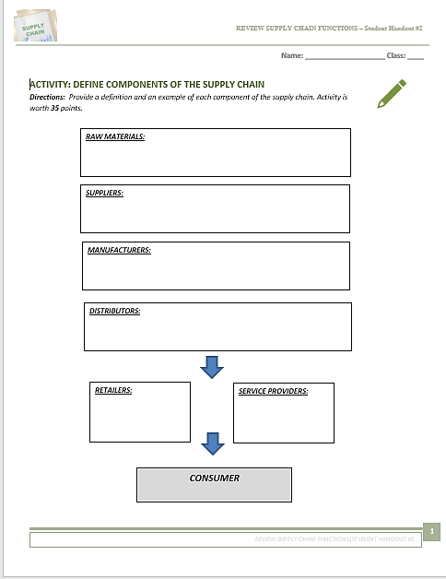
Activity – Supply Chain Review
COMPLETE:
ACTIVITY: Define Components of the Supply Chain

Slide 10
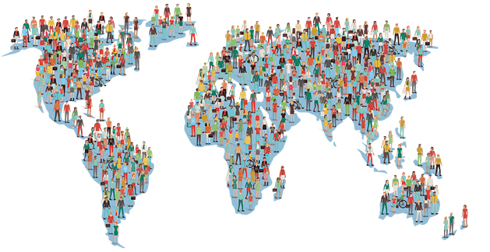
Case Study: Chocolate Bars and Population Shifts
“Tomorrow’s workers and customers will look a lot different than yesterdays. For the most part, they will be older, more urban, and more diverse. Supply chains will need to adapt to these changes appropriately. Here’s how one global candy company is doing just that.”

Slide 11
Supply Chain Functions

Slide 12
What is Demand Planning?
Demand planning is the process of planning goods, materials, and resources required for procurement and manufacturing to support the sales forecast.
Sales forecasting defines what customers will buy over a defined period, usually one year. In turn, the demand planning function defines what inventory and resources are needed to support the sales forecast.

Slide 13
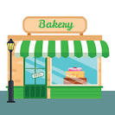
Example of Demand Planning
Example:
A commercial baker sells cakes, cookies, and breads. The company forecasts, or predicts, how many cakes and cookies its customers might purchase categorized by size and type. These quantities and variations translate into raw material requirements and other resources needed to manufacture finished products.
The forecasting part in this example is the finished products of cakes, cookies, and breads, and the demand plan defines the ingredients, ovens, mixers, and equipment used, as well as the number of people preparing the baked goods

Slide 14
CPFR – Collaborative Planning, Forecasting, and Replenishment
Set of business processes, backed up by information technology, in which supply chain partners agree to:
Mutual business objectives and measures
Develop joint sales and operational plans
Collaborate to generate and update sales forecasts and replenishment plans.
Benefits:
More effective inventory management
Improved customer service
Improved profitability

Slide 15
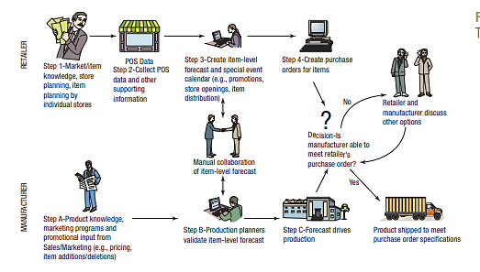
Example – CPFR Approach

Slide 16
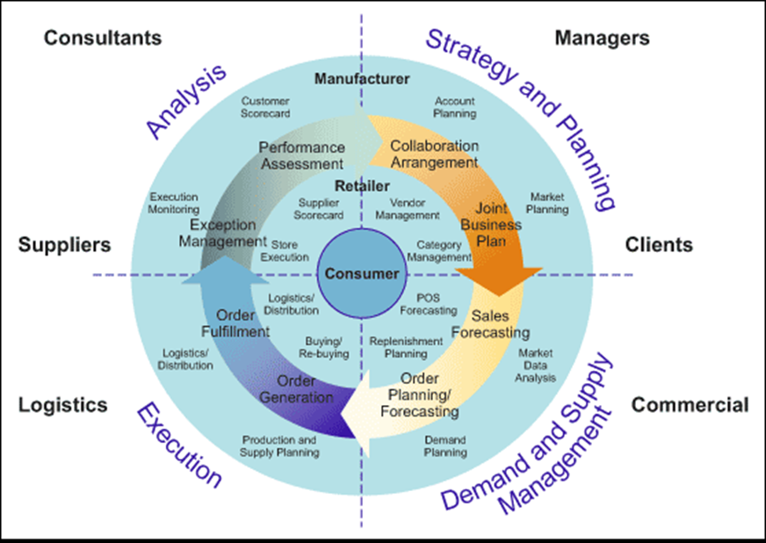
Activity: CPFR Worksheet
Complete the worksheet for CPFR

Slide 17
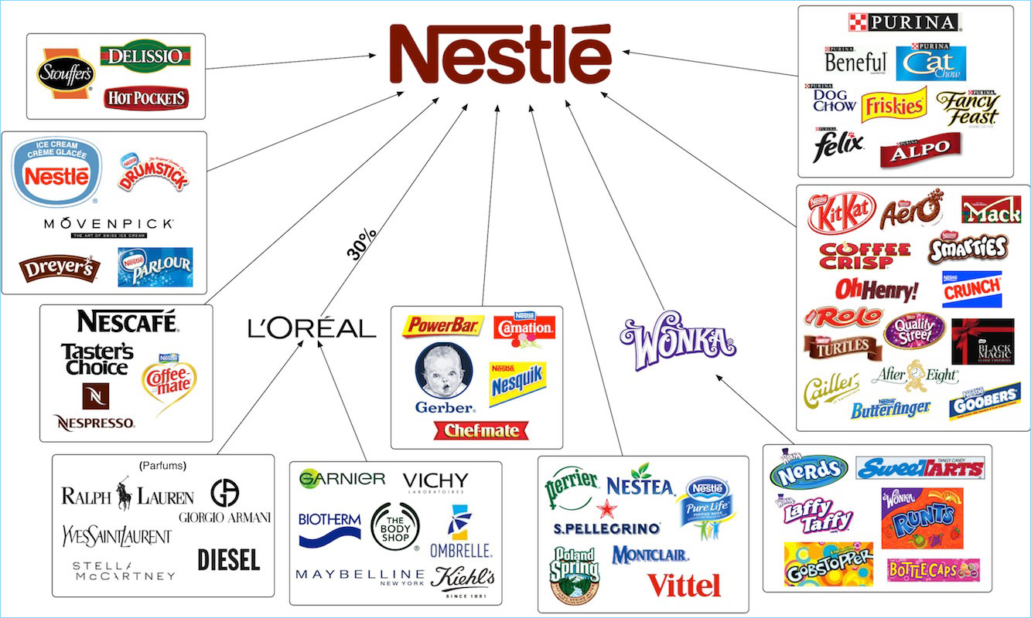
Nestle Demand Planning
https://www.youtube.com/watch?v=CBLk4_0YQnI

Slide 18
What is Forecasting?
Forecasting is the art and science of predicting future events.
Methods:
taking historical data (such as past sales) and projecting them into the future with a mathematical model
It may be a subjective or an intuitive prediction (e.g., “this is a great new product and will sell 20% more than the old one”).
It may be based on demand-driven data, such as customer plans to purchase, and projecting them into the future.
Forecasting Steps:
Determine the use of the forecast
Select the items to be forecasted
Determine the time horizon – Is it short, medium, or long term?
Select the appropriate forecasting model
Gather the data needed to make the forecast
Make the forecast
Validate and implement the results

Slide 19
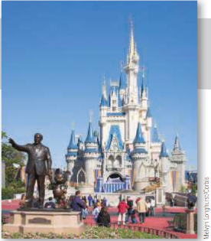
PRACTICE:
Read over the information on “Forecasting at Disney World”
Provide an example from the reading of each of the 7 forecasting steps.

Slide 20
Practice Answer Key – Forecasting at Disney World
Determine the use of the forecast: Disney uses park attendance forecasts to drive decisions about staffing, opening times, ride availability, and food supplies.
Select the items to be forecasted: For Disney World, there are six main parks. A forecast of daily attendance at each is the main number that determines labor, maintenance, and scheduling.
Determine the time horizon of the forecast: Is it short, medium, or long term? Disney develops daily, weekly, monthly, annual, and 5-year forecasts.
Select the forecasting model(s): Disney uses a variety of statistical models that we shall discuss, including moving averages, econometrics, and regression analysis. It also employs judgmental, or nonquantitative, models.
Gather the data needed to make the forecast: Disney’s forecasting team employs 35 analysts and 70 field personnel to survey 1 million people/businesses every year. Disney also uses a firm called Global Insights for travel industry forecasts and gathers data on exchange rates, arrivals into the U.S., airline specials, Wall Street trends, and school vacation schedules.
Make the forecast.
Validate and implement the results: At Disney, forecasts are reviewed daily at the highest levels to make sure that the model, assumptions, and data are valid. Error measures are applied; then the forecasts are used to schedule personnel down to 15-minute intervals.

Slide 21
Forecasting Approaches
Quantitative Forecasts
Forecasts that employ mathematical modeling to forecast demand.
Examples:
Moving Averages - uses a number of historical actual data values to generate a forecast - useful if we can assume that market demands will stay fairly steady over time
Exponential Smoothing - latest estimate of demand is equal to the old forecast adjusted by a fraction of the difference between the last period’s actual demand and last period’s forecast – involves very little recordkeeping of past data
Qualitative Forecasts
Forecasts that incorporate such factors as the decision maker’s intuition, emotions, personal experiences, and value system.
Examples:
Jury of executive opinion
Sales force composite
Market survey

Slide 22
Supply Management and Procurement

Slide 23
SCM Activities
SCM takes into consideration activities involved in confirming that products from the raw material stage are turned into finished products and delivered to customers.
These activities include:
• Sourcing of raw material and parts
• Manufacturing and assembling
• Warehousing and controlling inventory
• Entering and managing orders
• Finishing, customizing, and packaging
• Distributing across all channels
• Delivering to final customers
• Managing relationships with suppliers
• Managing relationships with customers
• Maintaining the information systems necessary to monitor the above activities

Slide 24
Procurement Process
Procurement personnel receive requirements on purchase requisitions, solicit suppliers for pricing and delivery, evaluate supplier responses using an evaluation process, negotiate to achieve best value, and make awards by issuing POs. POs are a company’s authorizing documents and financial commitments to buy products and services.
Without linkage to the demand plan, procurement would not know what to buy and when to buy it. The demand plan considers when items are needed in inventory against the supplier’s lead time (the time it takes for a supplier to deliver goods after a PO is placed).
Procurement is a function that interacts with suppliers globally to achieve the best value for an organization. Procurement personnel must consider the benefits and risks of working with suppliers in different countries. The specific issues must be managed across different time zones and cultures, and different approaches must be used to mitigate supplier disruptions like natural disasters, embargos, strikes, currency fluctuations, and military conflicts.
Procurement personnel must also manage suppliers after awarding a PO to ensure products and services are delivered on time, at the value stated on the PO, and at the correct quality level. If suppliers are not managed and open POs are not tracked, late deliveries could cause manufacturing disruptions and even delivery delays, resulting in lost sales.

Slide 25
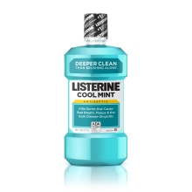
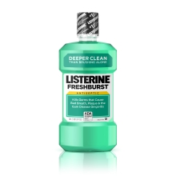
Listerine’s Supply Chain
Listerine was first formulated in 1879 as a surgical antiseptic and has been used by dentists for oral care since 1985. In 1914 it became the first over-the-counter antiseptic mouthwash. The original formula has a notoriously strong flavor, but it was almost 80 years before new variations were introduced. Then in 1992 Cool Mint Listerine was introduced, followed by FreshBurst in 2003—and now there are eight different versions, marketed under the slogan “Kills germs that cause bad breath.”
The ownership of Listerine has changed several times. Most recently it was owned by Pfizer’s consumer healthcare division until this was taken over by Johnson and Johnson in December 2006.

Slide 26
Great Moments in Listory
https://www.youtube.com/watch?v=nqyJ1OL2IYs

Slide 27
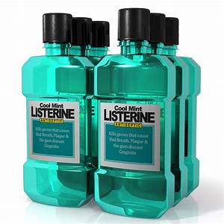
ACTIVITY: Map Listerine Supply Chain
Directions: Using MS Word, map the supply chain flow for Listerine from raw materials to consumer. Make sure to indicate what TIER your suppliers are.
Australian farmers grow eucalyptus, harvest the leaves and send them to processing company to extract the oil.
The eucalyptus oil is then sold to distributors and on to one of Johnson & Johnson’s manufacturing plants in Texas.
Natural gas is drilled in Saudi Arabia.
Union Carbide buys liquid gas and processes it into alcohol, which is shipped to the manufacturing plant in Texas.
Farmers in the U.S. Midwest harvest corn.
The corn is processed to make Sorbitol which both sweetens and adds bulk to the mouthwash.
Sorbitol is sent to the manufacturing plan in Texas.
The manufacturing plant collects all of these ingredients and produces the Listerine.
The mouthwash is packed and sent to wholesale distributors or directly to retail outlets.
(Sources: Website at www.listerine.com, 2008; Kalakota, R. and Robinson, M. (1999) e-Business, roadmap for success, Addison Wesley, Reading, MA)

Slide 28
Supply Chain - Listerine

Slide 29
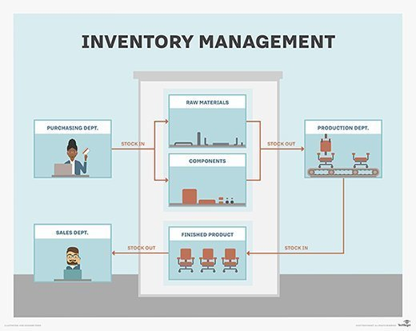
Inventory Management

Slide 30
Definition – Inventory Management

Slide 31
Warehousing Operations

Slide 32
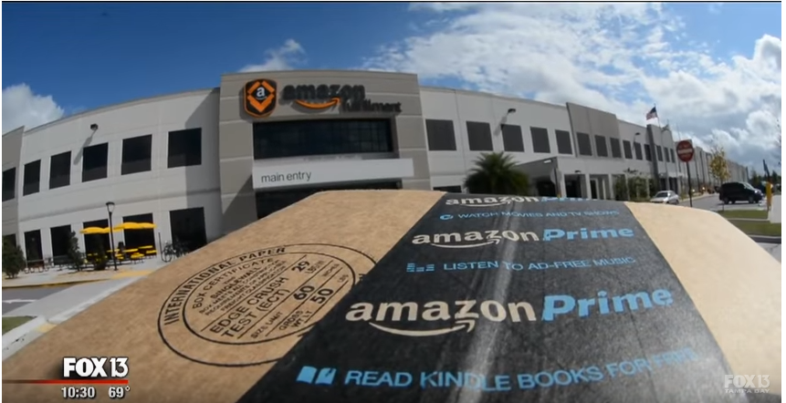
Warehousing Operations
Warehousing personnel perform the receipt, storage, retrieval, and distribution of procured goods and materials. Initially, goods and materials are received from suppliers into a warehouse by warehousing personnel who unload trucks, inspect items to ensure there is no product or shipping damage, and process the items (now formally part of inventory) to a storage location until they are needed. Once there is a demand for the stored inventory, warehousing personnel retrieve or pick the inventory and deliver it to the intended destination, such as manufacturing for assembly.
https://www.youtube.com/watch?time_continue=78&v=Y-lBvI6u_hw

Slide 33
Manufacturing and Service Operations
Manufacturing organizations convert raw materials and other procured items into final products that can be delivered to a customer. In order to fabricate products in a manufacturing organization, there must be an accurate sales forecast that is converted into a demand plan; those requirements are sent to procurement to obtain raw materials, equipment, space, and other resources.
Manufacturing is dependent on demand planning to schedule the assembly work, on procurement to buy needed items, on the warehouse to deliver items for assembly, and on inventory management to ensure the right items are available at the right time.
Service operations personnel are responsible for products that require routine maintenance, repairs, and warranty work. For example, if an automobile is recalled or needs repair or periodic maintenance, it is not sent back to the factory where it was assembled; instead, there is a separate dealer network of authorized service operations centers.

Slide 34
Manufacturing and Service Operations

Slide 35
Activity: Assembly Line Production
Instructions:
Divide class into groups of 4 people – select a team captain
Form an assembly line to make peanut butter and jelly sandwiches – make sure to discuss the most efficient way to setup your assembly line
You will have 60 seconds to make as many PBJ sandwiches as your team can (sandwiches must be sliced in half and stacked on the plate)
The team that makes the most sandwiches (correctly) wins

Slide 36
Transportation Operations

Slide 37
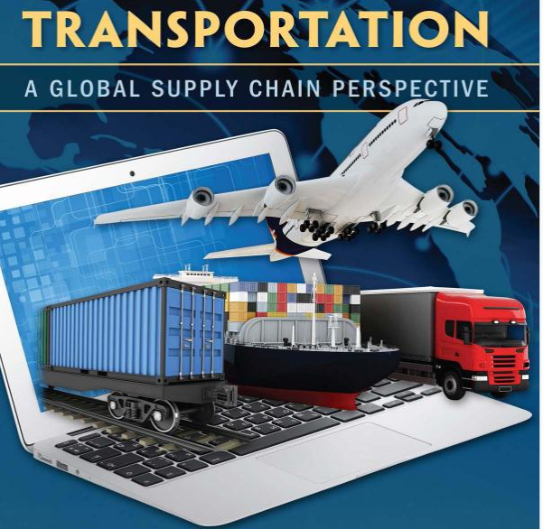
Transportation Operations
Primary Modes of Transportation:
Air
Rail
Water
Road
Pipeline

Slide 38
Transportation Operations
Transportation operations involve ensuring the flow of inventory from points of origin in the supply chain to points of use and consumption.
The three primary components in transportation operations are inbound, outbound, and reverse logistics.
Inbound logistics supports the procurement of materials and goods from supplier locations.
Outbound logistics supports the distribution of materials and goods to customer locations.
Reverse logistics supports product returns, recycling, reuse of materials, and waste disposal.

Slide 39
Transportation: Distance, Rate and Time
Anticipatory Set:
You are shipping a container with about 30,000 tennis shoes from Hong Kong to Long Beach. When are your shoes going to arrive in Long Beach?
As long as you know distance and rate of speed for the ship, you can figure out when the shoes are expected to arrive.
Formula:
Distance: Rate x Time

Slide 40
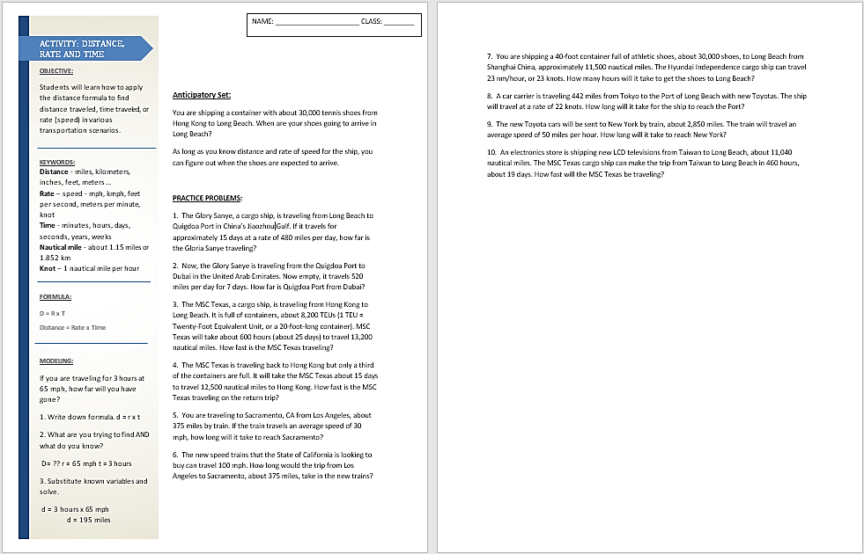
Activity: Distance, Rate and Time

Slide 41
Customer Service Operations

Slide 42
Customer Service Operations
Customer service is essentially the delivery of customer satisfaction and covers all aspects of the supply chain.
Customer service focuses on identifying and meeting customers’ needs, wants, and expectations before, during, and after they buy products.
Customer service also interfaces with operations, warehousing, and inventory, which assist in ensuring customers receive products when they need or want them while simultaneously managing inventory to control costs.

Slide 43
Dimensions of Customer Service
Time – period between successive events
Order Cycle – time between placing one order and then the next order
Dependability – reliability of service encounter – consistent order cycles, safe delivery, and complete delivery

Slide 44
Dimensions of Customer Service
Communication – to be effective must be two-way exchange between seller and customer
Convenience – ease of doing business with a seller
Multichannel Marketing System – separate marketing channels to serve customers
Brick and Mortar Store
Online Ordering – Website
Omnichannel Marketing System – place order online and then pickup in store

Slide 45
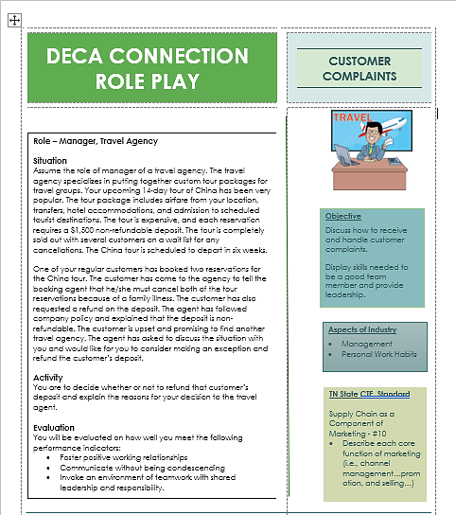
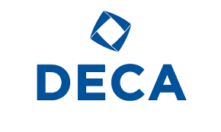
ROLE PLAY: Receive and Handle Customer Complaints

Slide 46
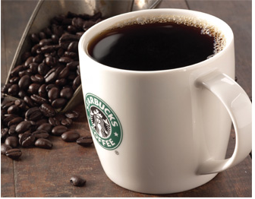
PROJECT: MAPPING THE SUPPLY CHAIN OF STARBUCKS COFFEE
From Bean to Cup: How Starbucks Transformed its Supply Chain

Slide 47
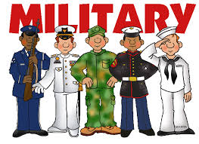
PROJECT: Compare and Contrast Subdivisions of Logistics
Reading: Combat Cargo: The Challenges of Military Logistics

