Slide 1
Social Responsibility and Ethics Ms. Biba S. Kavass

Slide 2
Objectives
Explain the concept of social responsibility as a component of business
Understand what is meant by business ethics
Identify the types of ethical concerns that arise in the business world
Discuss the factors that affect the level of ethical behavior in organizations
Examine codes of conduct and their role in adhering to social responsibility and ethical behavior

Slide 3
TN CTE State Standards
Social Responsibility and Ethics - #23
Research the concept of social responsibility and ethics as important components in business. Develop a hypothesis for why businesses must increasingly consider their impact on society when making decisions. Then, attend a local business-sponsored community service event or explore case studies illustrating the social responsibilities of today’s businesses. Write a reflection paper summarizing observations; specifically, evaluate how businesses benefit from engaging in responsible business practices, including benefits to the community, the environment, the marketplace, and the business/workplace itself.

Slide 4
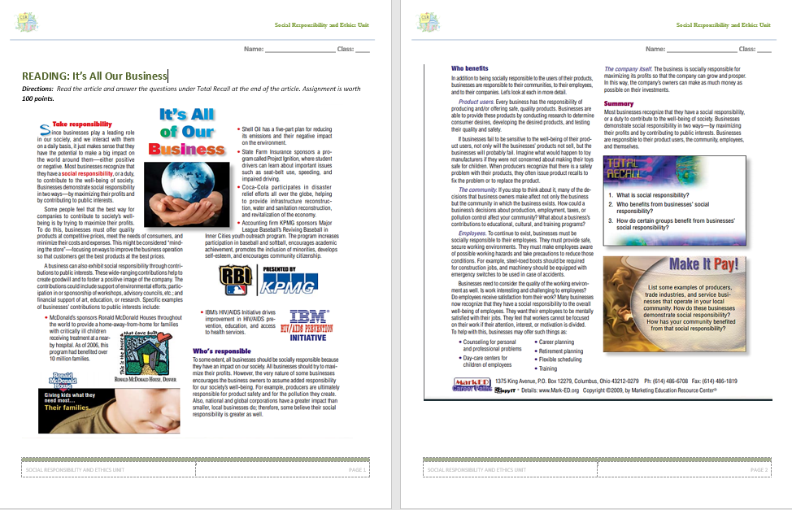
Reading: It’s All of Our Business

Slide 5
Social Responsibility
Recognition that business activities have an impact on society and the consideration of that impact in business decision making
Sustainability - meeting the needs of the present without compromising the ability of future generations to meet theirs
Corporate Citizenship – adopting a strategic approach to fulfilling economic, ethical, environmental, and social responsibility

Slide 6
https://www.ispot.tv/ad/nod_/subaru-never-been-more-true-t1

Slide 7
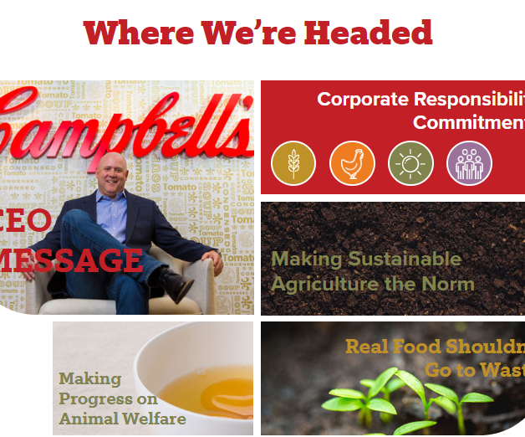
Campbell Soup – Corporate Responsibility
https://www.campbellcsr.com/home.html

Slide 8
Business Responsibilities to the Public
Consumerism – all activities undertaken to protect the rights of consumers
Basic Rights of Consumers:
Right to Safety
Right to be Informed
Right to Choose
Right to be Heard

Slide 9
Activity: What Responsibilities Do the Following Companies have to Consumers?
E-Cigarettes
Diet Pills
Fast Food
Vitamins
Red Bull – Energy Drinks

Slide 10
Definition of Business Ethics
Application of moral standards to business situations
Right and wrong

Slide 11
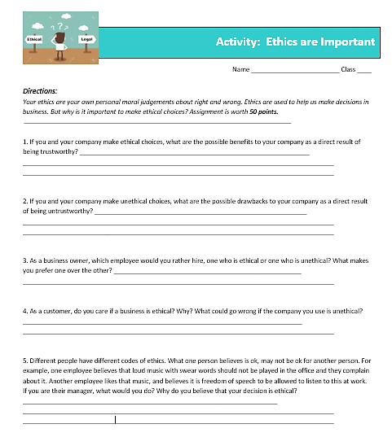
Activity: Ethics are Important
Your ethics are your own personal moral judgments about right and wrong. Ethics are used to help us make decisions in business. But why is it important to make ethical decisions?

Slide 12
Understanding Business Ethics
http://bizkids.com/clip/profile-hacker-cracker

Slide 13
Factors Affecting Ethical Behavior
Individual – personal knowledge, value, and goals
Social – cultural norms, attitudes, and social media
Opportunity – amount of freedom provided

Slide 14
Activity: Match the Terms
Notes:
Reputation, Unethical, Values, Trust, Guilty, Role Model, Honest

Slide 15
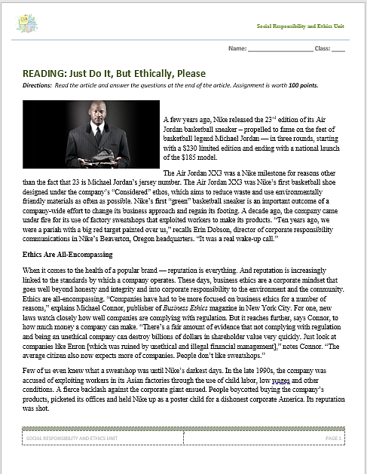
Reading: Just Do It, But Ethically, Please

Slide 16
Ethical Issues
Fairness and Honesty
Organizational Relationships
Conflict of Interest
Communications

Slide 17
Fairness and Honesty
Obey all laws and regulations
Refrain from knowingly deceiving, misrepresenting, or intimidating others
Activity:
Take the Ethics Poll Questionnaire
Compare your answers to others in class
Write a conclusion statement on what the poll shows in general about fairness and honesty in the workplace

Slide 18
Organizational Relationships
Unethical behavior in this area includes:
Taking credit for others’ ideas or work
Plagiarism – knowingly taking someone else’s words, ideas, or other original material without acknowledging the source
Not meeting one’s commitments in a mutual agreement
Pressuring others to behave unethically

Slide 19
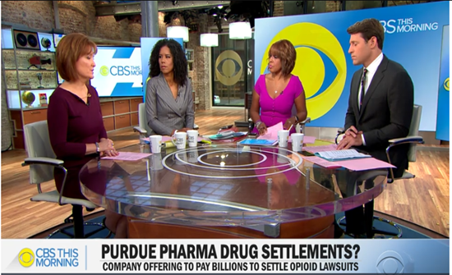
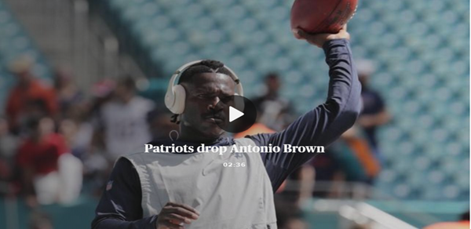
Organizational Relationships
https://www.cbsnews.com/news/purdue-pharma-sackler-family-wealth-where-did-the-sacklers-shift-cash-from-opioid-maker/

Slide 20
Conflict of Interest
Results when a businessperson takes advantage of a situation for his or her own personal interest rather than for the employer’s interest
Examples – bribes, gifts, or favors

Slide 21
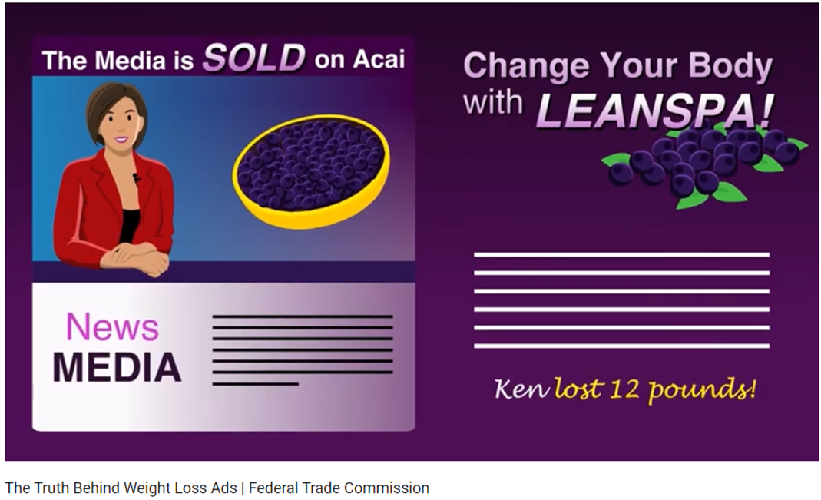
Communications
False and misleading advertising
https://www.youtube.com/watch?v=8nvVcmXtEeE&feature=youtu.be

Slide 22
Government’s Role in Encouraging Ethics in Business
Sarbanes-Oxley Act of 2002 – protection for employees who report corporate misconduct – protects whistle-blowers
Whistleblower Protection Act of 1989 – protects federal employees who report misconduct

Slide 23
Code of Ethics/Conduct
Written guide to acceptable and ethical behavior as defined by an organization
Outlines:
Uniform policies
Standards
Punishments for violation

Slide 24
Activity: Code of Conduct Role Play – Questions to Consider
Directions:
Divide into groups of 2 – read each scenario and answer the questions below for each scenario. Your group will be called on to role-play one of the scenarios of your choosing to the class (role-play must include the answers to the questions below for that scenario). Each scenario is worth 20 points. Role-play is worth 20 points. Total of 100 points.
During the group brainstorming portion of each role-playing scenario, discuss the following questions:
What are the possible choices?
Is there a right or wrong choice?
What are possible consequences of each choice?
Who will be affected by each choice?
Would I feel guilty because of any of the choices?
Would any of the choices embarrass me if others found out?
Do I have an obligation or duty to make a certain choice or to report the situation?
If there are negative consequences for doing the right thing, how can I face them in a strong, positive way?

Slide 25
Activity:
Go to bkavass.weebly.com and pull-up the Nike Code of Ethics
Go to the Table of Contents on page 4 and choose one section to examine
Write a summary on the section that you choose

Slide 26
Activity: Your Own “Code of Conduct”
Directions:
Write your personal code of ethics/conduct for living your life. You must have at least 5 maxims.
Each section is worth 5 points for a total of 25 points.

Slide 27
Concept Check
When a company acts in an ethically questionable manner, what types of problems are caused for the organization and its customers?
How can an employee take an ethical stand regarding a business decision when his or her superior already has taken a different position?
To what extent should climate change be shared by manufacturers, consumers, and government?

Slide 28
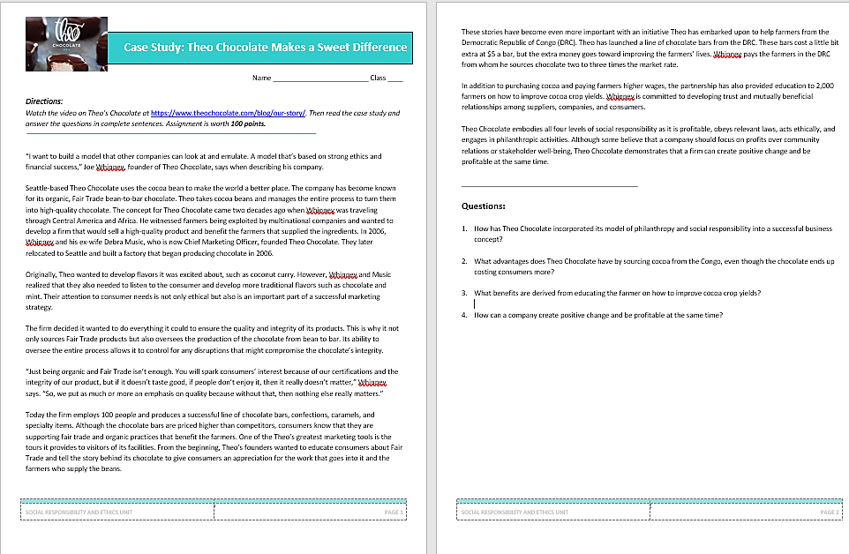
Case Study: Theo Chocolate Makes a Sweet Difference

Slide 29
DECA Connection Role Play – Business Ethics
Role – Director of Marketing and Brand Management
You are to assume the roles of Director of Marketing and Brand Management for Celebration Resorts, a chain of hospitality resorts with two domestic locations and five international locations. The Senior Vice President has asked you to analyze the final product of a hired social influencer and determine how the company should proceed.

