Slide 1
Soft Skills Self-Esteem

Slide 2
Objectives
Define self-esteem
Recognize the importance of having a healthy self-esteem
Learn ways to boost your self-esteem
Differentiate between image and self-image

Slide 3
BIG CONCEPT
When you picture yourself in your mind, what do you see?
Do you feel good about who you are, how you see yourself, and how others see you?
________________________________
Feeling good about yourself affects how you act and live.

Slide 4
SELF-ESTEEM
Definition - confidence in one's own worth or abilities; self-respect.
What are some other words that represent self-esteem?
_________________________
_________________________
_________________________

Slide 5
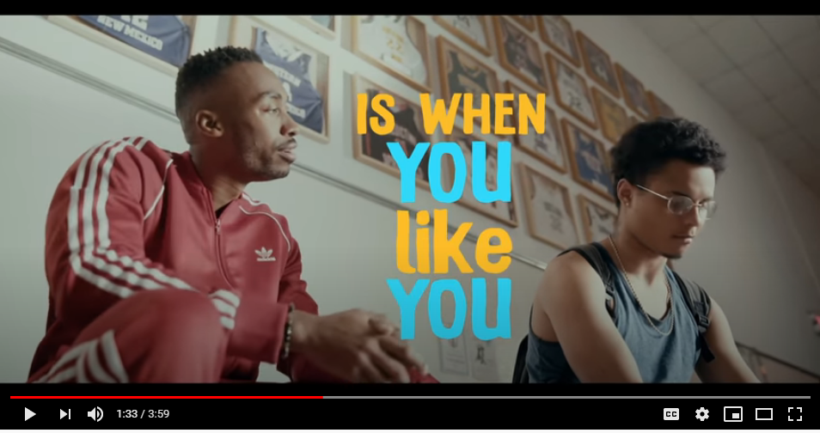
Quotations are commonly printed as a means of inspiration and to invoke philosophical thoughts from the reader.
https://www.youtube.com/watch?v=UB7nGT3egak

Slide 6
Self-Esteem Matters
Self-esteem helps you. It gives you the courage to try new things. Or make new friends. With self-esteem, you believe in yourself. You know that good things can happen when you try. Self-esteem helps you when things don't go your way. It helps you accept mistakes. If you miss the soccer goal or lose a library book, you don't get too mad at yourself. You just try again. You find a way to do better.
Low self-esteem can hurt you. It makes kids feel unsure. They don't think they can do things well. With low self-esteem, kids might not try. They might not go after their goals. They might be afraid to fail. Low self-esteem makes losing seem worse than it is. It makes mistakes seem bigger than they are. It makes it hard to get over things that don't go well. Instead of trying again, kids with low self-esteem might give up.
You can build your self-esteem. Self-esteem can start with things parents say when a kid is very young. A parent might tell a baby, "Look what you can do — you're walking all by yourself!" Being told good things makes the baby feel proud and feel good. As you get older, self-esteem can grow. Parents and teachers can let you know they see good things in you. Friends can help you feel liked. You can build your own self-esteem too. Notice when you try new things. Notice when you learn to do something. Did you try a new sport? Did you learn to ride a bike, play a song, or do a math problem? Be happy and proud. You don't have to brag out loud, but you can give yourself a quiet little high-five. Yay, you!

Slide 7
Self-Esteem: Feel good about yourself
Teens with Self-Esteem
feel proud of what they can do
see the good things about themselves
believe in themselves, even when they don't do well at first
feel liked and accepted
accept themselves, even when they make mistakes
Teens with Low Self-Esteem
don't think they are as good as others
don't feel liked or accepted
think more about the times they fail, than the times they do well
don't notice the good things about themselves
are hard on themselves and give up easily

Slide 8
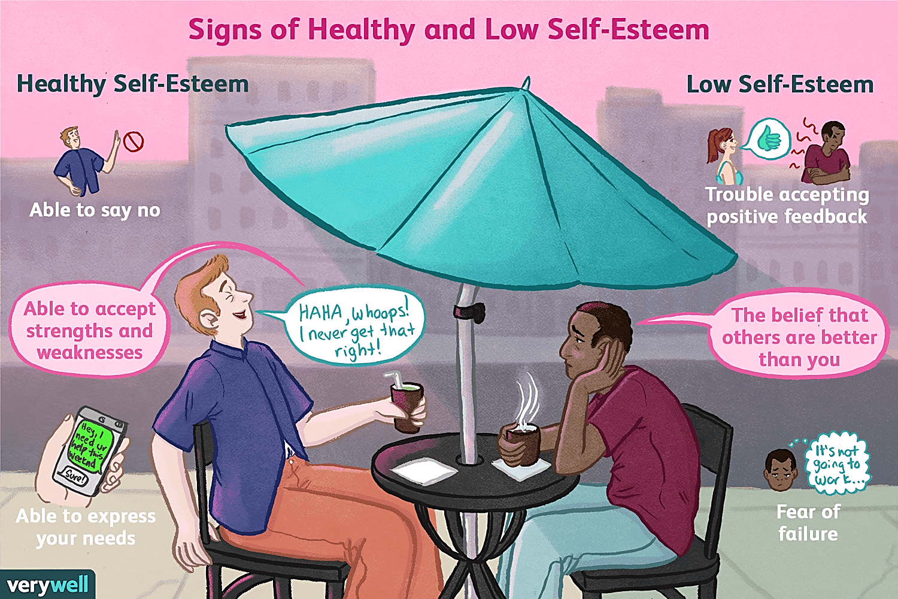

Slide 9
HOW’S YOUR SELF-ESTEEM?
Take the Quiz on Self-Esteem at https://teenshealth.org/en/teens/self-esteem-quiz.html?ref=search#catbest-self
Reflect on the insight provided throughout the quiz

Slide 10
PEOPLE WITH HIGH SELF-ESTEEM
Do better in school
Have an easier time making friends
Have better relationships with adults and peers
Are more likely to stick with something until they succeed
Feel more control of their lives
Find it easier to deal with disappointment
Enjoy life more
Activity:
Think of someone you admire who has high self-esteem.
What qualities about that person’s self-image impress you?
How do you think that person developed high self-esteem?

Slide 11
PROJECT: Self-Esteem Hotline
Directions:
Today we’re going to be volunteering at the school’s Self-Esteem Hotline. Give advice to each of the callers on how to improve their self-esteem.
Remember: A positive attitude, healthy lifestyle choices, and a willingness to seek creative solutions make a great combination for good self-esteem.
Caller #1
“My dad is really mad at me because I got a C- in math. I usually get B’s, but I just started on the track team and I got a part-time job. Now my dad wants me to quit my job and the track team! I guess I can’t do it all. Help!” —Running Scared
Caller #2
“I tried out for the basketball team for the past 2 years and was cut both times. All my friends are on the team and now I have nothing to do after school. I used to think I was good at basketball, but I guess I really stink. Maybe I should just forget about sports.” —Sports Skunk

Slide 12
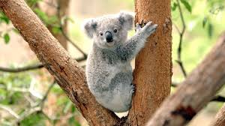
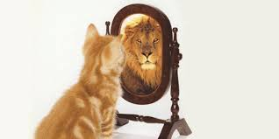
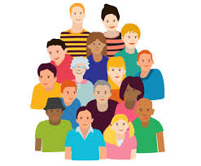
Self-Image vs. Image
Self-Image:
the idea one has of one's abilities, appearance, and personality.
Image:
the general impression that a person, organization, or product presents to the public
Question:
What animal represents your self-image?

Slide 13
Discussion Questions
What mental picture do you have of yourself? How do others perceive you? Are these perceptions similar?
What are self-image and self-esteem? How does your self-esteem develop? How does each affect the way you act and how others see and treat you?
How can having high self-esteem affect your life? How can having low self-esteem affect your life? Why do some teens have low self-esteem?
Has someone ever said something to you about the way you looked that hurt your feelings? How can family, friends, classmates, and teachers influence a person’s self-esteem?
Can your self-esteem change? What kinds of things can you do to improve your self-esteem?

Slide 14
It’s not who you are that holds you back, it’s who you think you’re not!

Slide 15
Take IBM-Quiz on Self-Esteem on www.quizizz.com

