Slide 1
Supply Chain Trends - Blockchain
Supply Chain I

Slide 2
Objectives
Explore concept of blockchain
Determine the key elements of blockchain
Analyze the benefits of blockchain
Examine how blockchain can be used in the supply chain to provide transparency
Create a presentation on how Wal-Mart and IBM are using blockchain in the food industry

Slide 3
Definition of Blockchain
A blockchain is a distributed electronic ledger shared across a network of servers that records transactions in cryptographic units that are called blocks in a permanent and verifiable manner. They are often referred to as digital ledger technologies (DLT).
IBM Cloud Blockchain TV Commercial, 'The Blockchain Built for Smarter Business - https://www.ispot.tv/ad/w9Bi/ibm-cloud-blockchain-the-blockchain-built-for-smarter-business#

Slide 4
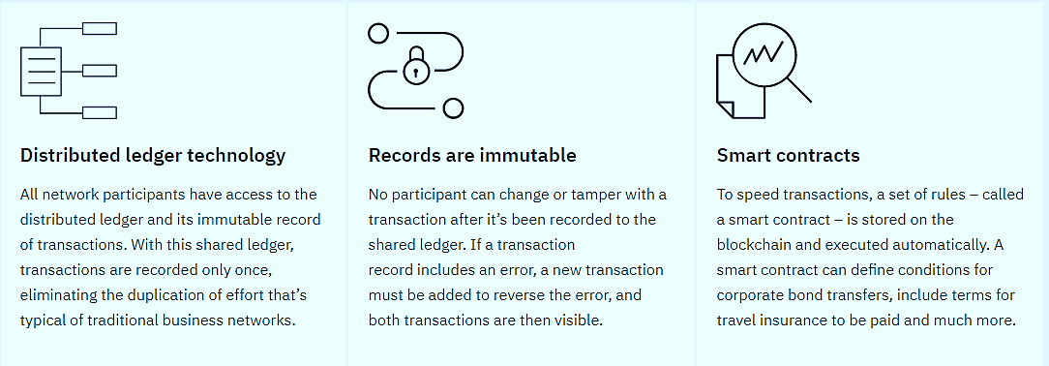
Key Elements of a Blockchain
Source: https://www.ibm.com/blockchain/what-is-blockchain

Slide 5
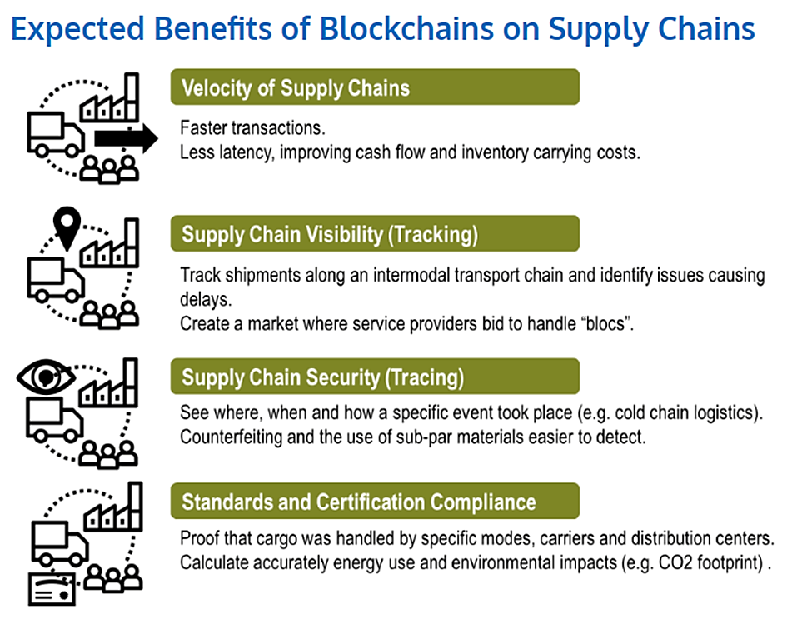
Benefits of Blockchain
Source: The Geography of Transport Systems

Slide 6
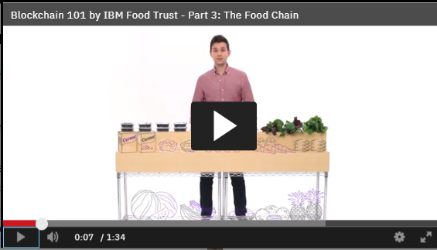
Traceable Supply Chain
The food industry is just one of many being transformed through blockchain technology. Learn how it can trace when, where and how food has been grown, picked, shipped and processed – all the while protecting network-participant data.
https://www.ibm.com/blockchain/what-is-blockchain

Slide 7
Reading: Blockchain at Walmart: Tracking Food from Farm to Fork
Read the article on “Blockchain at Walmart: Tracking Food from Farm to Fork” and answer the following questions:
Provide 2 examples of food-related concerns
Why does it take so long to trace the source of food source illnesses?
Explain how blockchain can bring traceability and transparency to a supply chain
What improvements can blockchain bring to the food industry?
According to IBM, what are the 3 main costs that affect a food supply chain?
How is Wal-Mart improving their supply chain through machine learning?

Slide 8
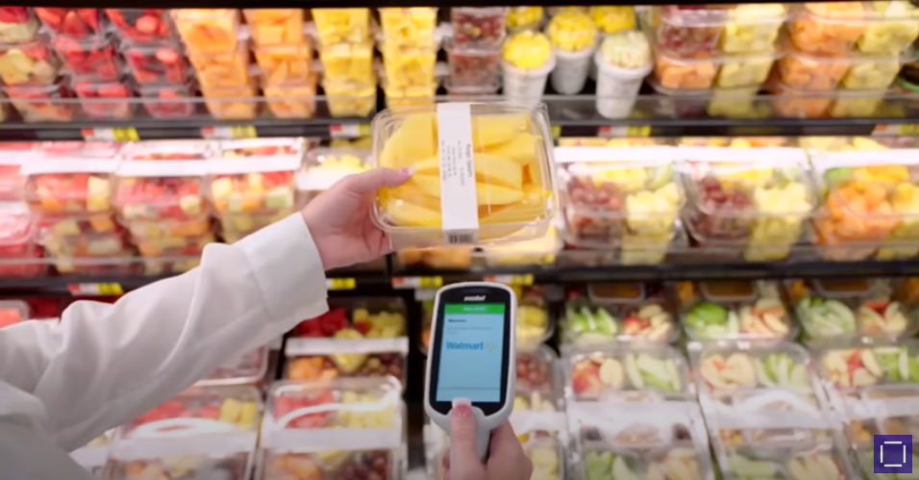
Walmart’s Food Safety Solution Using IBM Food Trust
https://www.youtube.com/watch?time_continue=4&v=SV0KXBxSoio&feature=emb_logo

Slide 9
Walmart’s Expectation of Value

Slide 10
Food Traceability and Transparency

Slide 11
Life of a Mango

Slide 12
Mango Board Agronometrics
Source: https://www.agronometrics.com/static/mangoboard/index.html

Slide 13
Essential Question: Benefits to Consumers?
How will Walmart’s blockchain partnership with IBM on the traceability of mangoes benefit the end consumer?
_______________________
_______________________
_______________________
_______________________
_______________________

Slide 14
Themes of Blockchain

Slide 15
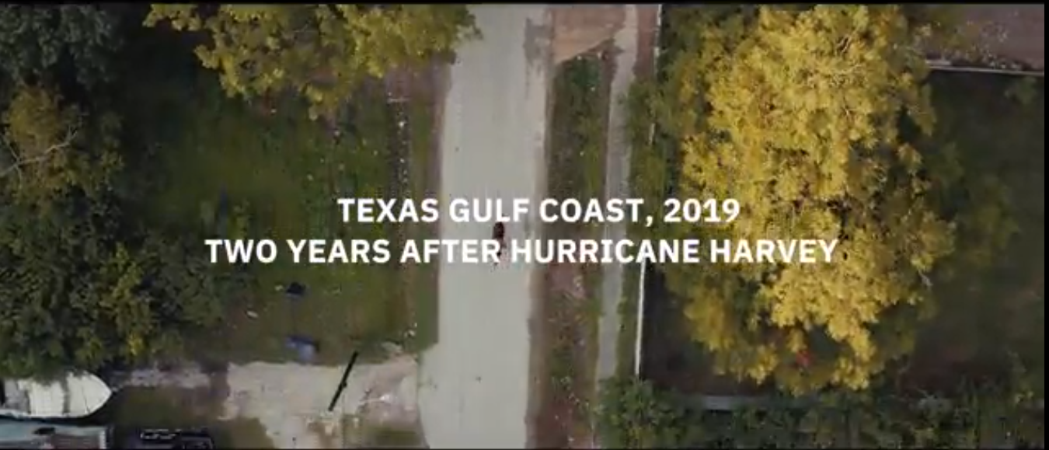
How Blockchain is Transforming Disaster Relief
Bonds of Trust
https://www.ibm.com/blockchain/resources/disaster-recovery/?urx=true

Slide 16
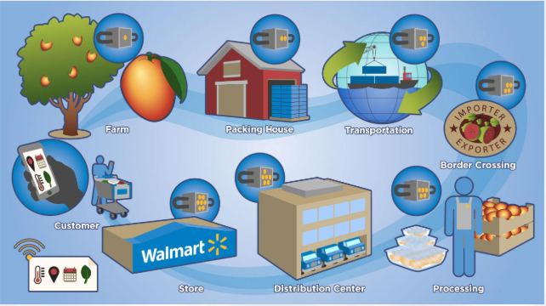
Project: Blockchain at Walmart: Tracking Food from Farm to Fork
Food safety has always been a global concern. According to the World Health Organization, about 420,000 people die each year due to food poisoning.
In the U.S. alone, the total cost caused by food-related concerns—spanning from medical costs to economic loss due to halted productivity—range from $55.5 billion to $93.2 billion a year. This cost has increased by 20% in the last four years according to IBM.
These food-borne illnesses happen all over the world. In most cases, it takes authorities days if not weeks to isolate the problem before it can be contained.
Why does it take that long to trace the source? It’s slow because participants in the food industry supply chain each have their own information silos. Food can only be traced one step at a time. Blockchain in combination with the Internet of Things (IoT) might just be able to solve this problem.

