Slide 1
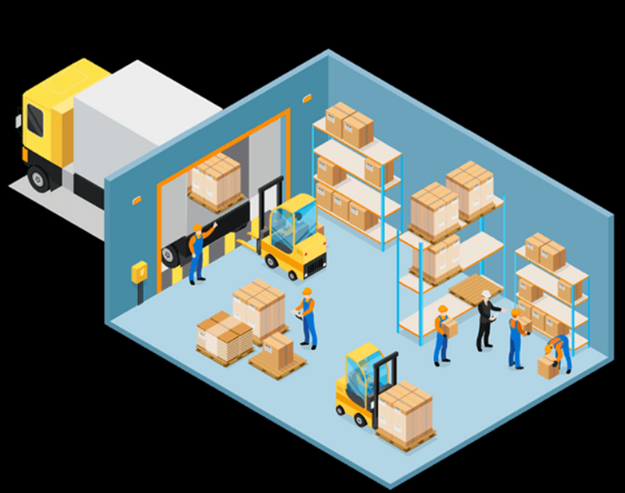
WAREHOUSE
MANAGEMENT – Part I
Supply Chain I - Ms. Biba S. Kavass

Slide 2
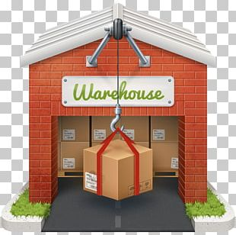
Objectives
Students will compare and contrast warehousing
requirements for a variety of products
Students will discuss the role of warehousing in a
logistics system
Students will examine various types of warehouses
Students will explore warehouse operations,
including the completion of warehouse documents
Students will assess prominent operational issues
in warehousing
Students will investigate various WMS software
programs
Students will design a warehouse layout plan for a specific industry

Slide 3
TN STATE CTE STANDARDS
Warehousing #7: Compare and contrast the warehousing requirements for a variety of different products including items
such as perishable foods, hazardous chemicals, large items like furniture and appliances, school supplies, seasonal items, and subassemblies for the manufacture of a given product.
Warehousing #8: Write an informative report describing different warehouse layouts and equipment used to move materials in each, classifying equipment according to type and purpose (including but not limited to powered industrial vehicle,
sortation equipment, conveyors, automatic storage and retrieval systems, etc.). Differentiate between bulk and rack storage
and indicate situations when each is employed. List the three categories of aisle spacing and describe the advantages and
disadvantages of each.
Warehousing #9: Investigate various warehouse management system (WMS) software programs and create a comparison
chart that could be used by a warehouse manager to select software to meet the specific needs of his/her operation.
Warehousing #10: Demonstrate the ability to complete and interpret warehouse documents including, but not limited to,
packing slips, bills of lading, advance shipment notices, distribution sheets, pick lists, invoices, special orders, and inventory
forms. Research storage and shipping documentation required by government and regulatory agencies, such as declaration
forms for Customs or MSDS when storing materials in a warehouse to be OSHA compliant.

Slide 4
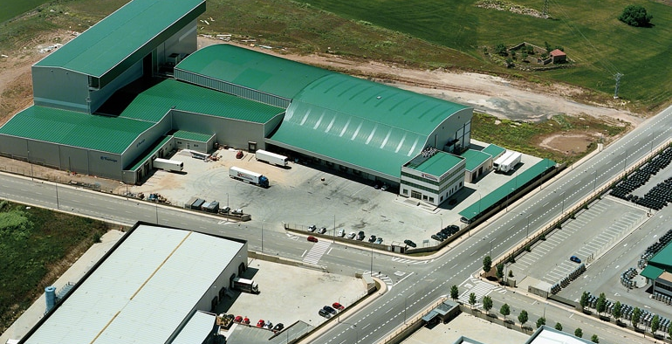
Warehouse
“A warehouse is a facility that, along with storage racks, handling equipment and personnel and management resources, allows us to control the differences between the incoming flow of goods (received from suppliers, production centers, etc.) and the outgoing flow of goods (goods being sent to production, sales, etc.).”Source: Interlake Mecalux
Right Product – Right Place – Right Time

Slide 5
Distribution
All the activities associated with the movement of
material, usually finished goods or service parts, from the manufacturer to the customer.
Distribution Channel – connecting customers with the products and services they want and need to purchase
Manufacturer – produces finished products
Wholesaler – buys large quantities of products
directly from the manufacturer, stores them in a
warehouse, and then sells smaller quantities to
retailers

Slide 6
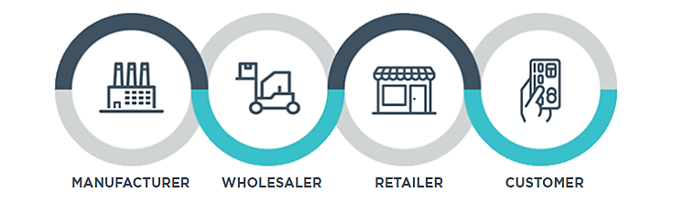
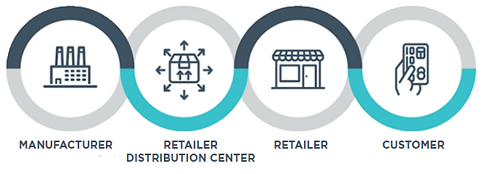
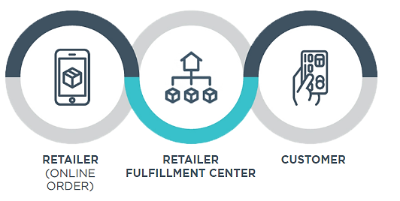
Product Distribution Channel Options

Slide 7
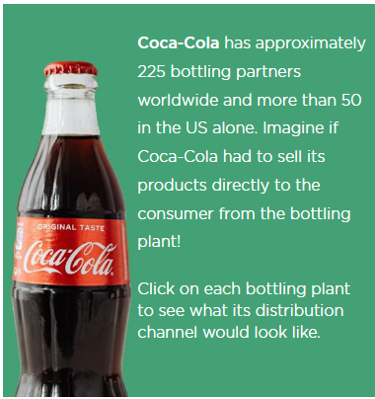
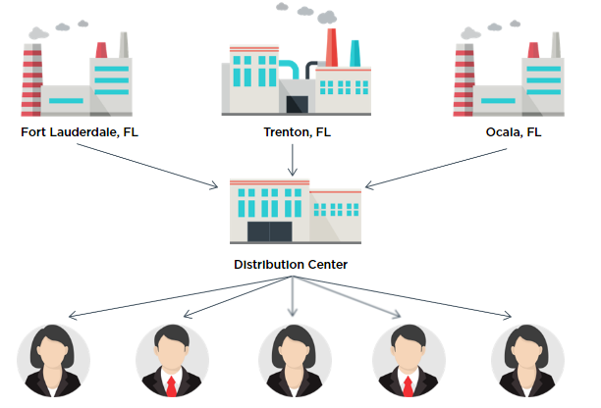
Role of Intermediaries in the Distribution Channel

Slide 8
Difference Between a Warehouse, a Distribution Center and a Fulfillment Center
Warehouse: accommodate long-term storage of goods
Needs can be different based on products:
Grocery Warehouse – deal with perishable
items
High-Ticket Items – needs extra security
Distribution Center: set up to distribute goods with a shorter storage time (about a week).
Products and supplies constantly move from
being received, used to fill orders and shipped out as new products arrive.
Fulfillment Center: fill orders placed by phone or online – tend to be high tech

Slide 9
Primary Advantages of Warehousing
They offer businesses a competitive advantage by placing the products where and when they are needed by the customer
They allow businesses to meet and anticipate market needs even when fluctuations in supply and demand occur

Slide 10
Critical Thinking Question
How did the pandemic affect the supply chain?
Write your answer on the index card provided and turn in at the end of class.

Slide 11
Key Parts of Supply Chain
https://my.pennfoster.com/scormviewer/index.aspx?resourceID=Xh3%2bD7370nB3XNQFwgX1y6cjO8mgf52s

Slide 12
FIFO – first-in, first out method
First products to arrive in the warehouse should be the first
products to be distributed and sold

Slide 13
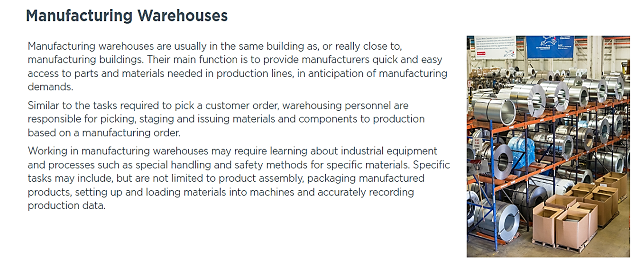

Slide 14
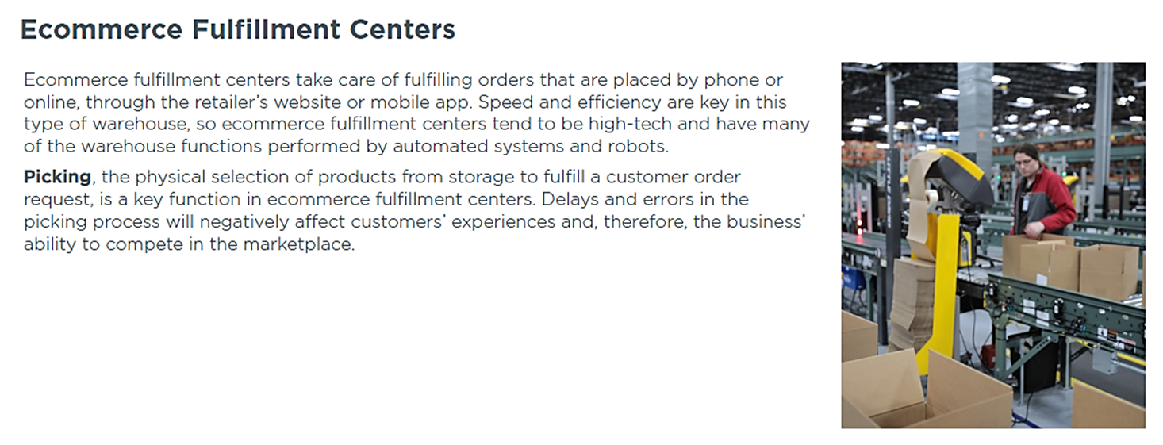

Slide 15
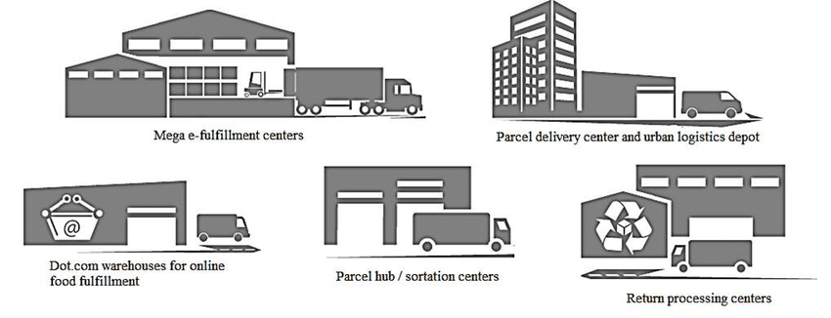
Activity: What Type of Warehouse Do I Need?
Different types of products have a diverse warehouse
requirements. Complete the worksheet on “What type
of warehouse do I need?”

Slide 16
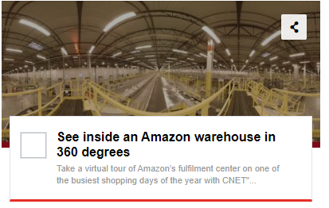
Virtual Reality – Warehouse Tour
https://www.youtube.com/watch?v=-d3DKy-ahdg

Slide 17
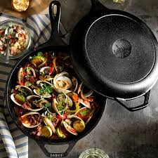
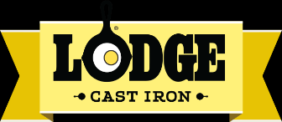
Case Study: Cookware Company Stirs Up a Sizzling Supply Chain
When sales of cast-iron cookware heat up, a well-known brand prepares a solution to expand manufacturing
capacity and warehouse space.
Cast-iron cookware, a kitchen staple for generations, is surging in popularity.
Industry experts attribute a 50-percent jump in sales this decade to millennials
and others who appreciate cast iron's value and versatility. Home cooks can
prepare nearly any recipe in cast-iron skillets and pots on the stovetop or in the oven.

Slide 18
Warehouse Functions

Slide 20
Materials Handling Activity
Sorting – categorizing items based on their characteristics
Postponement – store semi-finished products that are only
transformed into end products once an order is received
Cross-docking – movement of merchandise to a shipping dock
bypassing storage

Slide 22
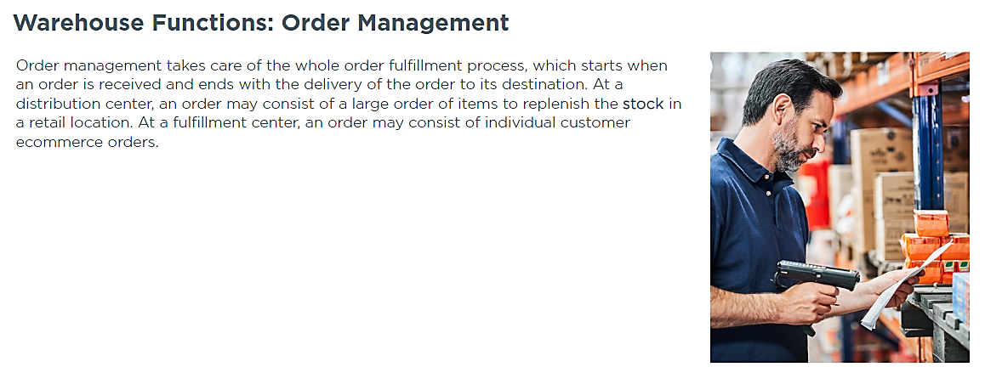

Slide 24
Warehouse Operations
Receive: product arrival and unloading
Stocking/Put-Away: product placed in appropriate storage area
Order Picking: Receipt of customer order – required items pulled down from storage
Pack, Ship: check accuracy or order, pack in appropriate containers, and ship product out to customer

Slide 25
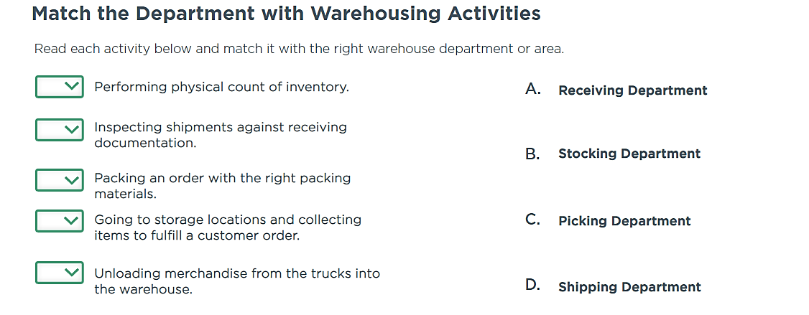

Slide 26
Common Entry Level Jobs
Receivers
Loaders
Pickers
Responsible for unloading merchandise from trailers and making sure freight quality and
quantities are accurate
Must perform all functions related to loading trailers,
including moving full pallets of products from the
warehouse onto a trailer and removing returned pallets
Fulfill store orders through pulling merchandise from a wide variety of places

