Slide 1
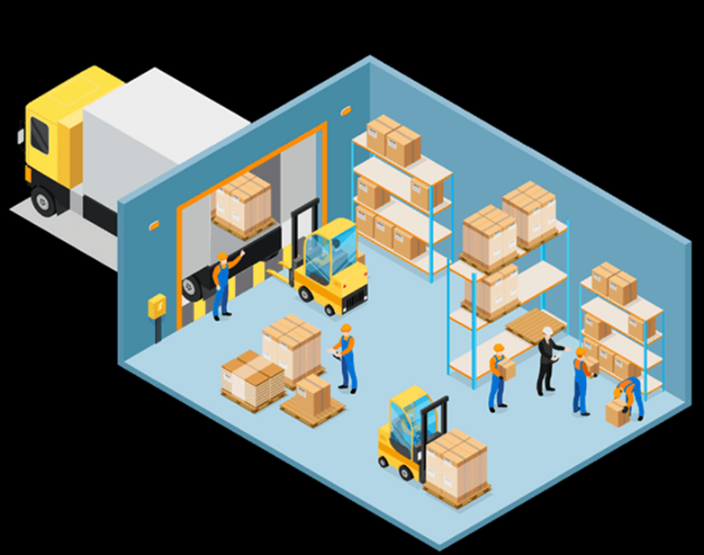
WAREHOUSE
MANAGEMENT – Part II
Supply Chain I - Ms. Biba S. Kavass

Slide 2
Warehouse Operations - Receiving

Slide 3
Warehouse Receiving
https://my.pennfoster.com/scormviewer/index.aspx?resourceID=sgb8BR8mkoM%2bgEFm1LMy%2ftKKWpCLWXU%2b

Slide 4
Receiving Activities
The goal of the receiving department is to accurately and quickly receive merchandise from delivery trucks and move it to inventory.

Slide 5
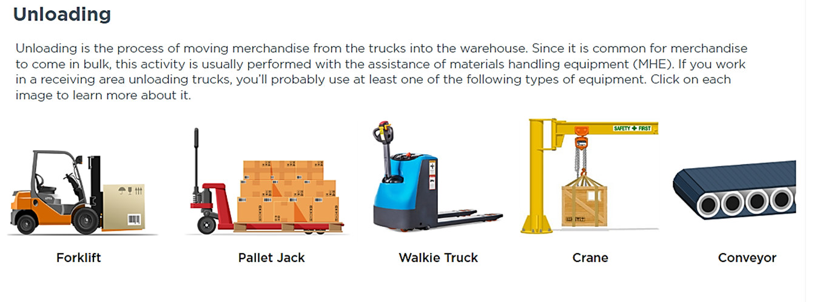

Slide 6
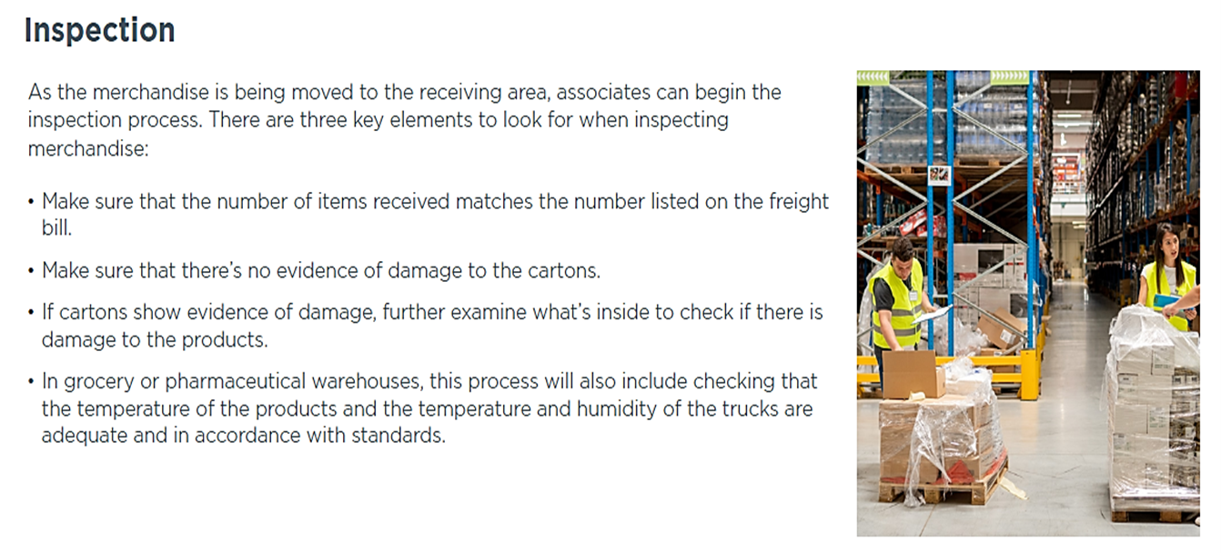

Slide 7
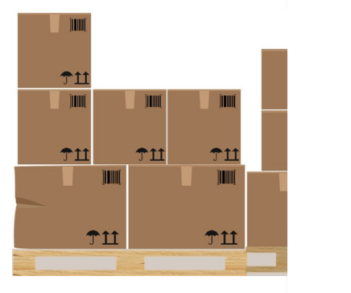
Activity: Inspecting Merchandise – Your Turn
An order has just arrived from Clean on Friday, a manufacturer of laundry supplies. Read each carton’s bar code, then enter
the product quantities into the inventory system.

Slide 10
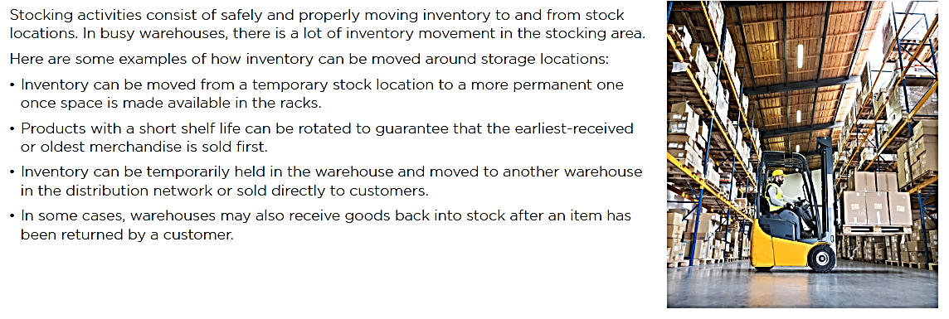
Stocking Activities

Slide 11
Product Storage Activities
Match each activity with the correct definition.
Provides inventory storage for raw materials and
components used in manufacturing
Converting small shipments into full truckloads
through repackaging or combining orders
Placing received inventory in proper warehouse
storage locations
Handles products bought through “spot” purchases
to fulfill unplanned demand
Transforms products received in bulk or large
quantities into smaller quantities
Holding stock due to seasonality, demand and sales
Calculates the optimum location for product storage within a warehouse, based on product characteristics
First-in first-out rotation subject to shelf-life
restrictions to avoid spoilage
Converts or combines wide variety of produced or
purchased products into stocked assortments or kits
Stowing
Stockpiling
Product Rotation
Consolidation
Bulk Breaking
Product Mixing
Spot Stocking
Product Support
Slotting

Slide 12
Storage Locations
Area – designates each physical area (ex. Cold storage)
Row – each rack line along an aisle
Bay – each row separated by metal beams or columns which divide the sections
Level – each shelf within a bay
Position - bins

Slide 13
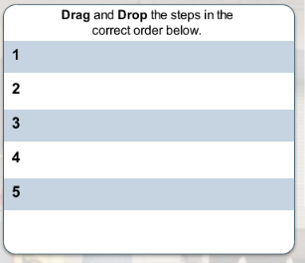
Practice: Steps for Standard Receiving Activities
Do you know the steps for standard receiving activities in chronological order? Drag and drop the following steps from first to last.
Inspecting the contents
Securing the truck
Assigning a truck to the proper
unloading location
Documenting discrepancies
Inspecting and breaking the seal on the truck door

Slide 14
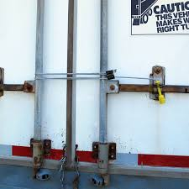
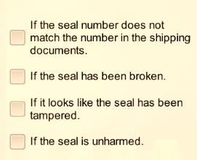
When Should You Refuse a Shipment?
Check all that apply

Slide 15
Warehouse Operations – Receiving Documents
Advanced Ship Notice (ASN) – electronic data interchange notification of shipment of product
Bill of Lading: receipt from the carrier to the shipper for the goods
received for transportation
Carrier Freight Bill: invoice presented by the carrier to the shipper, as a
demand for payment for services rendered
Delivery Receipt: document, issued by the carrier, which the consignee
signs as proof of receipt
Air Waybill: airfreight industry’s equivalent of the trucking industry’s bill of
Lading
Packing List: list of the individual items in the shipment
Purchase Order: document that authorizes the purchase of the goods

Slide 16
Receiving Documents – Bill of Lading
Primary Purposes:
Receipt from the carrier to the shipper for the goods received for transportation
Contract of carriage – contract between carrier of goods and consignee
( person whom goods will be delivered to at place of delivery)
Presumption of title to the goods
Types of Bills of Lading:
Straight Bill of Lading: a non-negotiable bill of lading used where the goods have been paid
for or do not require payment – most common
Order Bill of Lading: used as a means for the shipper to obtain payment for the materials from the customer
Electronic Bill of Lading: a paperless version of the bill of lading
Information on the Bill of Lading:
Shipper’s name and address Gross weight of shipment
Consignee’s name and address Who pays freight charges
Description of Materials

Slide 17
Activity: Complete a Bill of Lading

Slide 18
Customs Declaration Forms

Slide 19
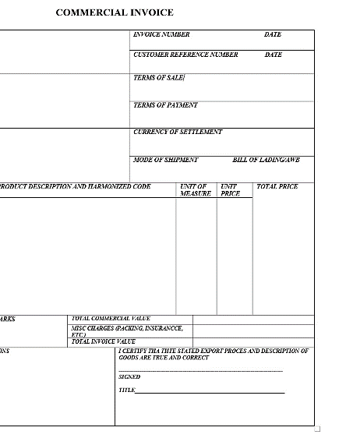
Commercial Invoice
Commercial Invoice is a bill for the goods from the seller to the buyer. The buyer (importer) will use this invoice and other shipping documents to get the products cleared through customs in the country of import.
Many governments use commercial invoices to determine the true value of goods when assessing customs duties.

Slide 20
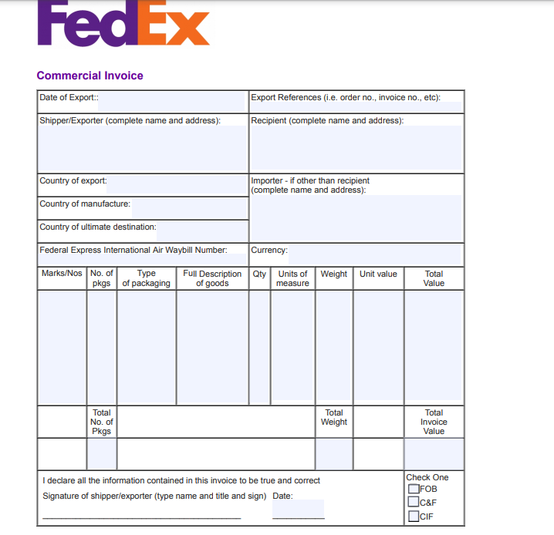
Activity: Complete a Commercial Invoice

Slide 21
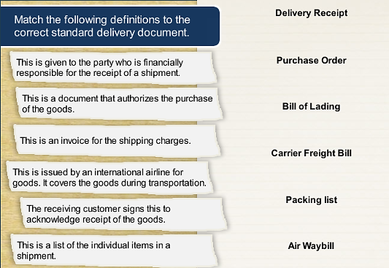
Match the Standard Product Delivery Documents

