Slide 1
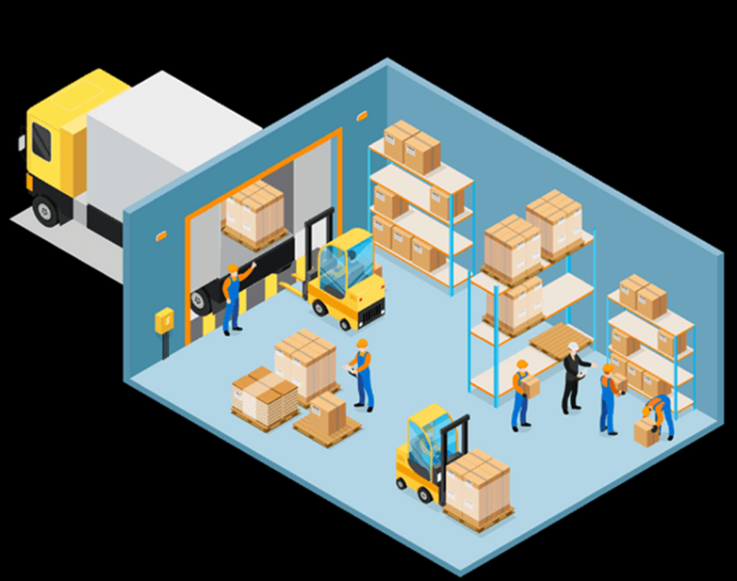
WAREHOUSE
MANAGEMENT – Part III
Supply Chain I - Ms. Biba S. Kavass

Slide 2
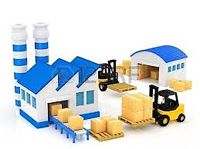
Warehouse Operations – Order Fulfillment Cycle

Slide 3
The Picking Process

Slide 4
Main Elements of a Pick List

Slide 5
Picking Technology
Pick to Light: uses lights to cue pickers on items that
should be picked
RF Picking Devices: most widely used – scan barcode to access real-time order data
Pick to Voice: receive voice directed instructions

Slide 6
Order Picking Options
Pick all the items in a single order before moving to the next order
Multiple orders are grouped into batches and picked at the same time
Orders are divided and picked in a
separate storage zones
Combination of zone and batch picking – orders organized into batches, then all zones are picked at the same time

Slide 7
Packing Process – Quality Check
One of the last stops before leaving the
warehouse and going into the customer’s
hands
Scanning the packing slip and comparing it to the products contained in the box
Can minimize the chances of errors

Slide 8
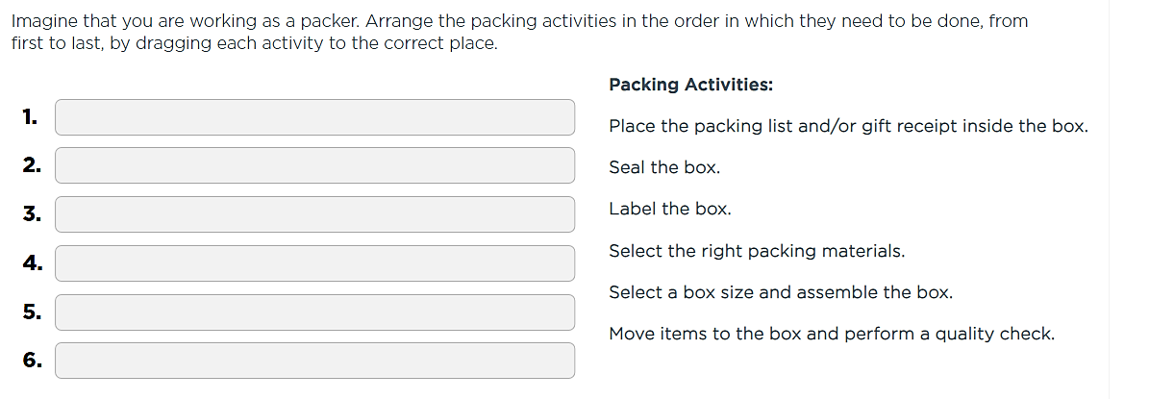
Activity: Exceling at Packing

Slide 9
Product Unitization

Slide 10
Warehouse Management

Slide 11
Warehouse Management
Operations Management: planning, executing, and controlling day-to-day warehouse operations
Logistics Management: creating transportation and information channels and by removing obstacles to efficient inbound and outbound delivery operations

Slide 12
Management Roles in Warehousing

Slide 13
Major Types of Warehouses
Private Warehouse – owned and operated by the same business that owns the product – more expensive but higher levels of efficiency and performance
Public Warehouse – facility, labor, storage and materials handling equipment are owned by another business, which charges a fee for storage and processing services
Contract Warehouse – form of public warehousing but usually set for a long-term period – costs are lower than public warehousing
Storage in Transit – special kind of warehousing in which products are stored in the mode of transportation the item is delivered in, such as a truck trailer or shipping container – can’t deliver direct to customer

Slide 14
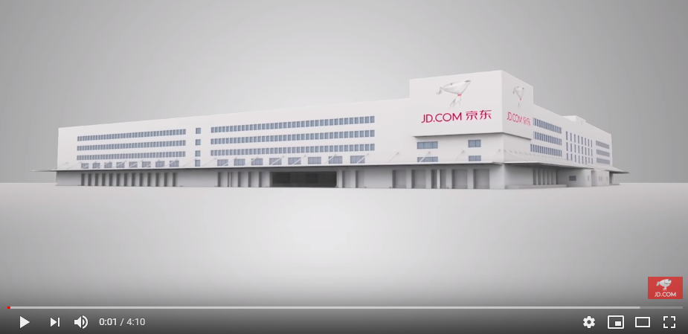
Smart Logistics Center of the Future
JD.com is the largest online retailer in China. With over 292.5
million customers, they have a vast network of warehouses and
delivery stations and deliver most orders in less than a day.
https://www.youtube.com/watch?v=udRYxhS4-Ow

Slide 15
Warehouse Location Strategy
Usually located closer to target
customers – decrease transportation
costs
Businesses can quickly respond to
customer needs
Shorter fulfillment and delivery times
Increase warehouse and inventory
carrying costs (storing unsold
inventory)
Typically located in less urban areas
Close to production and industrial
sites
Less expensive

Slide 17
Transportation Costs
Options:
Full Truckload (FTL) – fast and reliable way to ship large amounts of freight
Less-Than-Truckload (LTL) – more flexible shipping solution since can ship smaller volumes – more
expensive and longer delivery times

Slide 18
Warehouse Design and Layout

Slide 19
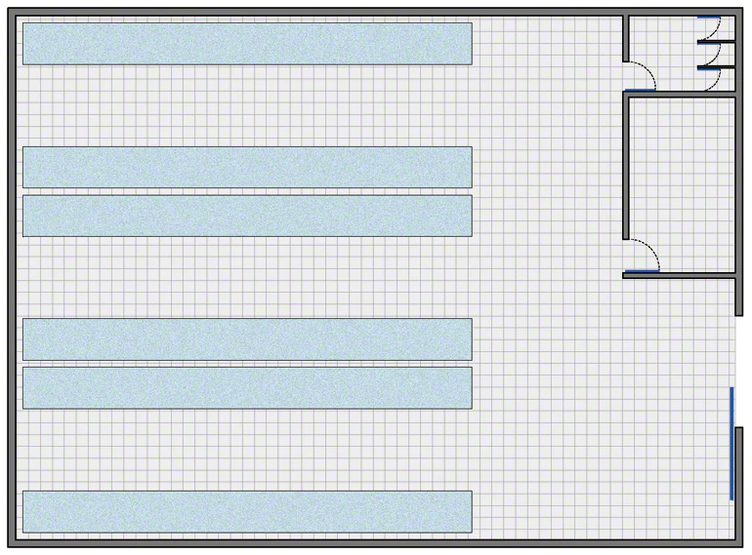
Warehouse Layout
The simplest warehouses normally have access doors, an open area for
maneuvering and verification, a storage area where the goods are located,
a management office for controlling operations, and toilets and changing
rooms for personnel.
https://my.pennfoster.com/scormviewer/index.aspx?resourceID=m6yYv13sDLjjtjgtSruFajcbMb2mPdr1

Slide 20
Warehouse Layout
Arrangement of a warehouse can take several forms depending on:
Products the warehouse stocks
Whether the facility performs manufacturing or is a distribution or fulfillment center only
Its service objectives
Its physical characteristics

Slide 21
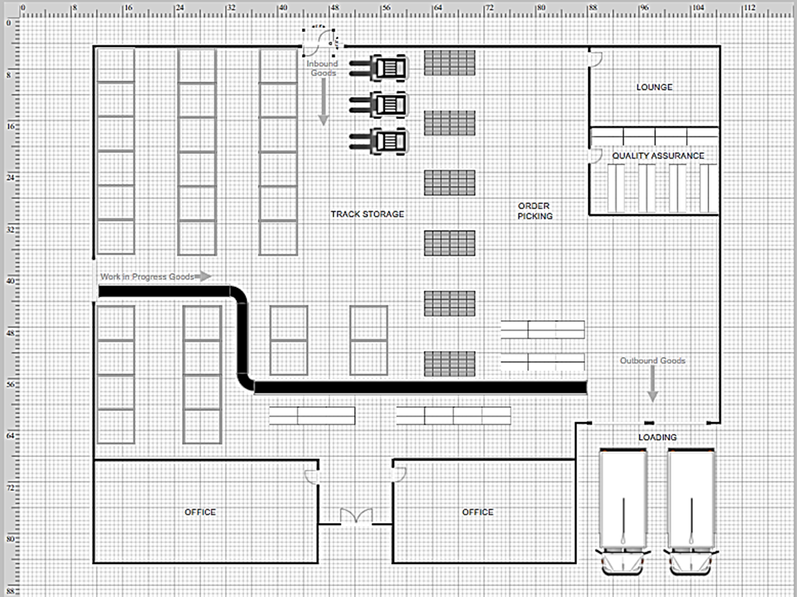
Sample Warehouse

Slide 22
Warehouse Size and Capacity
Size – expressed in physical dimensions (for example, 100 feet wide by 100 feet long
Capacity – amount of usuable storage space that is available to hold inventory. Total capacity can be calculated by multiplying the height of the structure by its width and depth

Slide 23
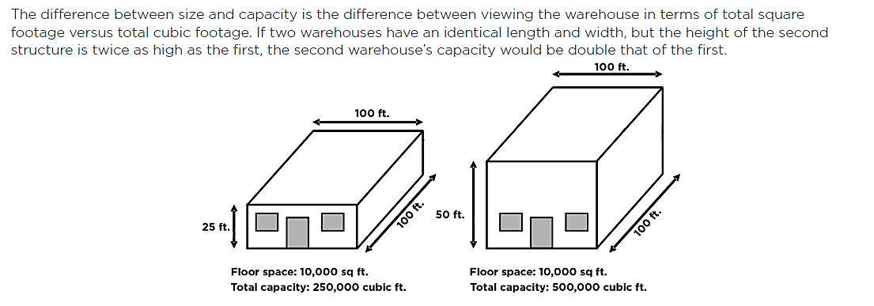
Differences: Warehouse Size and Capacity

Slide 24
Warehouse Storage Capacity
Warehouse storage capacity includes only the
section of the warehouse that houses
merchandise and is determined by calculating
the percentage of the warehouse storage
capacity occupied by storage racks or any type of storage.
Walkways, staging areas and other operational
aspects of a facility also reduce the total storage capacity. This is another reason why optimal
design is important—it’s critical to maximize
storage capacity.

Slide 25
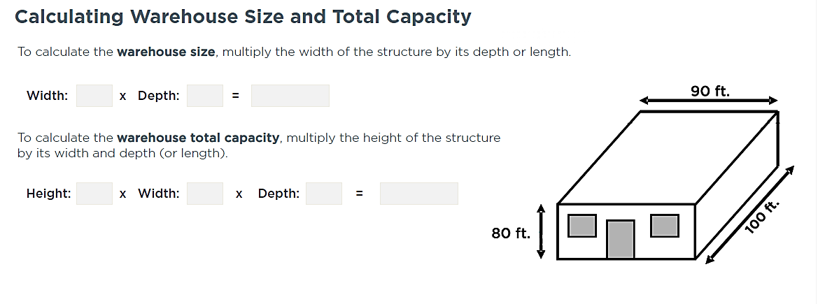
Notes:
Warehouse Size = 90 x 100 = 9,000 sq. ft.
Warehouse Total Capacity = 90 x 100 x 80 – 720,000 cubic feet

Slide 26
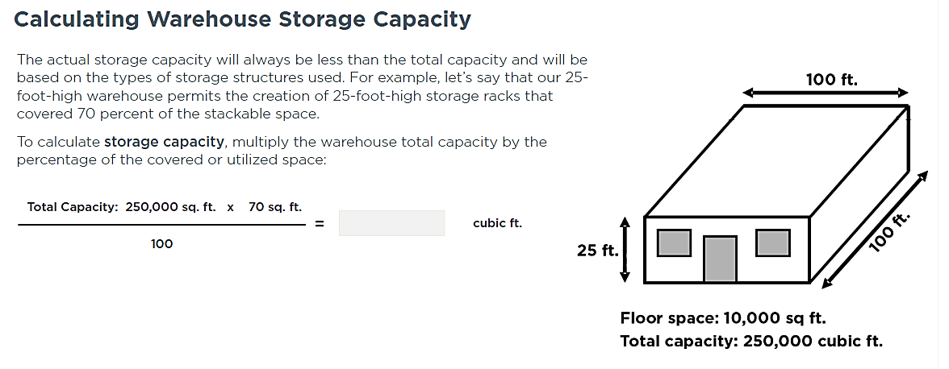
Notes:
175,000 cubic feet

Slide 27
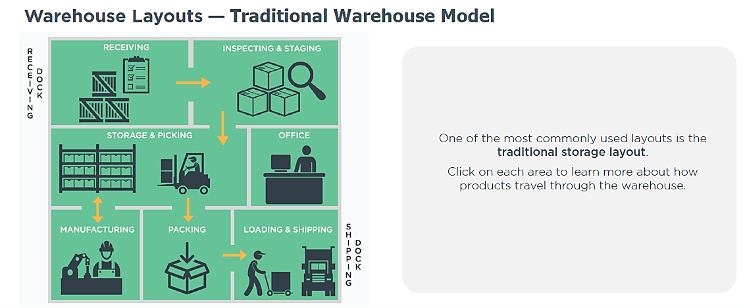
Warehouse Layouts

Slide 28
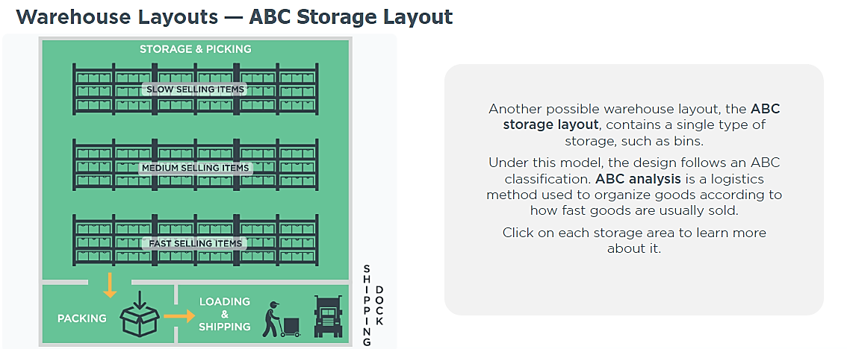
Warehouse Layouts

Slide 29
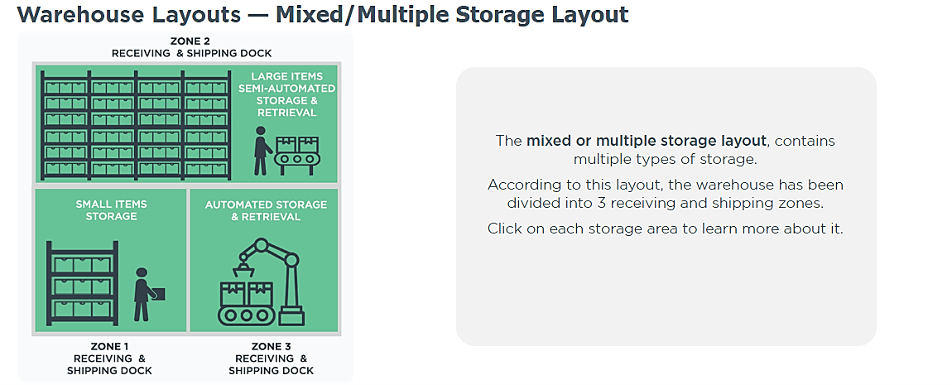
Warehouse Layouts

Slide 30
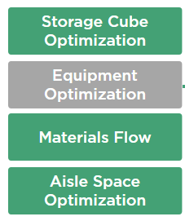
Warehouse Design Principles
Storage space should be calculated based on the cubic capacity of the storage area.
Appropriate storage and materials handling equipment selected.
Allow movement of goods in a straight line to
reduce travel time and distance.
Minimize aisle space as much as possible –
depends on type of material handling equipment

Slide 31
Activity: Optimize Layout
Select the warehouse layout that would best optimize warehouse throughput.
Option 1 Option 2 Option 3

Slide 32
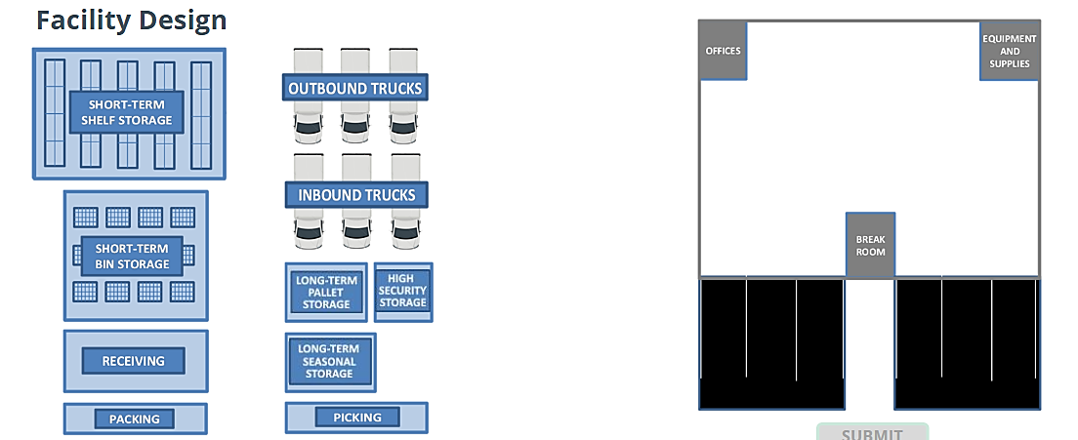
Practice - Warehouse Facility Design
Sketch your facility design using all the components on the left into
the blank areas in the warehouse on the right.

Slide 33
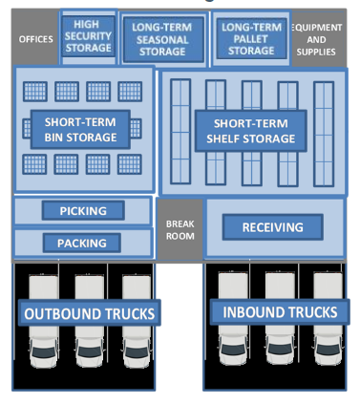
Warehouse Facility Design _____________ Recommendation

Slide 34
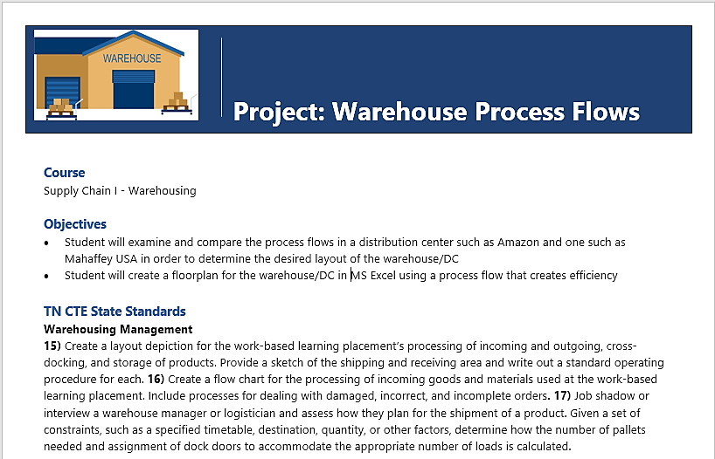
Project

