Slide 1
Certified logistics associate prep

Slide 2
Slide 1
Global Supply Chain Logistics
Chapter 1
Notes:
These can be changed to reflect your school’s specific rules.

Slide 3
Elements of the global supply chain life cycle
Raw Material Providers – mines and farms that extract the raw materials needed to product a product
Production Facilities – sites that convert raw materials into manufactured products
Warehouses and Distribution Centers – places where materials are stored for future use or through which materials are passed on to transporters
Warehouses – focus more on storage and inventory
Distribution Centers – focus more on movement of finished goods to a transporter
Transportation – material transporters who deliver materials to manufacturers, retailers, and consumers through various modes

Slide 4
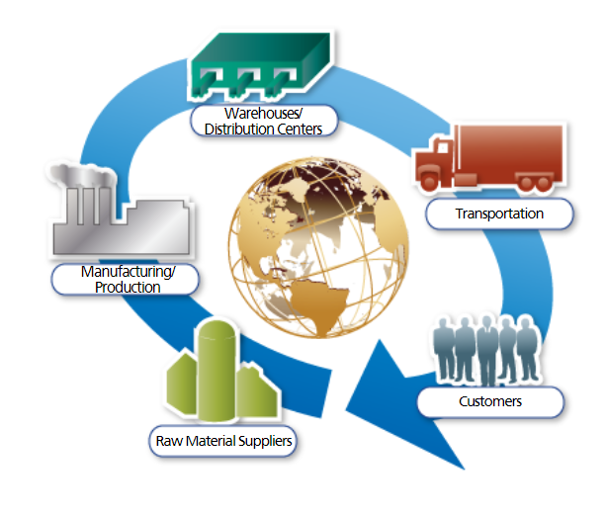
definitions
Supply Chain Logistics – involves the efficient, effective forward and reverse flow and storage of goods, services, and related information between the point of origin and the point of consumption in order to meet customer’s requirements
Material Handling Logistics – movement, storage, control and protection of materials and products throughout the process of their manufacture, distribution, consumption, and disposal
Global Logistics – process of moving materials across international boundaries within a global network of connected facilities and transportation modes

Slide 5
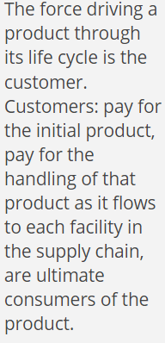
Who drives the supply chain?
Demand – customer’s need for a particular product, service or component

Slide 6
Forms of inventory
Raw Materials – materials ready for use in production
Work-in-process – all the materials currently being worked on
Finished Goods – finished products ready for storage or shipment
In-transit Inventory – products that are in the process of being transported from a supplier to a customer

Slide 7
Knowledge check

Slide 8
Customer interaction
Customers must specify any special needs including:
Material handling requirements
Due dates
Negotiated terms and conditions
Acceptance of product substitutions or back orders

Slide 9
supply
Supply:
Process of sourcing and building product inventory to established targets based on customer needs

Slide 10
Warehouses/distribution centers

Slide 11
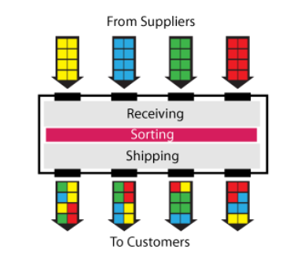
Basic functions of warehouses/distribution centers
Receiving – includes identifying goods, inspecting goods, processing paperwork, and dispatch to storage or distribution
Stocking – assigning products to proper location with the warehouse or in some cases directly to a staging area for quick release and shipping (cross-docking – goods in/goods out bays without being placed in storage)
Order Processing – assembling products from various locations within the warehouse for a specific customer order
Picking – can include full case, repack, and bulk/pallet picking
Packaging – if necessary, can stretch wrap for product protection

Slide 12
Knowledge check

Slide 13
Shipping and loading

Slide 14
Transportation modes

Slide 15
Transportation roles

Slide 16
A chain is only as strong as its weakest link

Slide 17
Knowledge check

Slide 18
Answer key

Slide 19
Trends in supply chain

Slide 20
Warehouses today

Slide 21
Knowledge check

Slide 22
Measure performance

Slide 23
Performance measures
Customer Response – order cycle time, quality of product, accurate invoicing
Warehousing/Distribution Center – units per hour, line items per hour, cases per hour, pallets per hour, labor cost per case
Transportation – cartons delivered per mile driven, total cost per mile, cost per stop on the delivery route, cost per carton delivered, trailer utilization

Slide 24
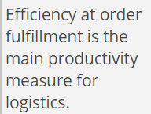
Productivity indicators

Slide 25
Knowledge check

Slide 26
Slide 1
Logistics Environment
Chapter 2
Notes:
These can be changed to reflect your school’s specific rules.

Slide 27
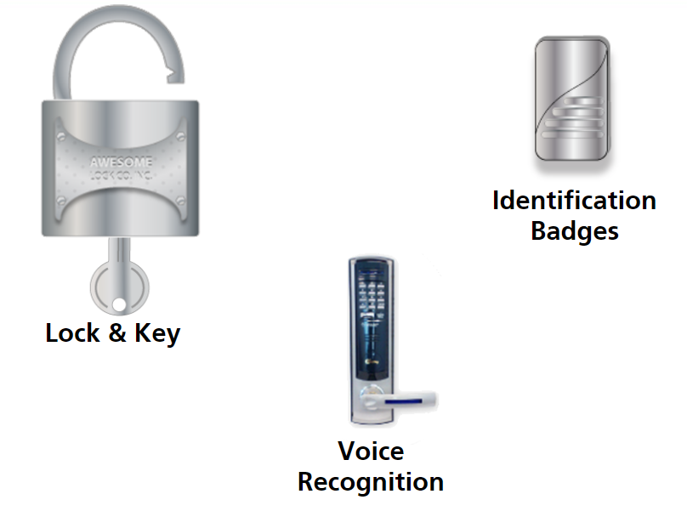
Basic security measures
PERSONNEL SECURITY

Slide 28
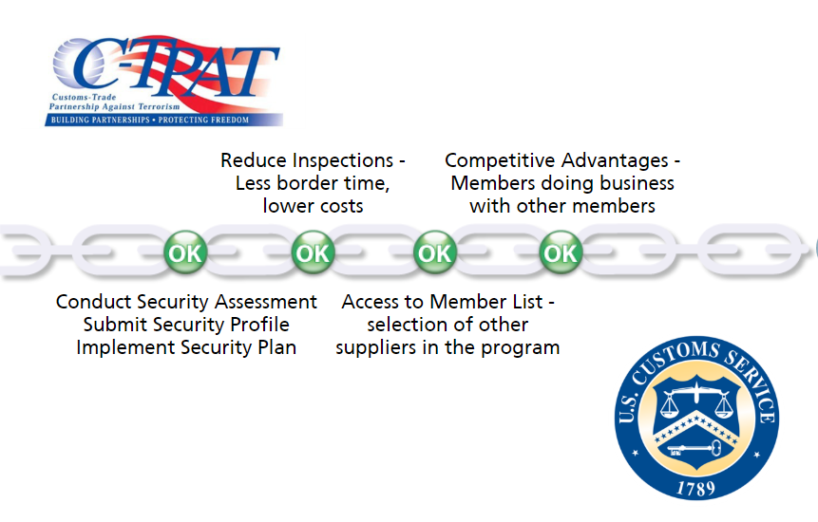
INTERNATIONAL SECURITY

Slide 29
Free trade zones

Slide 30
OTHER SECURITY REGULATIONS

Slide 31
OTHER SECURITY REGULATIONS
Timings for Advance Manifests:
Sea Vessels – 24 hours before loading
Aircraft – 4 hours before wheels up from North, Central and South America above the equator
Rail – 2 hours prior
Trucks – 1-hour prior
FAST Trucks – ½ hour prior

Slide 32
Other security regulations
Interconnection Security Agreement (ISA)
Federally mandated for any system, contractor, or agency that touches the federal IT system

Slide 33
Environmental impact of logistics
ISO 14000
Series of standards that outline a system for companies to help ensure the best measures are being taken to protect the environment at each link of the supply chain.
These standards provide businesses with an outline to manage environmental issues.
Government body responsible for enforcing regulations in the U.S. is the Environmental Protection Agency (EPA)

Slide 34
Government regulations

Slide 35
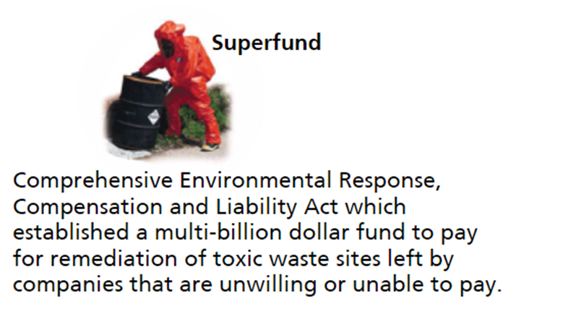
Government regulations

Slide 36
Hazardous materials
Includes:
Hazardous Substances
Hazardous Wastes
Marine Pollutants
Elevated-Temperature Materials

Slide 37
Hazmat employee

Slide 38
Hazmat regulations

Slide 39
Hazmat transport
Must register and pay fee to conduct business
Receives certificate of registration from USDOT
Receive a permit and must certify that they have a security plan that complies with government standards

Slide 40
recyling

Slide 41
Knowledge check

Slide 42
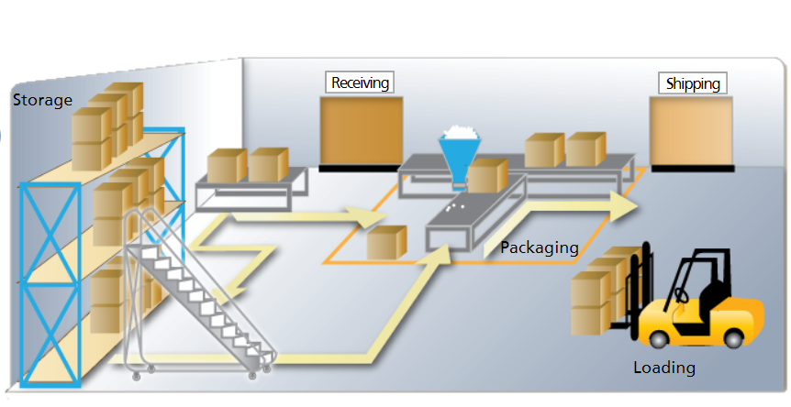
Logistics design layout
KEY ELEMENTS:
Space – measured in cubic feet – includes square footage and how high goods can be stored – use racks
Accessibility – retrieve materials with minimum of effort
Through-Put – volume of goods expected to move through warehouse

Slide 43
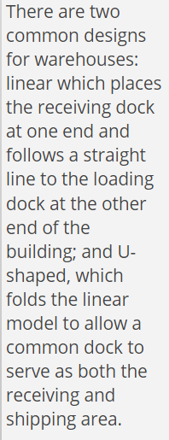
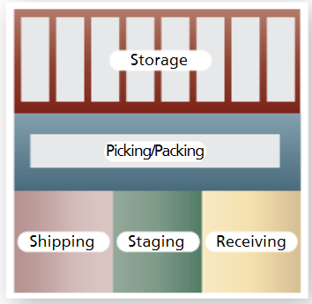
Warehouse design

Slide 44
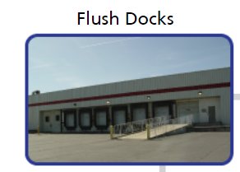
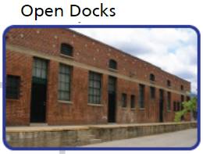
docks
Flush Docks:
Most commonly used
Outside wall of building is flush with face of dock
Trailer remains outside building
Open Docks:
Least expensive
Platform that extends out from exterior building wall
Safety is a concern in bad weather due to exposure

Slide 45
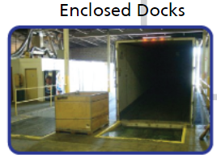
docks
Enclosed Docks:
Provide most security from theft and protection from weather
Like a large garage – entire truck and trailer loading area is inside
Must have adequate ventilation and drainage
Rail Sidings:
Usually located away from normal shipping/receiving area
Separate unloading and staging area
Often enclosed because of equipment used to unload them
Trucks tend to sit at siding longer waiting to be unloaded

Slide 46
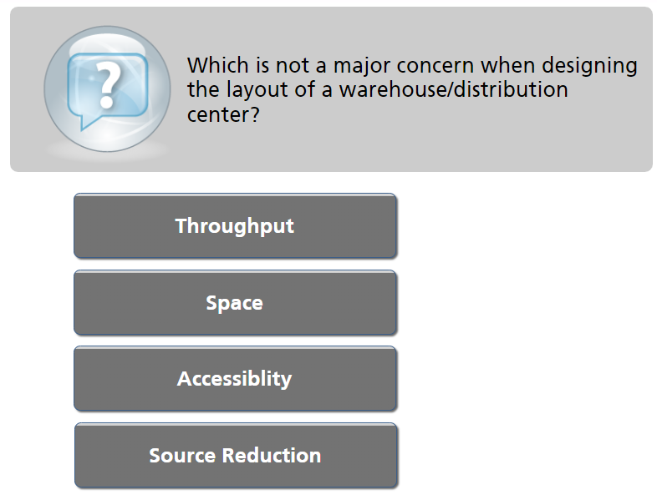
Knowledge check

